Slide 1

Primary school “E. Perodi” - Soci
Classes: V A and V B
S.Y. 2023-2024
Istituto Comprensivo Statale
“XIII Aprile 1944”
Via della Repubblica – Soci (AR)
TEACHERS: Laura Bartolini – Lucia Valenti

Slide 2
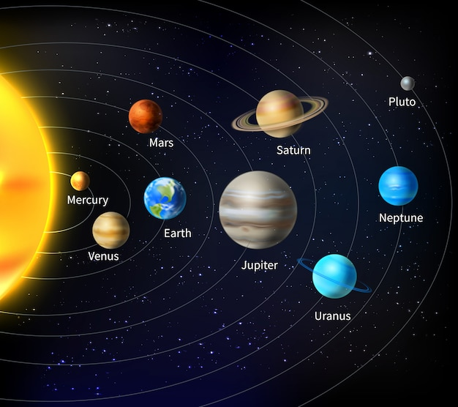
SCIENCE - ENGLISH
THE SOLAR SYSTEM

Slide 3
C.L.I.L. «THE SOLAR SYSTEM» PRIMARY SCHOOL OF SOCI - CLASSES VA- VB SCHOOL YEAR 2023- 2024
CONTENT | COGNITION | CULTURE | COMMUNICATION
What do you know about space and the solar system? What is the Sun? What is a star? Introduction of some names Discussion and presentation of the new vocabulary through flashcards games. Students create and describe cards with the characteristics of the planets and the sun Students describe the main characters and compare their qualities Identify the planets and discuss their features, concepts and terms that arise, such as rotation and revolution and orbit. Use comparative and superlative | Draw and color cards of the eight planets and of the sun Play group games Match words with pictures. Speaking: use new words and structures. s. Final CLIL test. | Use Internet for watching a video: “The solar system” Use Internet for finding information planets | Use a language that is accessible to the class, consider special needs. Improve their language skills. Learn some new words. (Science and technology vocabulary) Videos to learn properly Memorize / Remember items Frontal lessons Pair work Group work

Slide 4
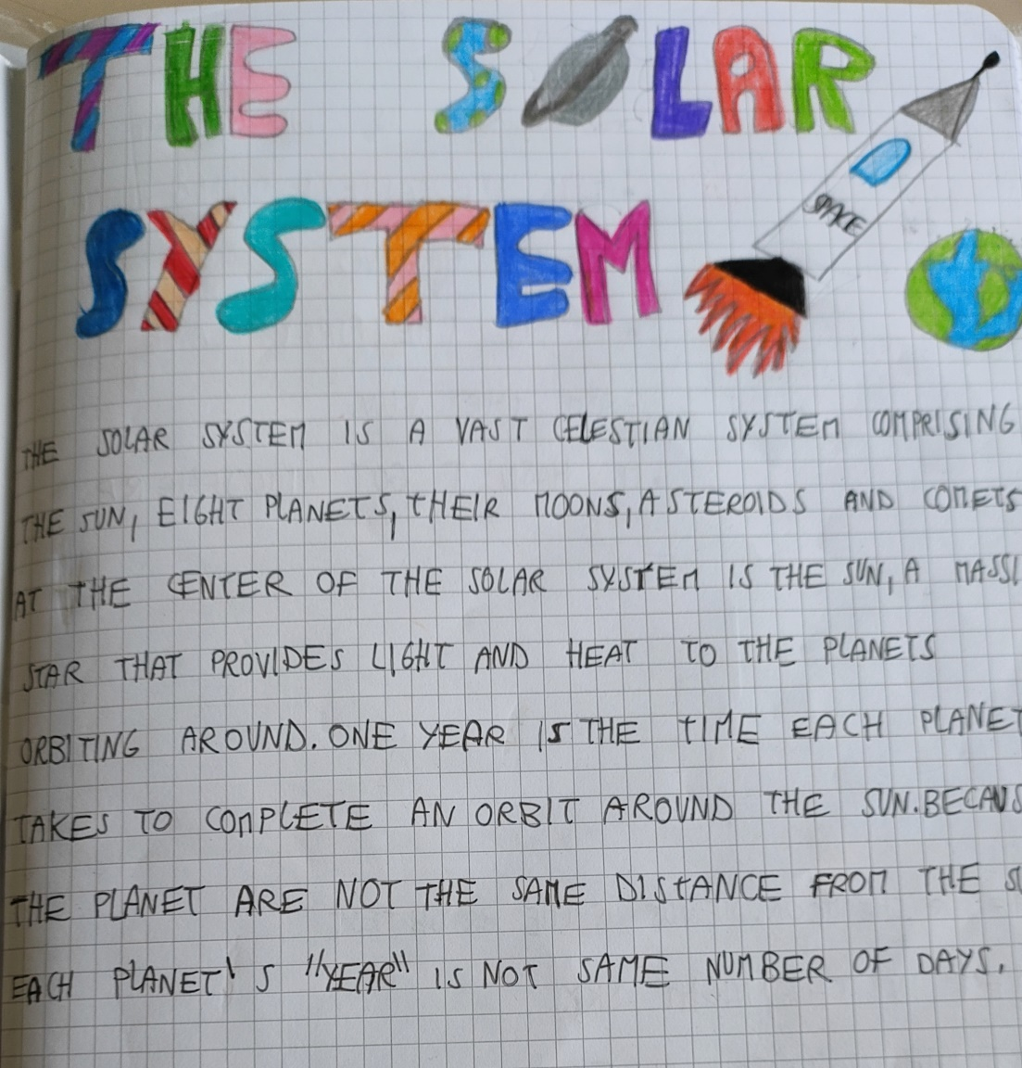

Slide 5
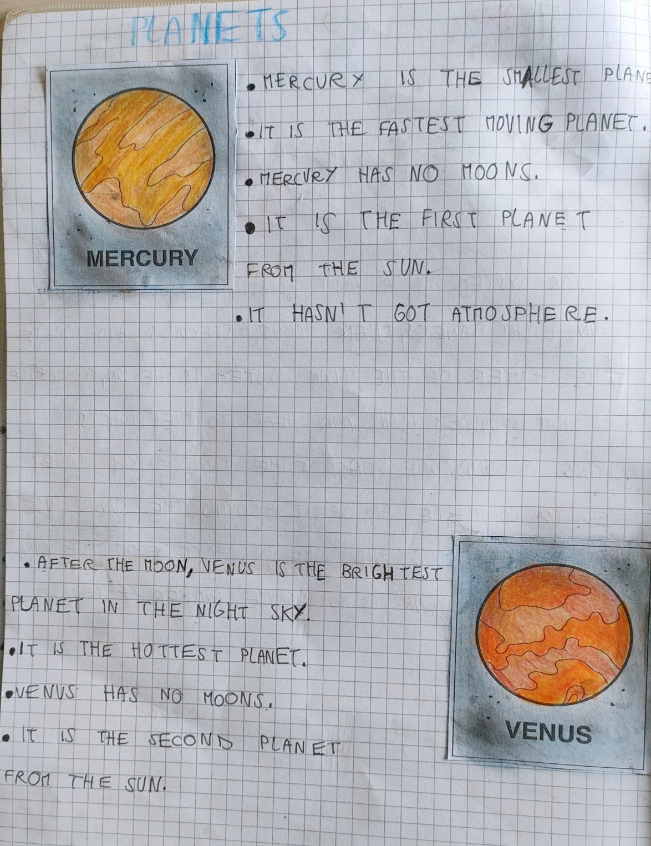
PLANETS

Slide 6
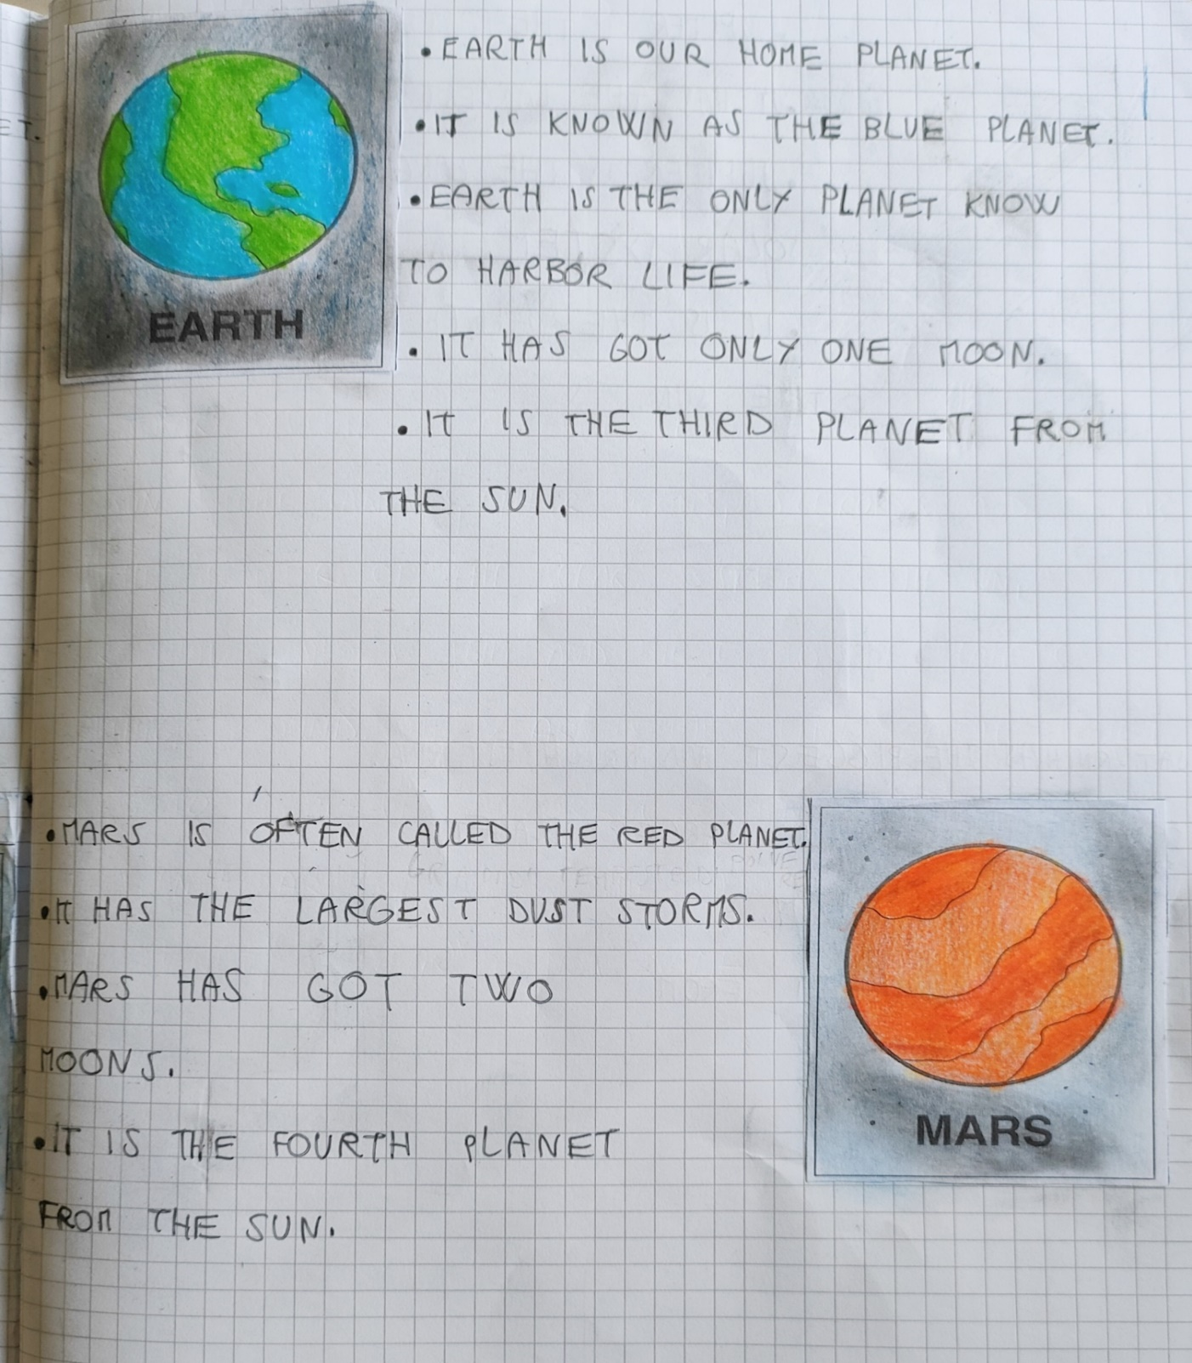

Slide 7
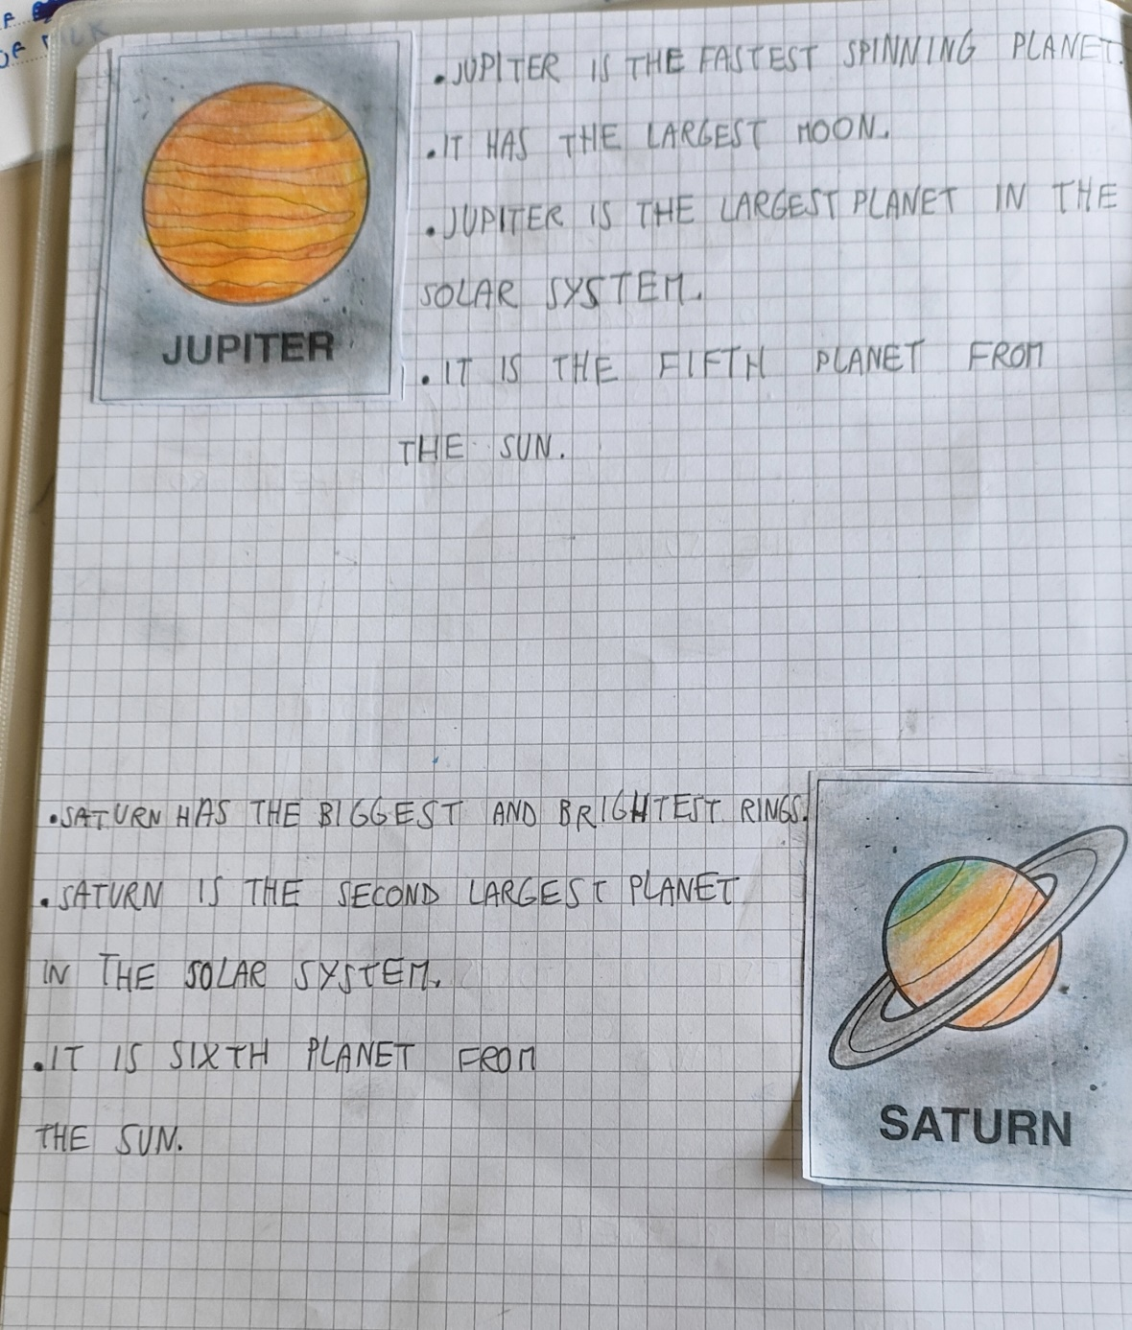

Slide 8
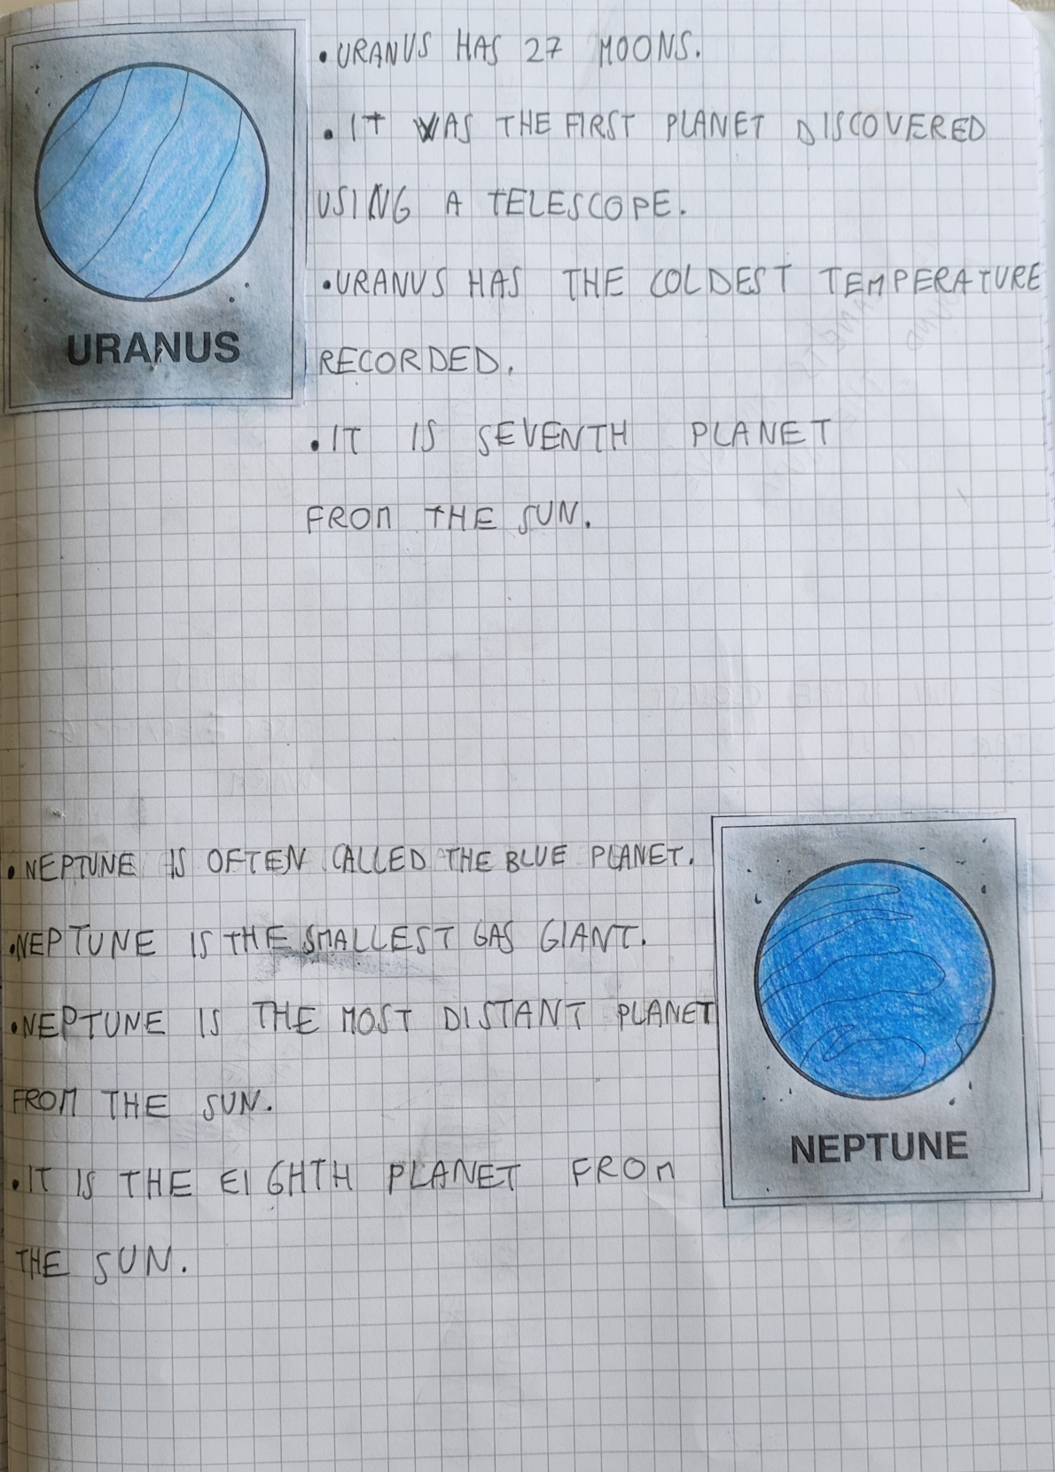

Slide 9
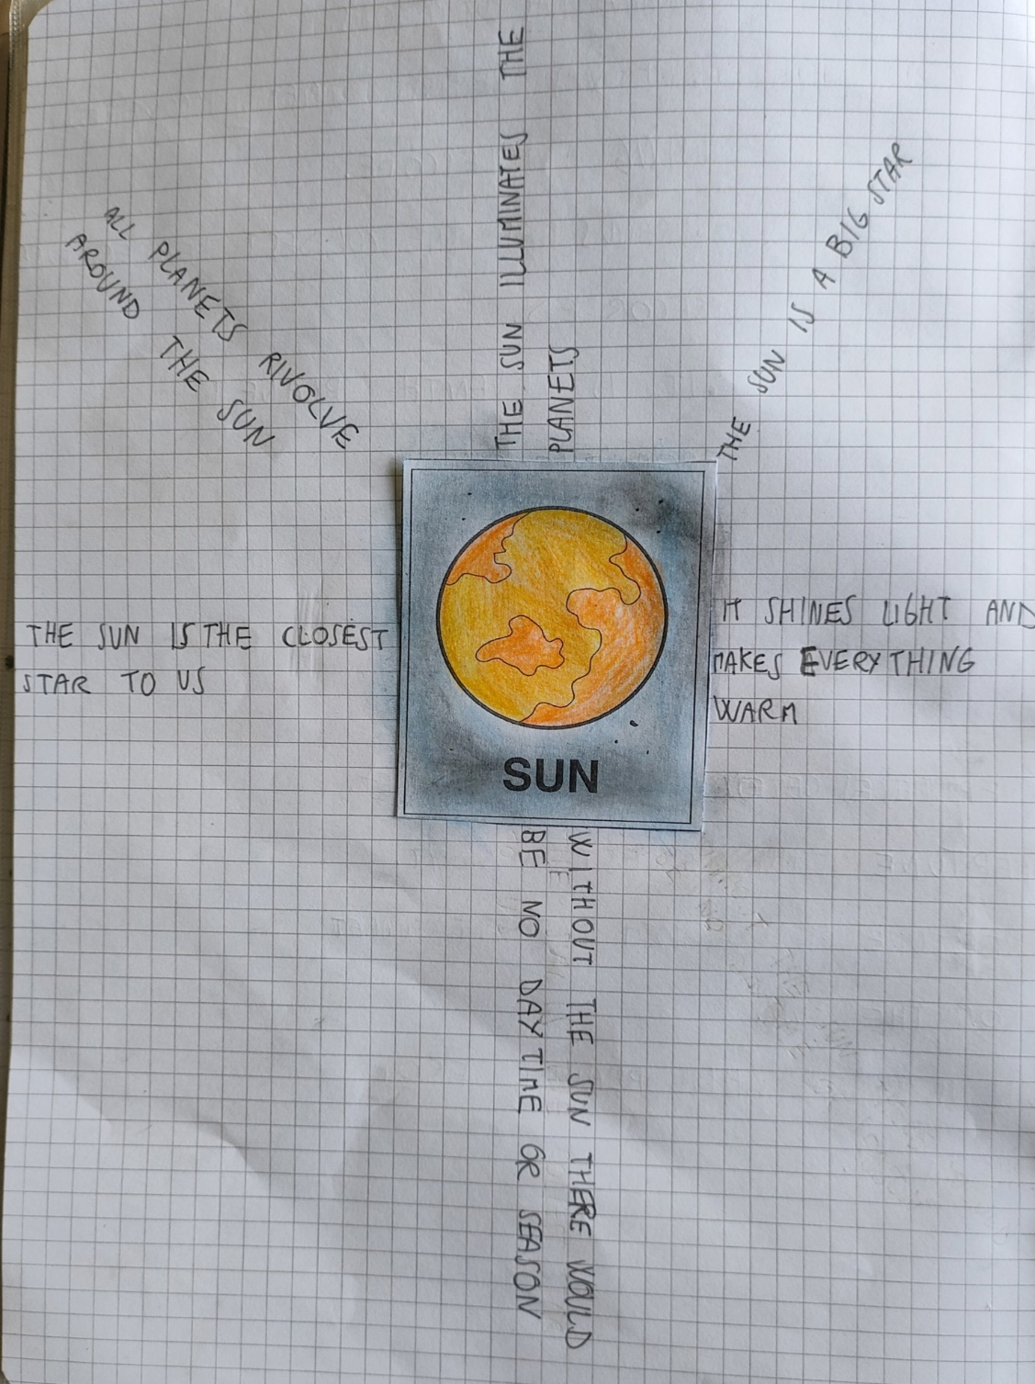

Slide 10
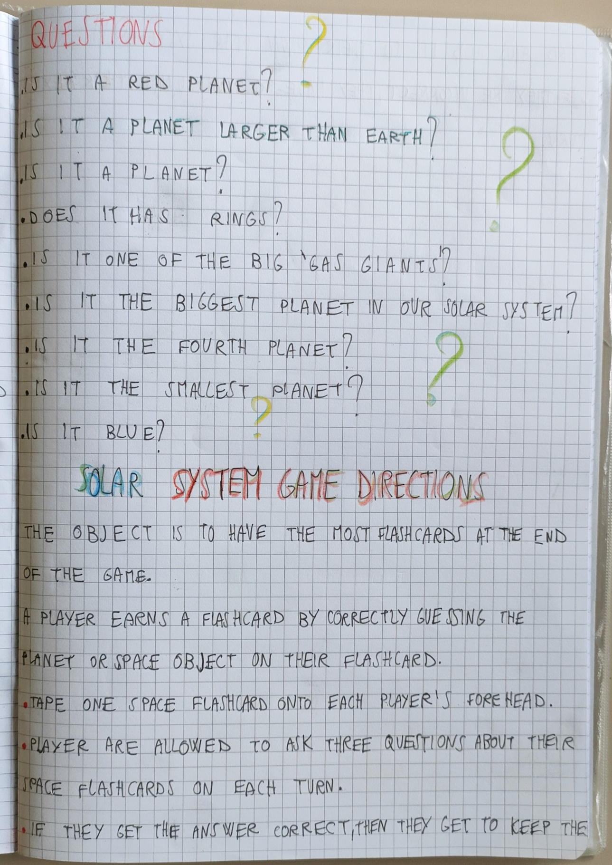
QUESTIONS

Slide 11
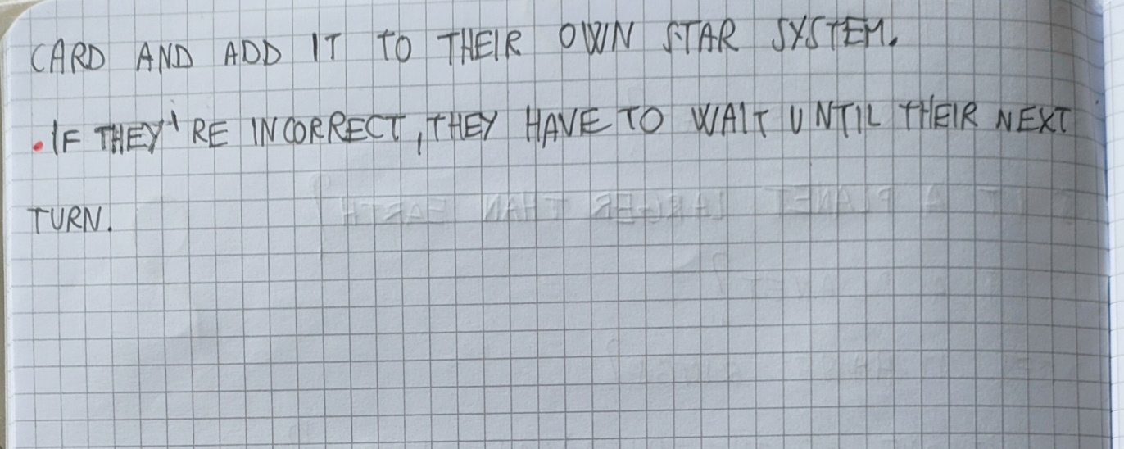
GAME

Slide 12
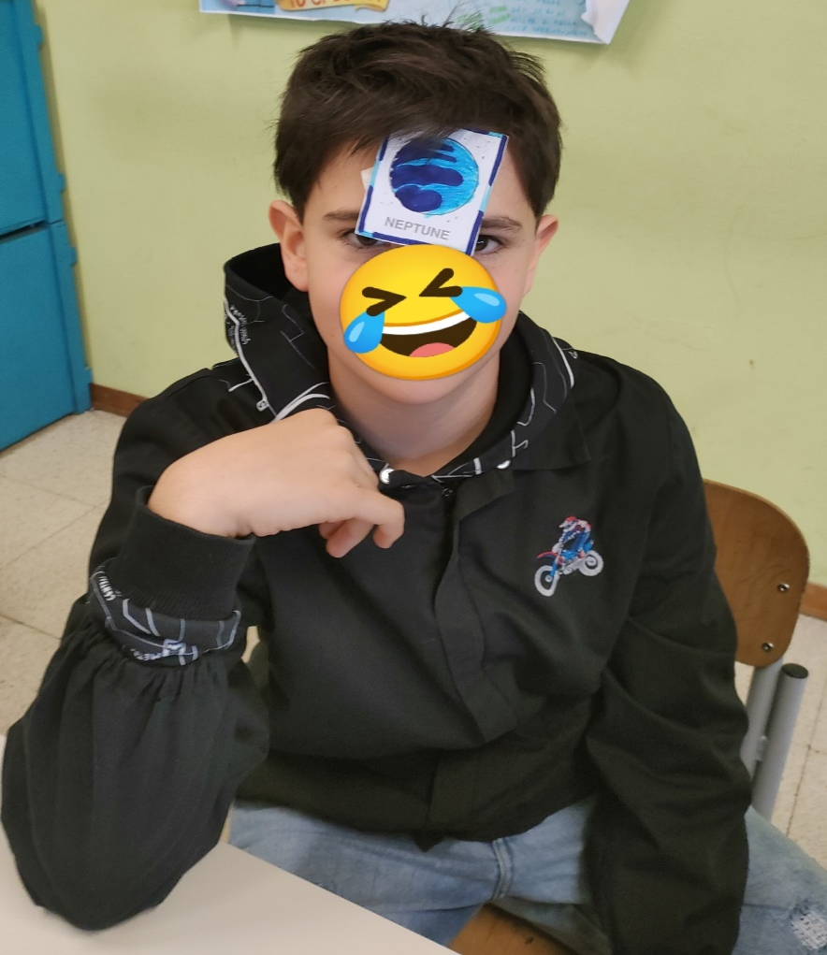
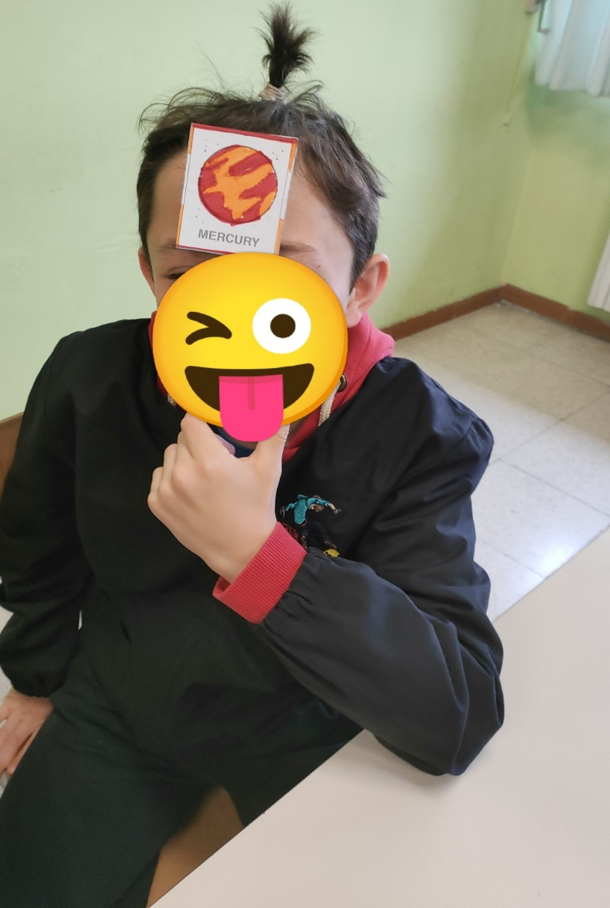
Learn by playing!

Slide 13
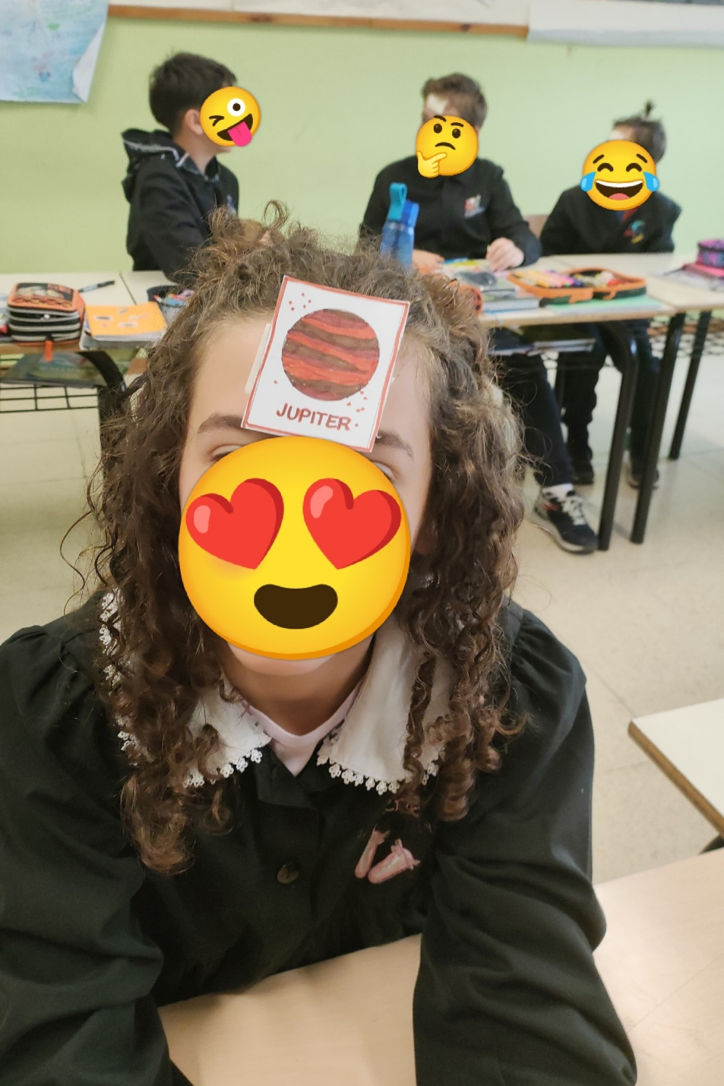
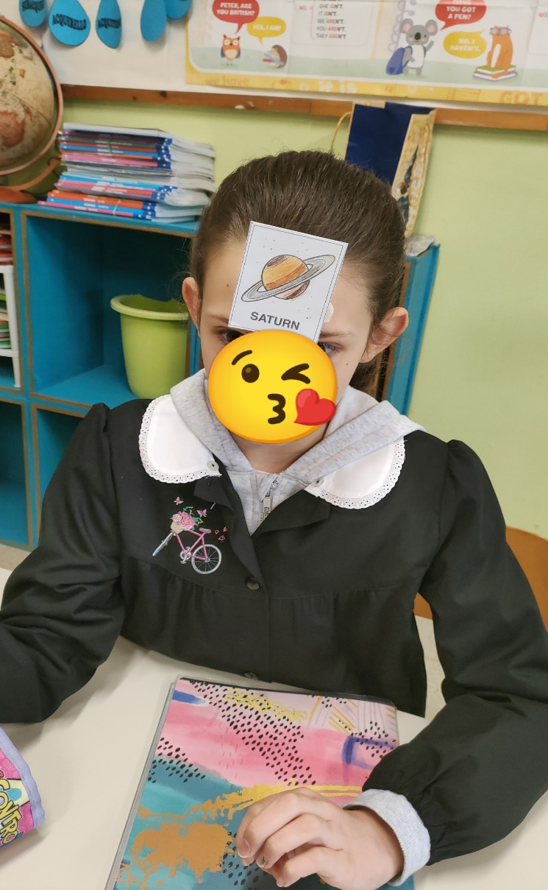

Slide 14
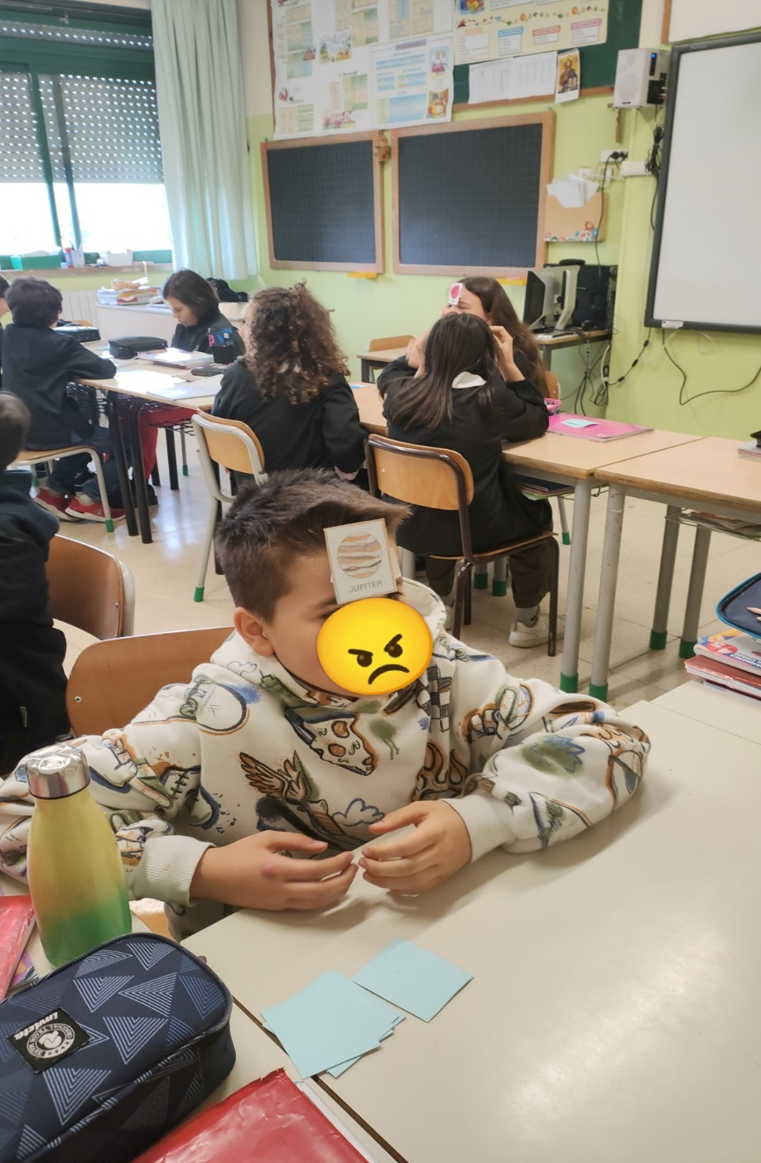
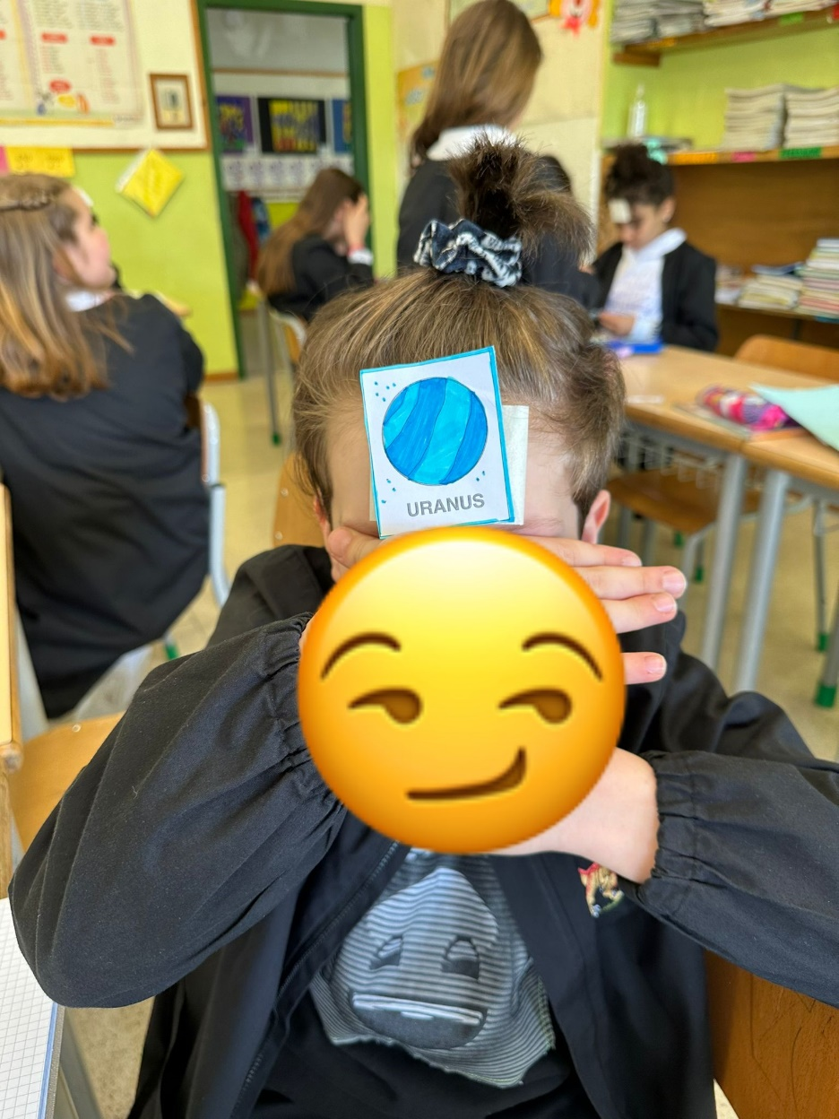

Slide 15
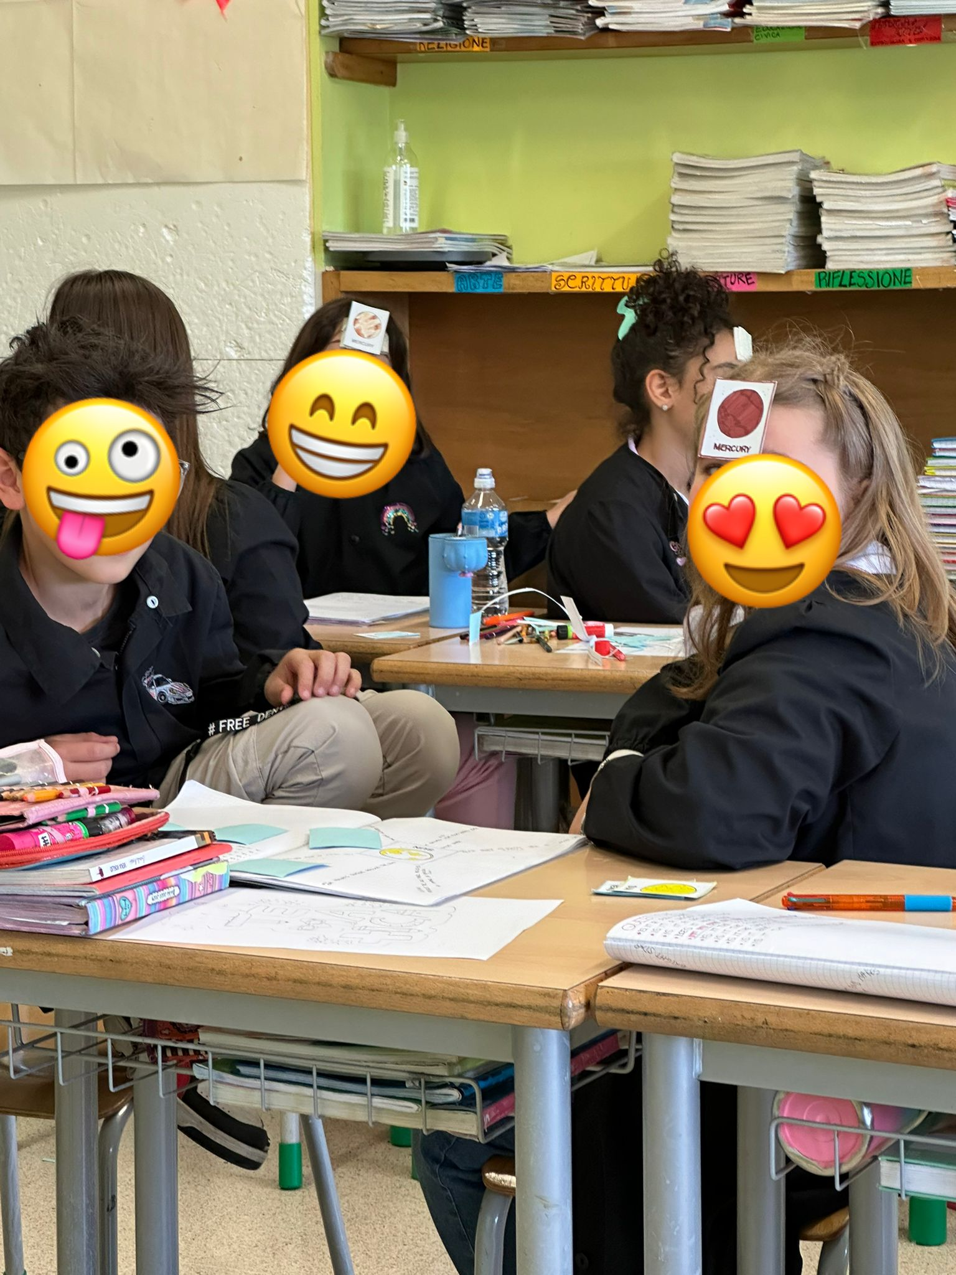
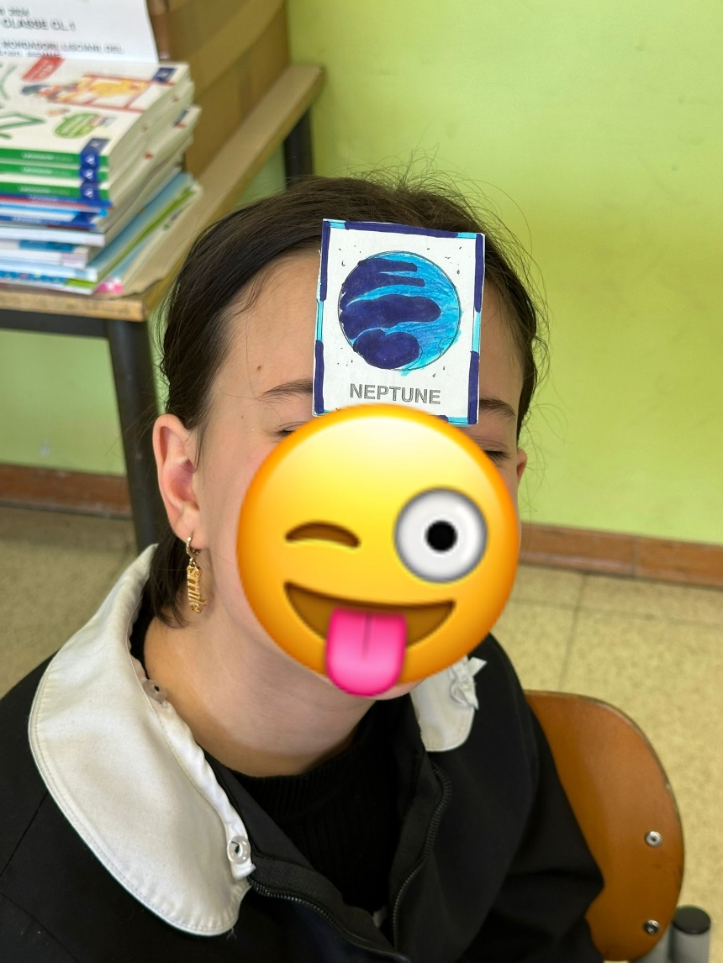

Slide 16
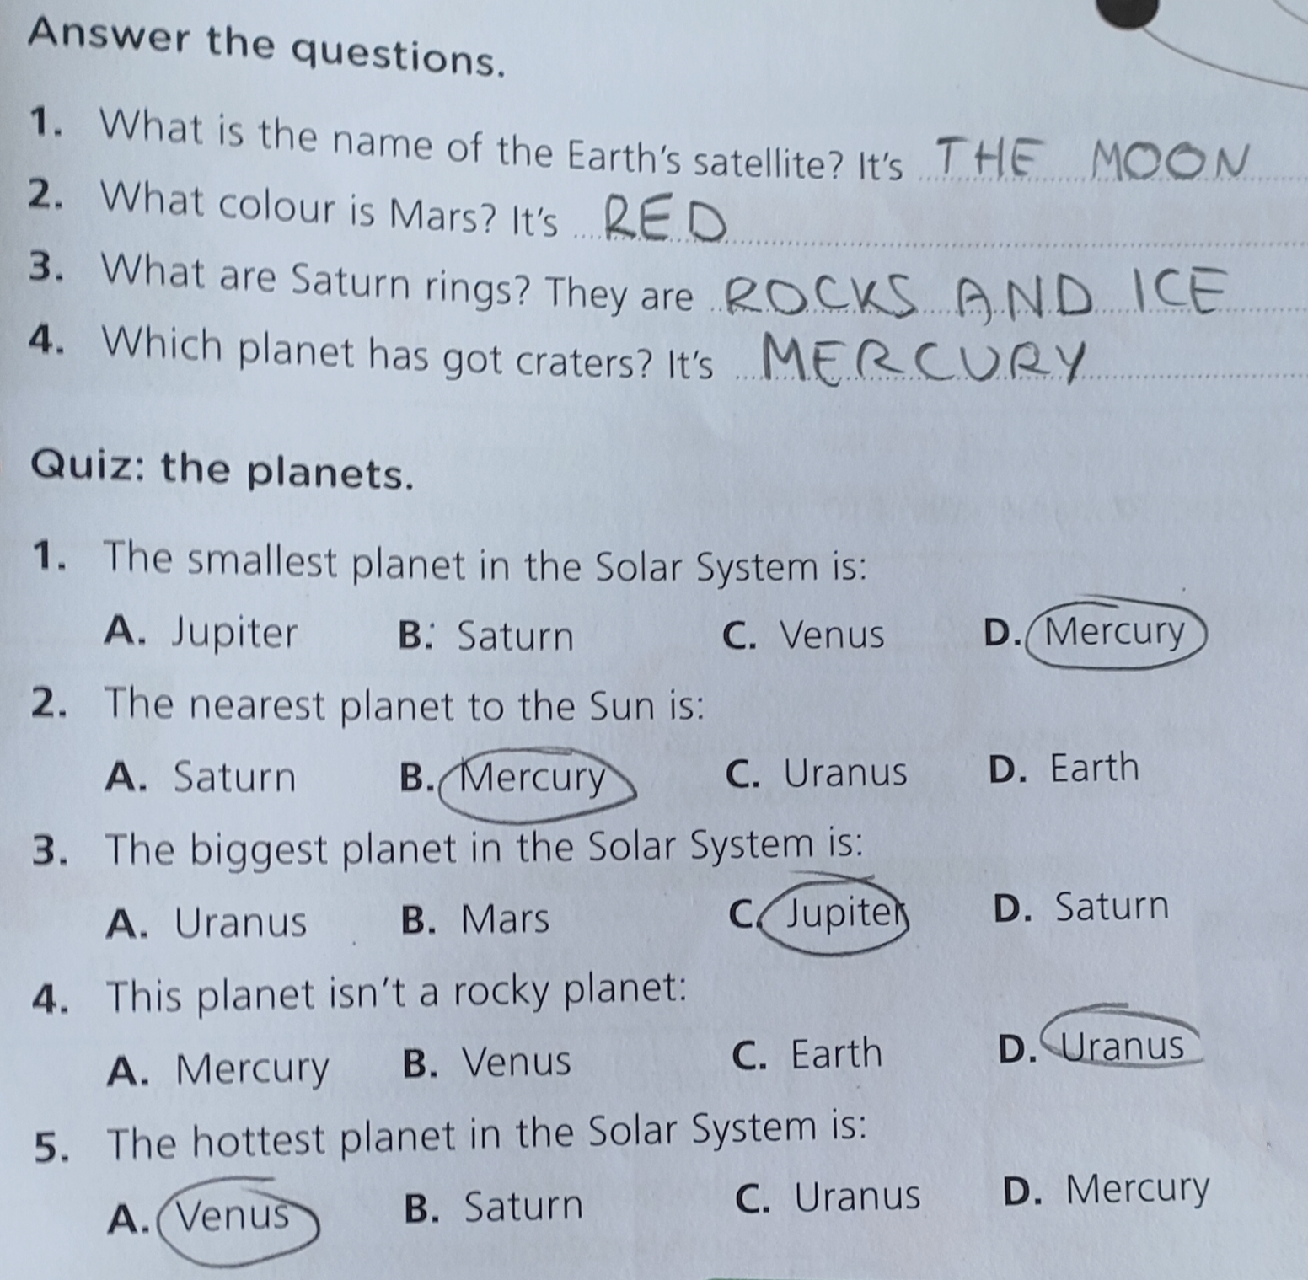
TEST

Slide 17
V A
V B
ROBERT E. B.
COSIMO D.R.
ARGJEND D.
KEVIN D.
CATERINA F.
AMELA F,
DUCCIO F.
LAPO G.
NICHOLAS M.
STELLA M.
REBECCA N.
AJNURA N.
SAMUELE P.
DENIS D. P.
ANNA S.
MATTIA T.
INAS Z.
HELENA B.
FRANCESCO C.
ADELE C.
EMMA D.P.
EDOARDO D.
ELFAT E.
FRANCESCO F.
ALESSIO G.
ALICE G.
ABDUL M.
ANDREA M.
LORENZO P.
DAVID F. P.
PEDRO P. D. A.
LAMYAE R.
CLAUDIO R.
DIEGO S.
GIULIA V.
Teacher: Lucia Valenti
Teacher: Laura Bartolini

