Slide 1
Istituto Comprensivo Statale “XIII Aprile 1944” Via della Repubblica – Soci (AR) SCUOLA PRIMARIA SOCI – SCUOLA PRIMARIA S. PIERO CLIL PROJECTS SCIENCE - ENGLISH S.Y. 2016-2017

Slide 2
THE WATER CYCLE
4 th CLASSES
Scuola Primaria SOCI - Scuola Primaria SAN PIERO

Slide 3
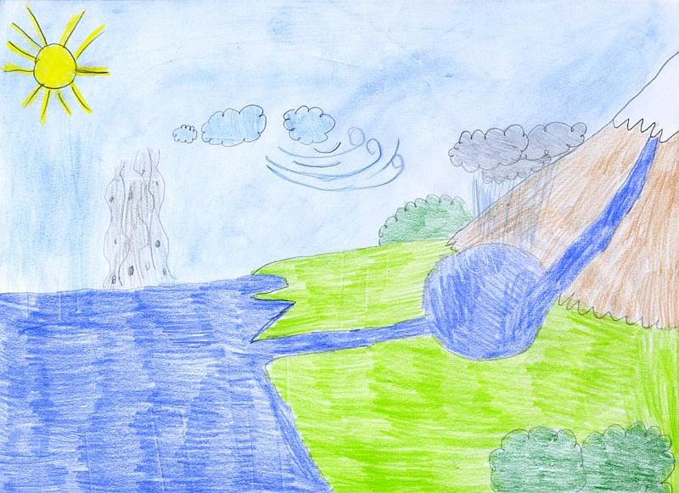
WHAT IS THE WATER CYCLE?
THE WATER CYCLE IS SIMPLY THE COMPLETE JOURNEY THAT
WATER MAKES IN ITS LIFE, FROM ONE PLACE TO THE OTHER AND FROM ONE STATE TO THE OTHER

Slide 4
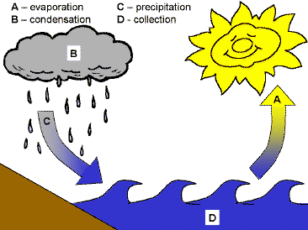
LESSON PLAN
CONTENT | COGNITION | CULTURE | COMMUNICATION
. identify the stages of the water cycle. . sing a song related to the topic. .reflect about their work and learn the new grammatical structure. . be respectful with classmates when working in groups. | . revisionon of the weather words (sun, cloud, drop …). . learn a new vocabulary relative to the science lesson: nouns (condensation, collaction…) and verbs (go up, fall down …). . match words with pictures. . complete some worksheet. . create a “clil book” and a poster in group about what they have learnt. | . learn something more about the water cycle. . explain the importance of the water cycle’s stages. | . discuss in group/pairs. . learn some new words. . present their drawings .the children will pactise orally what they have learnt about the water cycle, building simple sentences (sun shines in the sky - water goes down…)

Slide 5
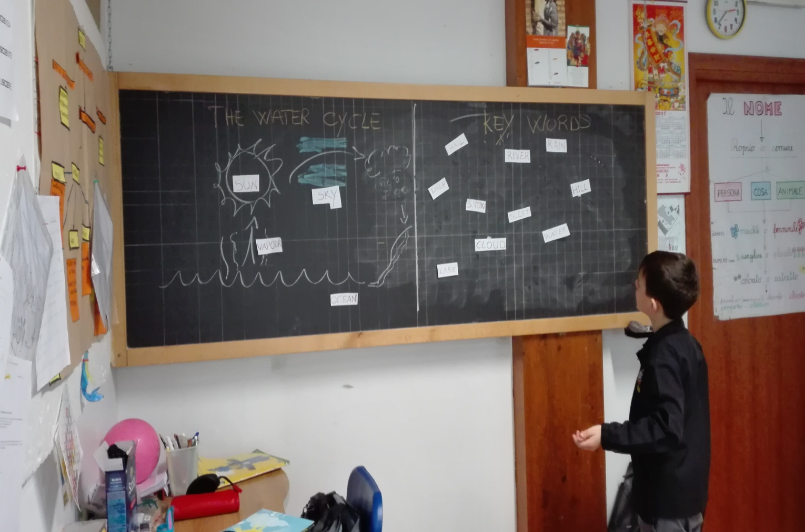
LEARN BY DOING

Slide 6
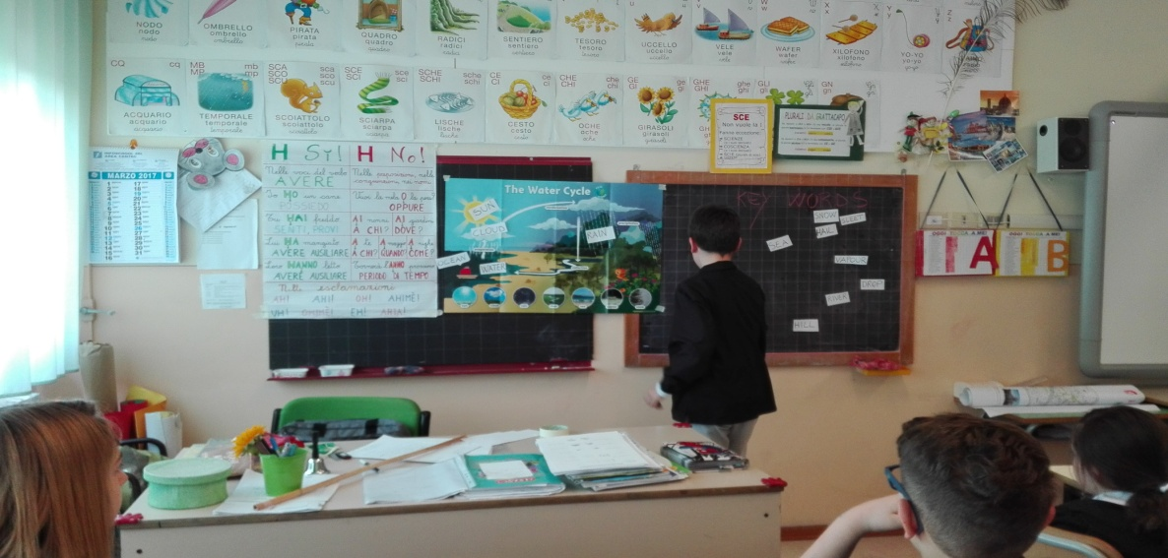
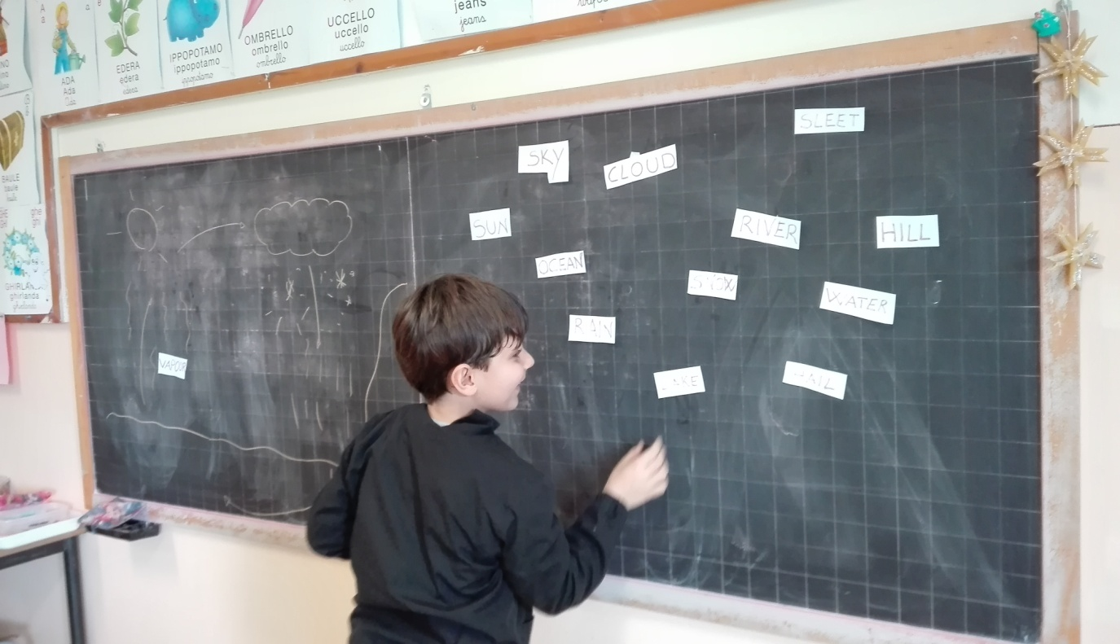
MATCH WORDS TO PICTURES

Slide 7
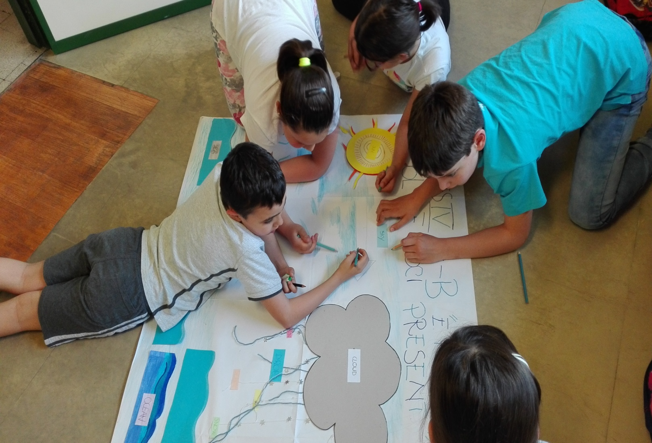
WORK IN PROGRESS

Slide 8
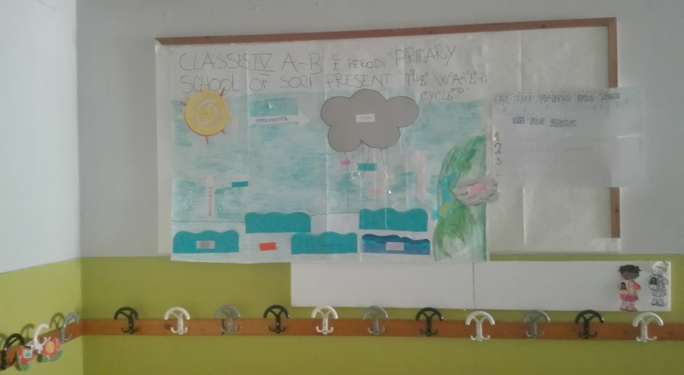
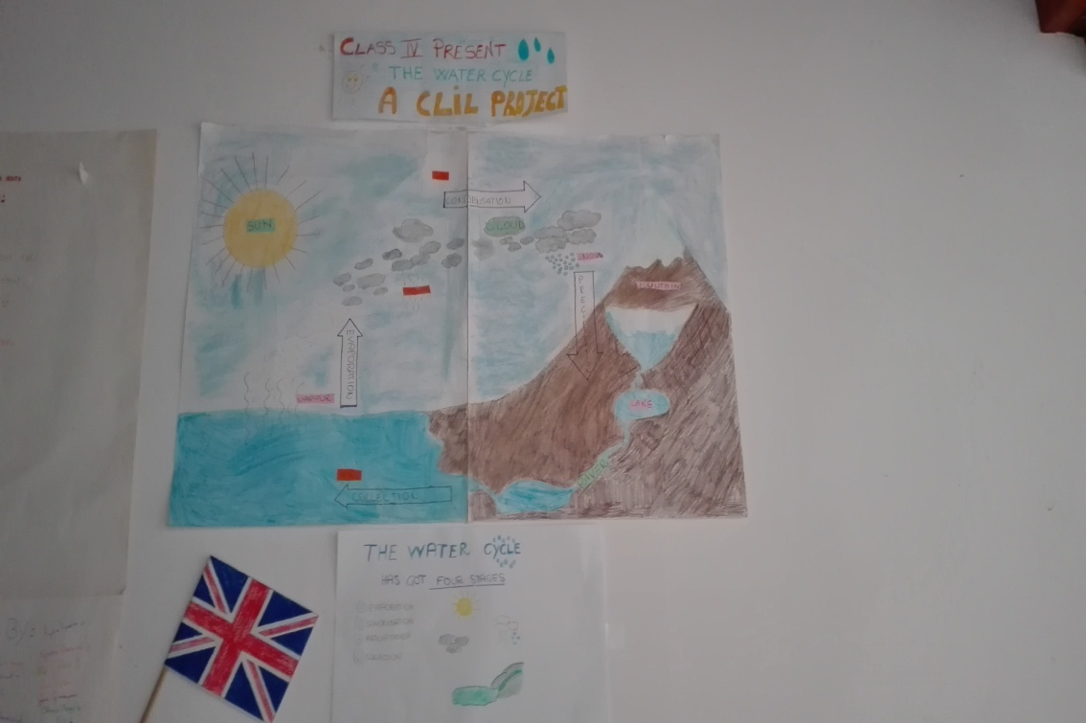
OUR CLIL
POSTERS

Slide 9
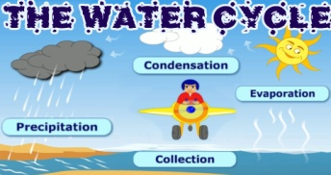
Engida Alessandro Sofia Riccardo Diego Valentina Lorenzo Niraj Matilde Vittoria Alessia Pietro Giovanni Christian Nicole Promi Vanessa Lapo Tommaso Elena Federica Luigi
Azzurra Omer Viola Elisa Pablo Sofia Tommaso Noemi Christian Cristian Ludovica Gabriele Blerim Filippo Chiara Viola Tanupreet Giada Gianluigi Gaia Suela Niccolò Rachele Bianca
CREATED BY …
Edward
Gianluca
Luca Orlando
Tommaso Lucrezia
Tommaso
Filippo Emil
Daniele
Angelo
Alessandro Tommaso
Francesco Sara

Slide 10
MY FIVE SENSES
5th CLASS
Scuola Primaria SAN PIERO

Slide 11
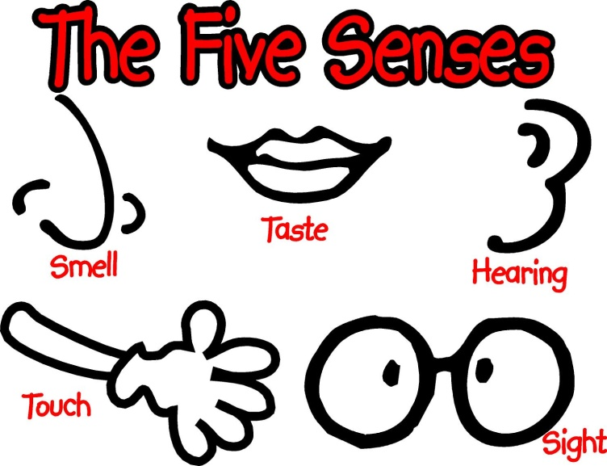
WHAT ARE THE FIVE SENSES?
The senses usually work together to give us a clear picture of the things around us.
The five senses are: taste, sight, touch, smell, and hearing.

Slide 12
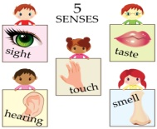
LESSON PLAN
CONTENT | COGNITION | CULTURE | COMMUNICATION
. identify the five senses and their corresponding organs. . sing a song related to the topic. .reflect about their work and learn the new grammatical structure. . be respectful with classmates when working in groups. | . revisionon of the body words (eye, nose, ear …). . learn a new vocabulary relative to the science lesson: nouns (sight, hearing …) and verbs (see, hear, feel …). . match words with pictures. . complete some worksheet. . use their senses. . create a “clil book” and a poster in group about what they have learnt. | . learn something more about the senses. . explain the importance of how senses provide information about the environment. | . discuss in group/pairs. . learn some new words. . present their drawings .the children will pactise orally what they have learnt about the five senses, building simple sentences (for example: eye is the organ sense of sight - we use our eyes to see things aroun us …)

Slide 13
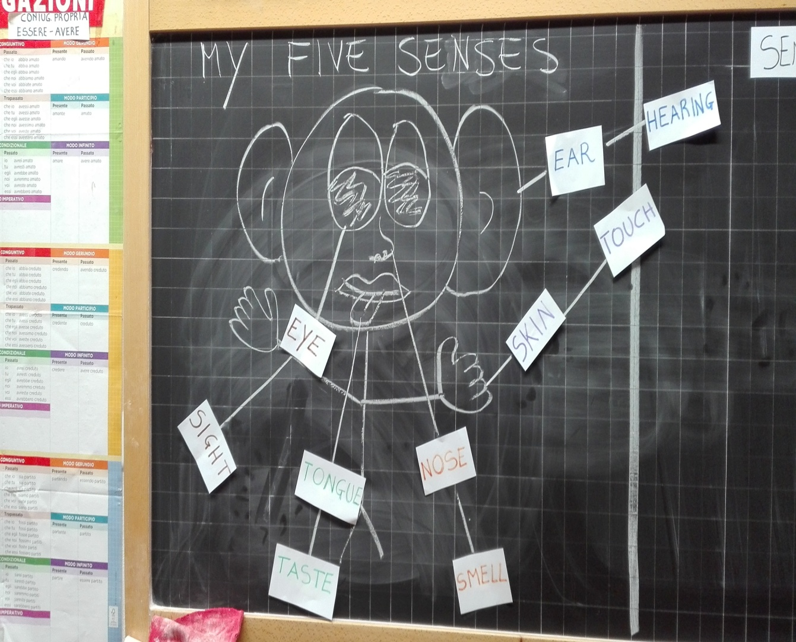
I HAVE FIVE SENSE ORGANS!

Slide 14
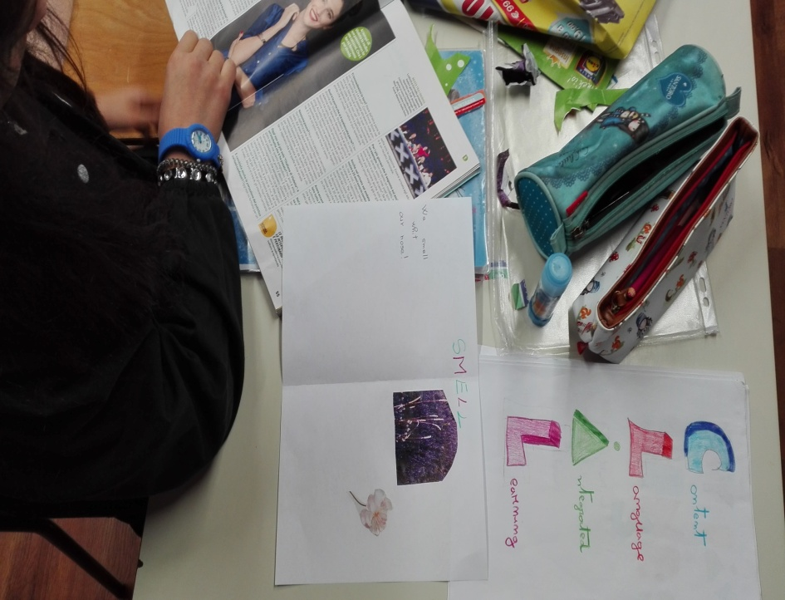
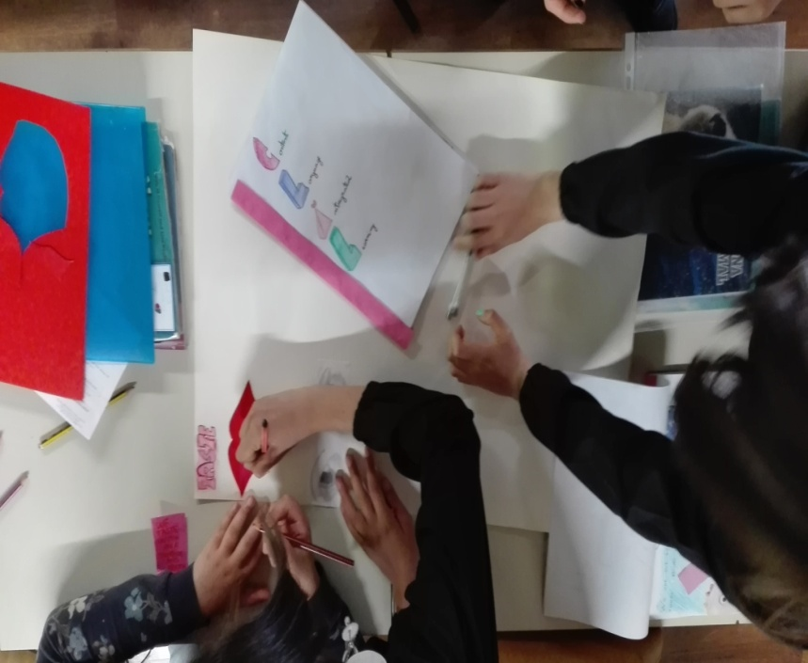
A CLIL BOOK

Slide 15
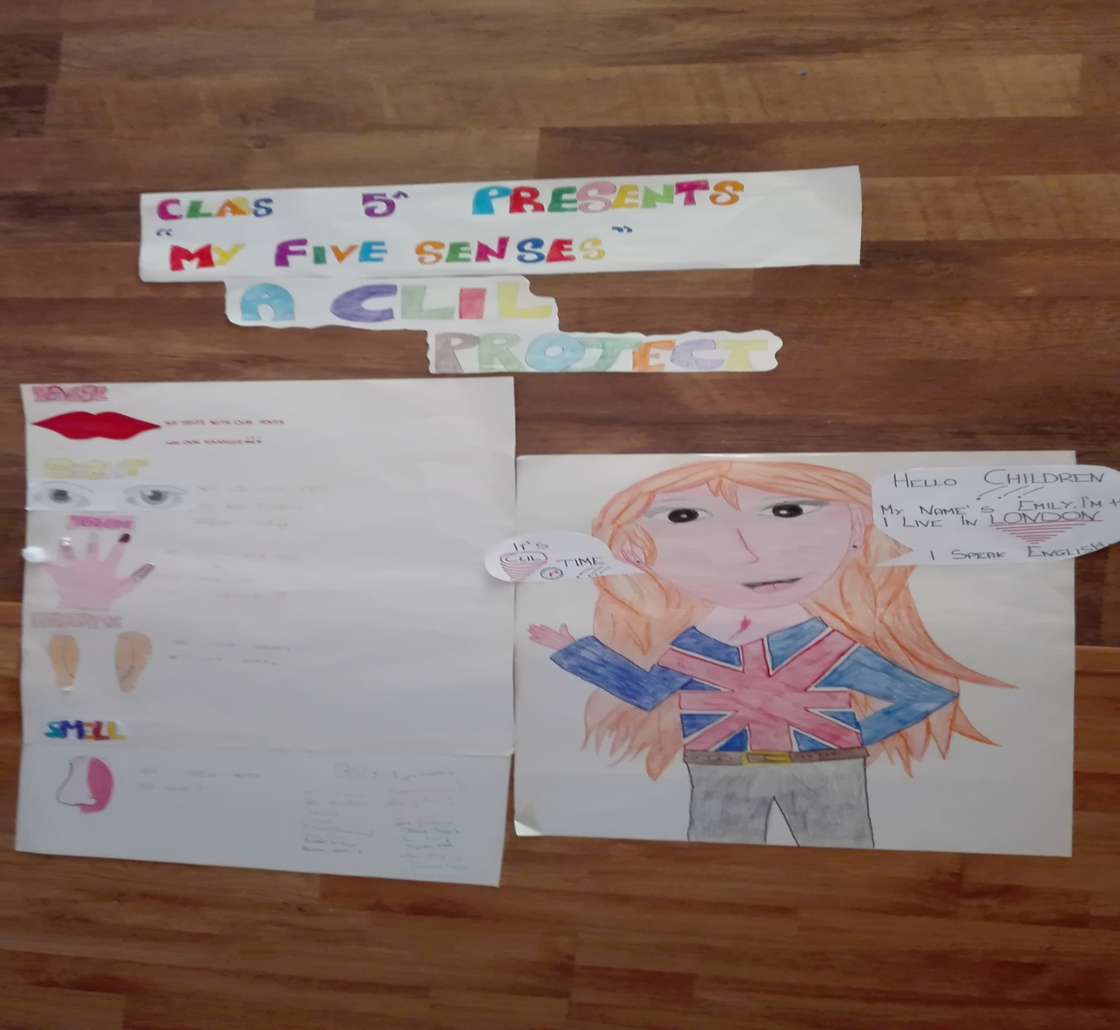
OUR POSTER

Slide 16
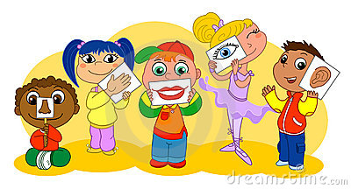
CREATED BY …
Alice Sara Alex Chiara Martina
Daniel Pietro Gaia Sofia
Chiara Tommaso Sofia Bianca Laura
Luca Filippo Agata Agnese
Michele

