Slide 1

ICS XIII APRILE SOCI
MONS. C. ZACCHI PRIMARY SCHOOL
S.PIERO IN FRASSINO
PROGETTO PON UNIONE EUROPEA
2014/2020
IF I WERE
CLASSES IV-V
MADRELINGUA INGLESE: GIULIA PERUCCHIO
TUTOR SPECIALISTA: MARIA LETIZIA FANI

Slide 2

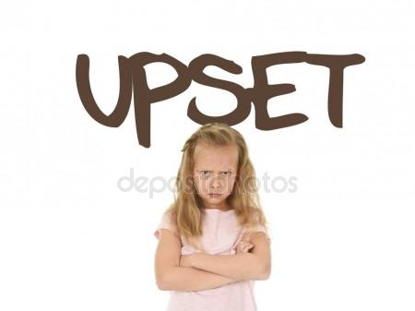
ASK PEOPLE…
HOW ARE YOU?
WHAT’S THE MATTER?
IS EVERYTHING ALLRIGHT?
I’M…

Slide 3





I’M WORRIED ABOUT THE ENGLISH TEST…
I’M HAPPY
I’M SAD
I’M ANGRY BECAUSE….
I’M BORED

Slide 4
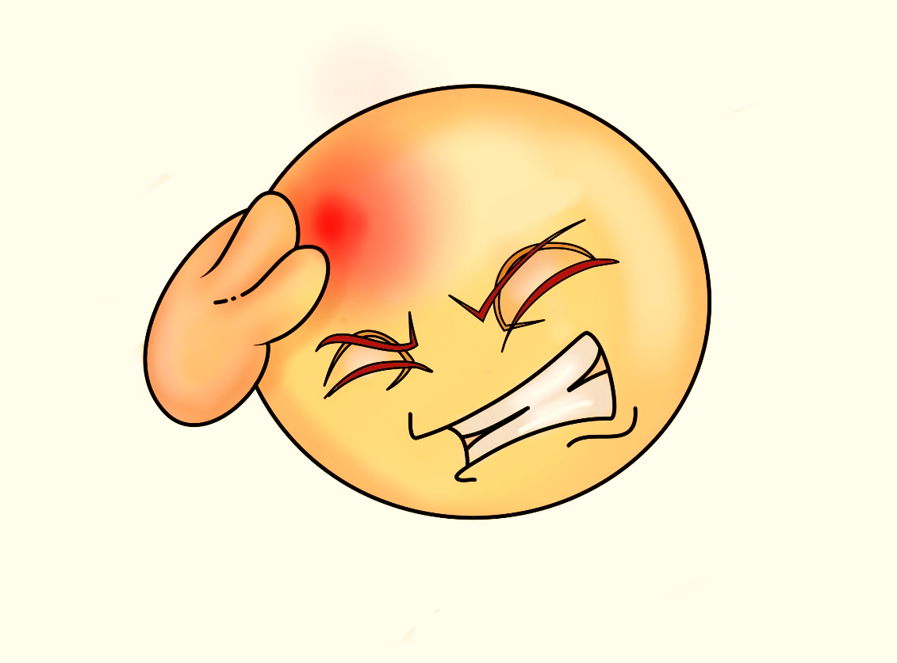
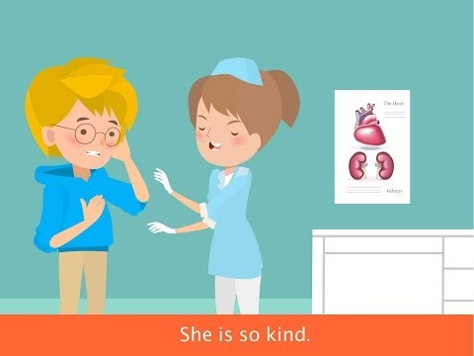
ARE YOU OK???
NOOOO….!

Slide 5
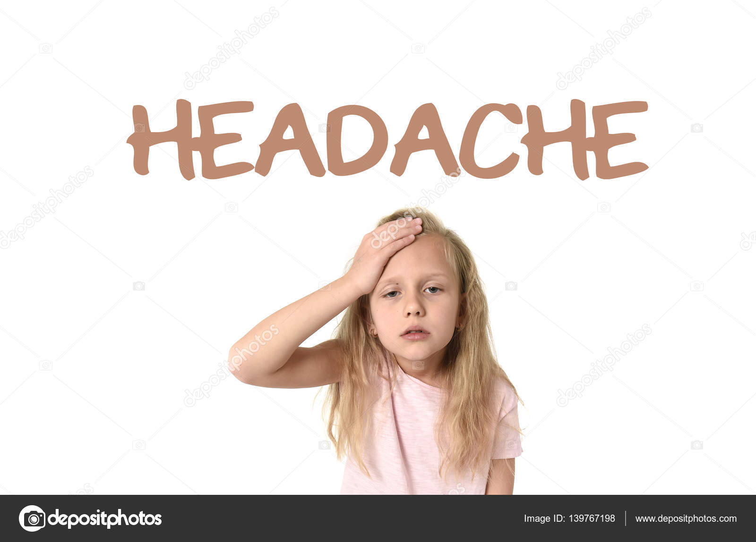
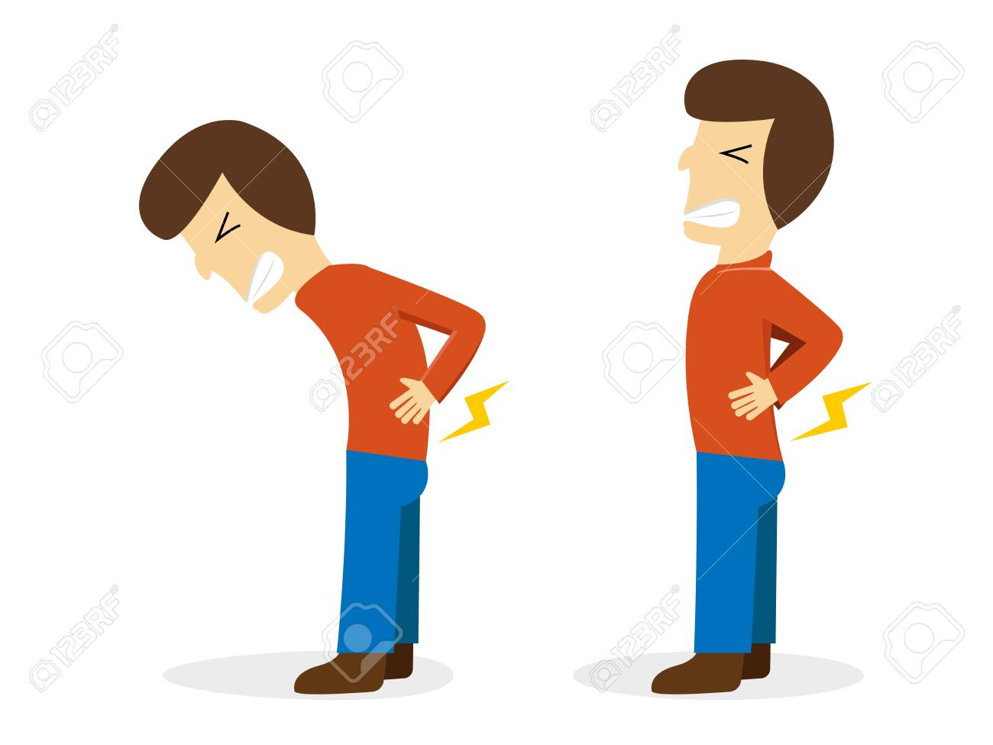
I HAVE GOT A…
BACK ACHE

Slide 6
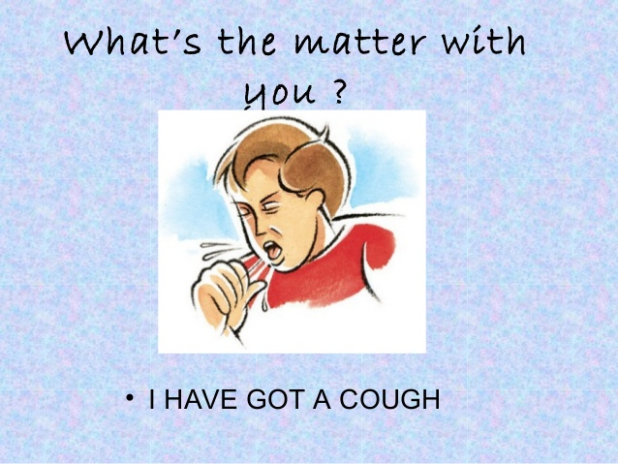
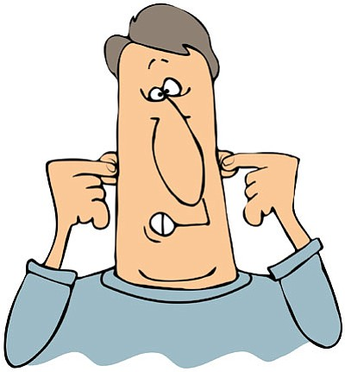
I HAVE GOT
EARS ACHE

Slide 7
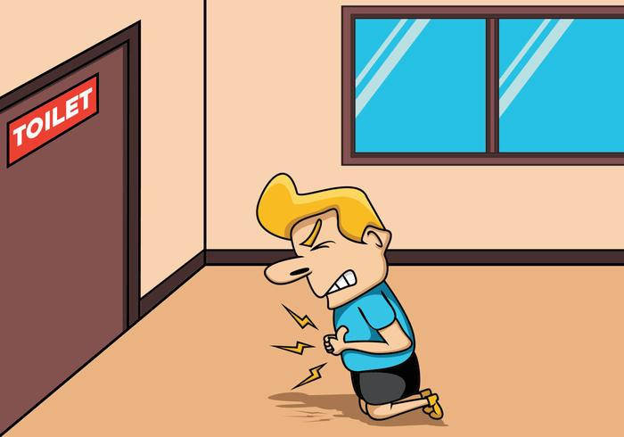
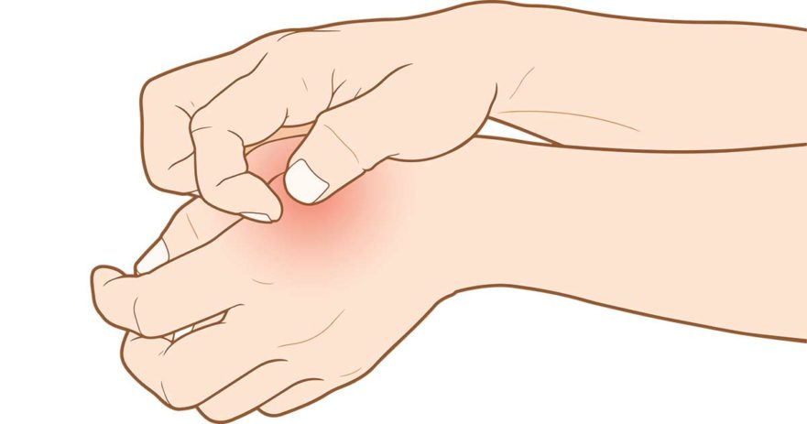
I HAVE GOT
STOMACH ACHE
A SKIN RASH

Slide 8
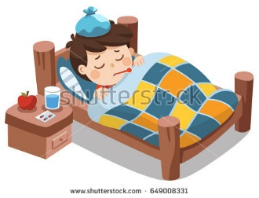
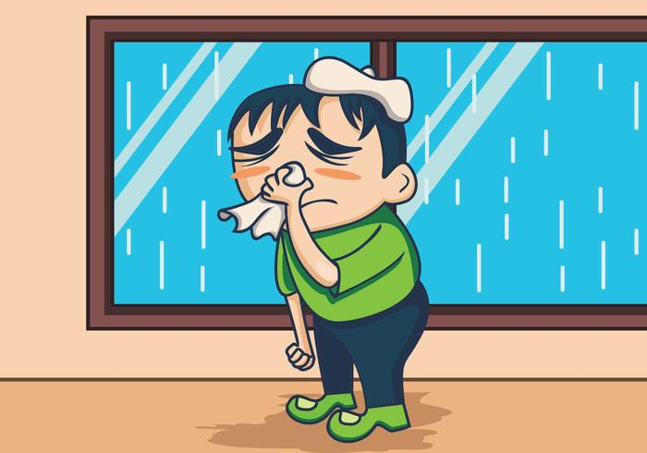
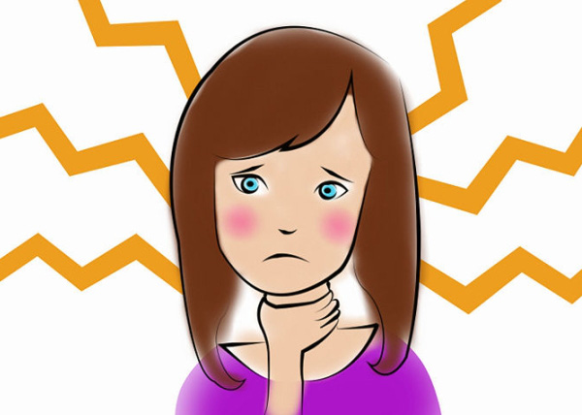
I HAVE GOT
FEVER
OR
THE FLU
A COLD
A SORE THROAT

Slide 9
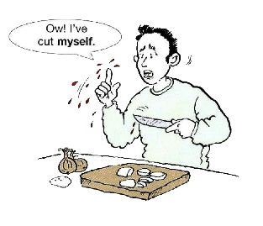
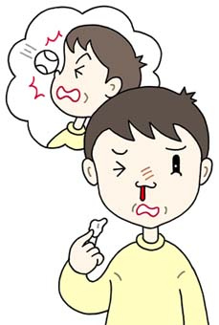
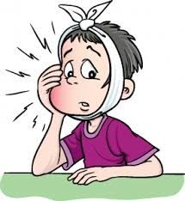
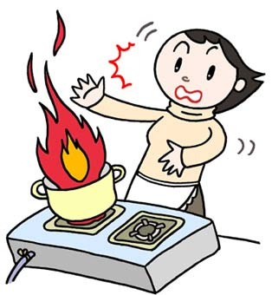
WHAT’S WRONG
WITH YOU???
MY NOSE BLEEDS
TOOTH ACHE
I BURNED
MY FINGER

Slide 10
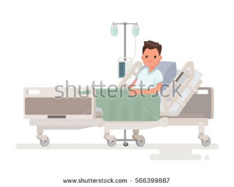
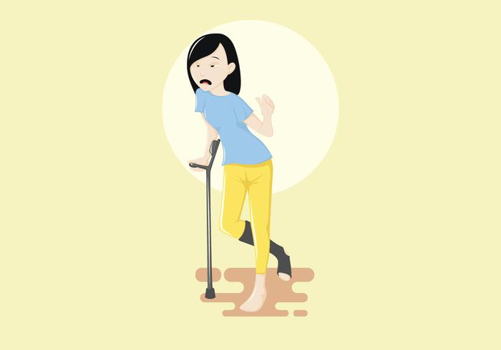
I’M IN HOSPITAL BECAUSE….
I BROKE MY LEG

Slide 11
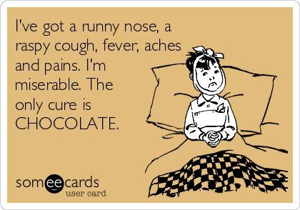
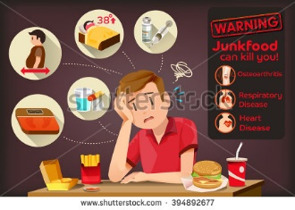
But… BE CAREFUL WITH JUNK FOOD
AND SWEETS!!!
AH AH AH!!!

Slide 12
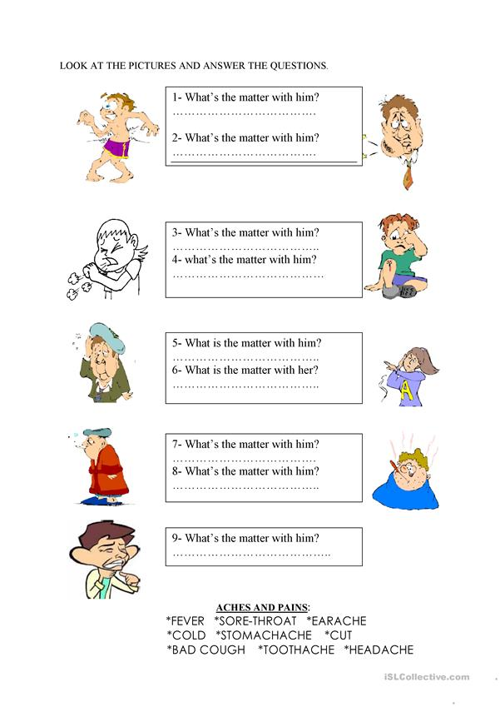
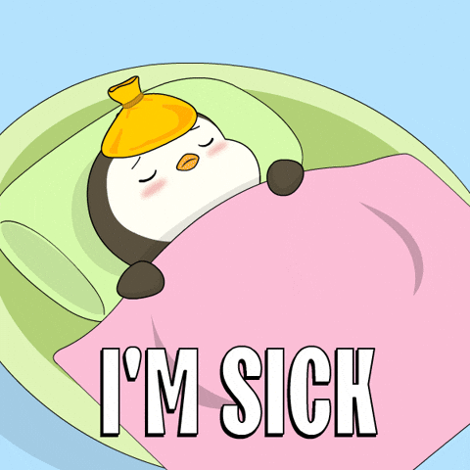
Do you understand?
Let’s do this activity to check

