Slide 1
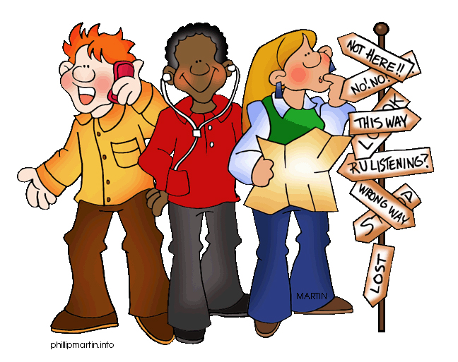
Asking and giving directions
ICS XIII Aprile Soci
PON Project on English
Tutor Teacher M.Letizia Fani
English Teacher Giulia Perucchio
22 nd February 2018

Slide 2
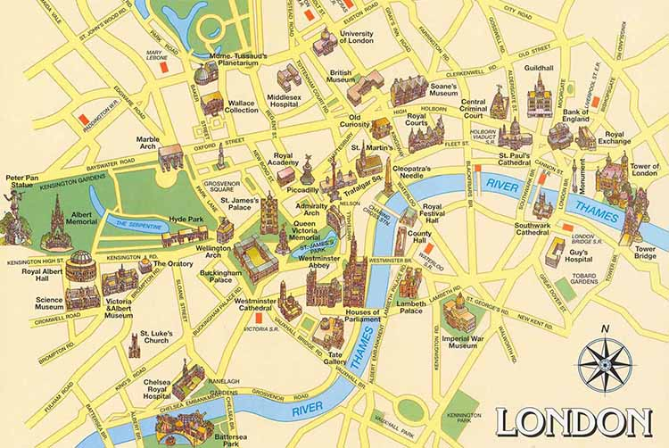
Where do you want to go? To London?...
INTERACTIVE LONDON MAP https://www.thinglink.com/scene/703428433115348993

Slide 3
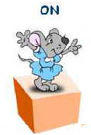
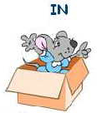
Prepositions of directions
In front of =
2. Behind =
3. On =
4. In =

Slide 4
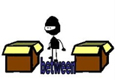
5. Beside =
6. Between =
7. Opposite =
8. Above =
9. Below =

Slide 5
10. Next to =
11. Across from =
12. Near =
13. Far =

Slide 6
Directions
Turn left =
Turn right =
Go straight =
Go over =
Go under =
For example: Go over a bridge.

Slide 7
Asking directions
How do I get to the…?
Where is the…?
Can you tell me where ……is?
Excuse me,
Pardon me,
I beg your pardon,
Sorry to trouble you, but
How do I get to the KFC restaurant?
Where is the coffee shop?
Can you tell me where 7 eleven is?
Excuse me, how do I get to the KFC restaurant?
Pardon me, where is the Coffee Shop?
I beg your pardon, can you tell me where 7 eleven is?
Sorry to trouble you, but where is the coffee shop?

Slide 8
Giving directions
You can go straight and turn left.
The Coffee Shop is next to the High School.
7 eleven is very near your house.
Sure…
Of course…
Yes, why not?
You can go straight and turn left.
The Coffee Shop is next to the High School.
7 eleven is very near your house.
Sure, you can go straight and turn left.
Of course, the Coffee Shop is next to the High School.
Yes, why not? 7 eleven is very near your house.

Slide 9
Activity 1 Complete with the prepositions:
The car is __________ the house.
The dog is _________ the house.
The house is _______ the tree and the dog.
The dog is _________ the sun.
The house is ________ the car.
The sun is _______ the dog.

Slide 10
The Drugstore is __________ the Post Office and the Movie Theater.
The Police station is ____________ the Drugstore.
The Hospital is ______ from the Library.
The Train Station is _____________ the School.
To go to First Street, _____ _______ from Central Avenue.
The Bank is _________ the Police Station.
The Church is __________ the Second Street.
The Restaurant is ________ the School.
On
Across from
Far
Near
Turn Right
Between
Next to
Opposite

Slide 11
Activity 2 Read the prepositions:

Slide 12
Vocabulary
Directions
Conversation
Lost
Foreigner
Landmark
Map
Location
Use Google navigator?
Look at the London tube map

Slide 13
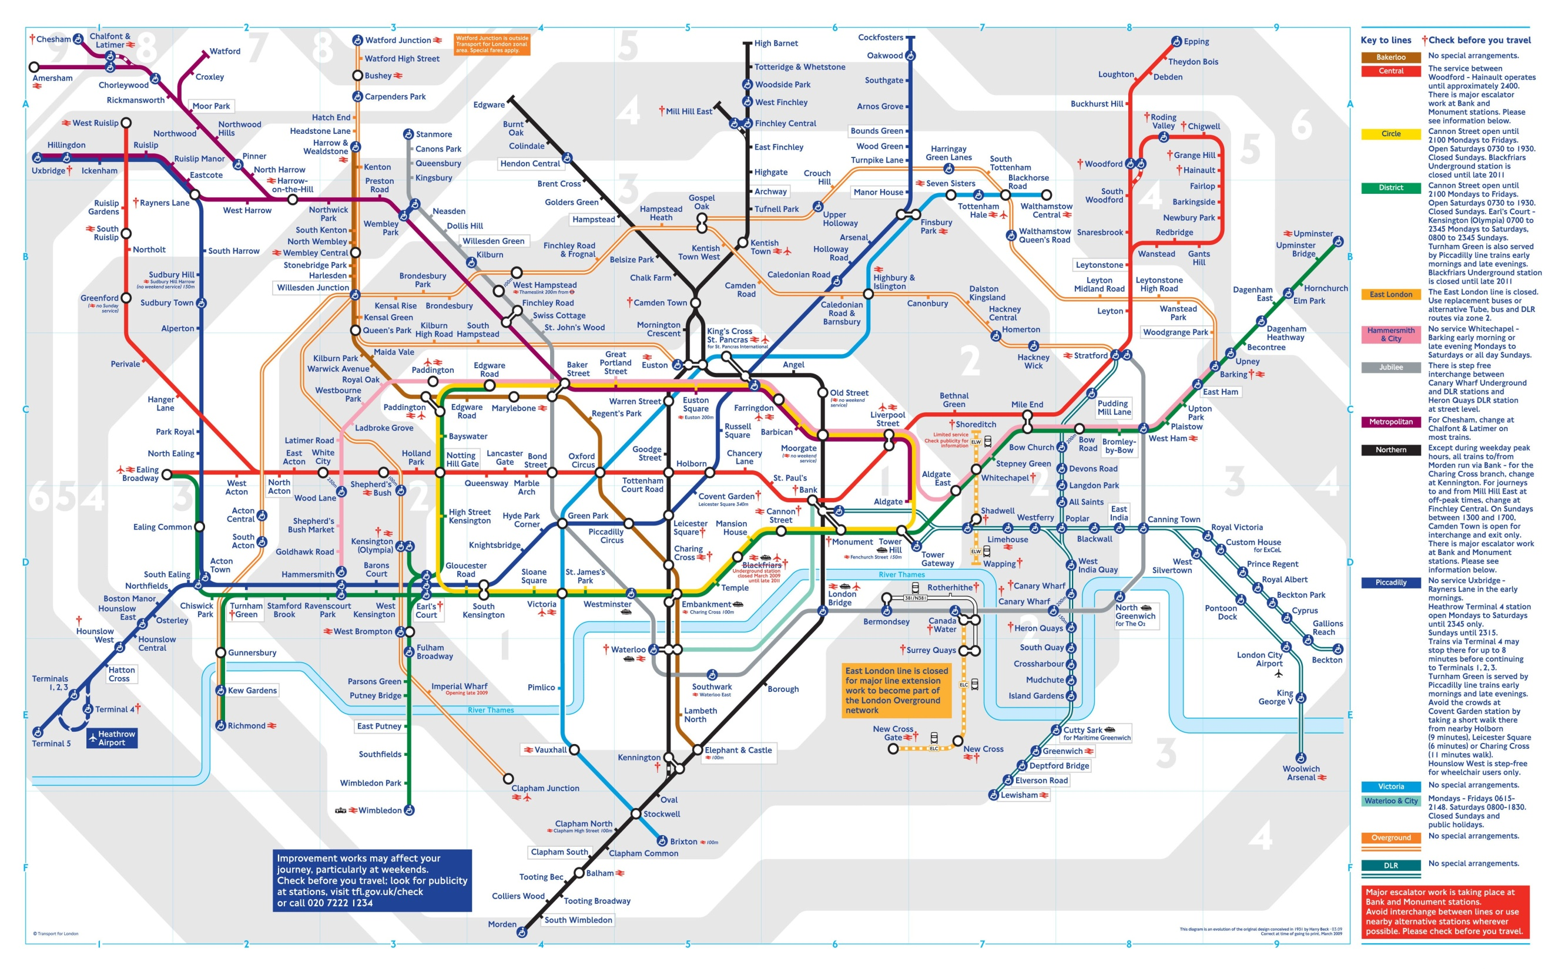

Slide 14
Asking Directions | Giving Directions
How can I get to the cinema?
You can get there by car/bus/train/tube
Excuse me, I’m new here. Can you speak English?
Yes, a little bit.
I’m a little lost. Can you help me please?
Sure. Where would you like to go?
Do you know where the bank is?
Yes, it’s just about 5-7 minutes from here.
Do you know where the bank is?
I’m sorry. I have no idea.
Is the bank far from here?
No, it’s just about 5-7 minutes from here.
Is the bank far from here?
Yes. You should probably take a taxi.

Slide 15
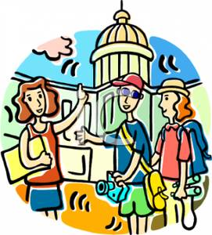
Conversation
Alice : Excuse me. We are a bit lost. Can you speak English?
Jan : Yes, but just a little. Can you speak slowly?
Alice: Ok. Do you know if there is a hospital around here?
Jan: Yes. Go straight along the road and turn right. There you will see the hospital.
Henry: Is it far from here?
Jan: No. It’s just a few minutes.
Henry: Is there any landmark?
Jan: Yes. The hospital is opposite
to the Train Station
Alice and Henry: Thanks a lot.
Jan: You’re welcome.

Slide 16
Possible activity
Draw your own town.
Name your town.
Create and mark roads and places (hospitals, shops etc)
Explain the directions of your town in about 5 sentences.

Slide 17
My Town/My village

Slide 18
Example
The name of my town is Arezzo /of my village is Bibbiena /Soci.
The Train station is downtown
The hospital is uptown
The Primary school is…
The department store is...

