Slide 1
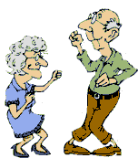
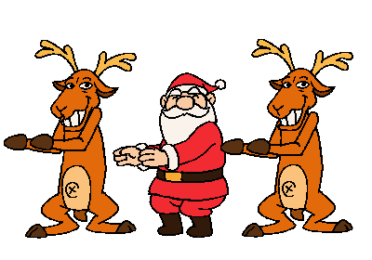
CHRISTMAS IN BRITAIN
Rockin around the Christmas Tree at the Christmas party hop A mistletoe hung where you can see Ev'ry couple tries to stop
Rocking around the Christmas Tree Let the Christmas Spirit Ring Later we'll have some pumpkin pie and we'll do some caroling
You will get a sentimental feeling When you hear, voices singing "Let's be jolly; Deck the halls with boughs of holly"

Slide 2
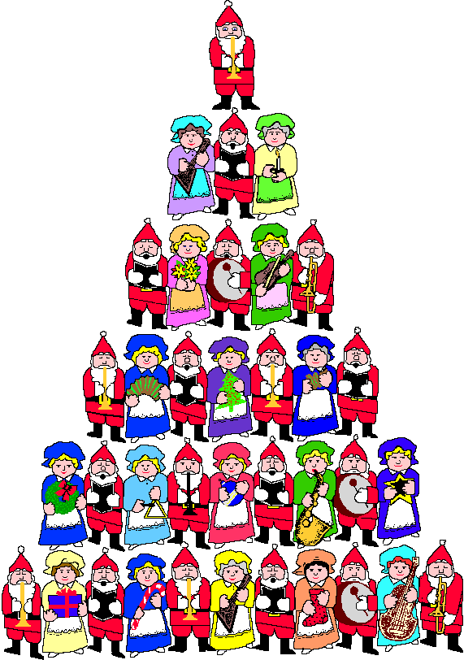
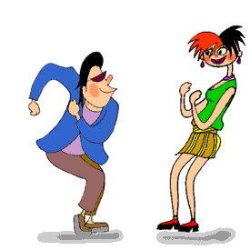
Christmas is on the 25th
December.
It’s called “Christmas
day”

Slide 3
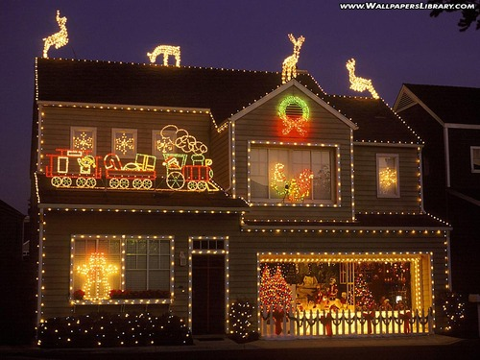
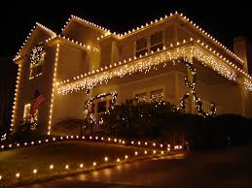
In December people decorate their houses with lights.

Slide 4
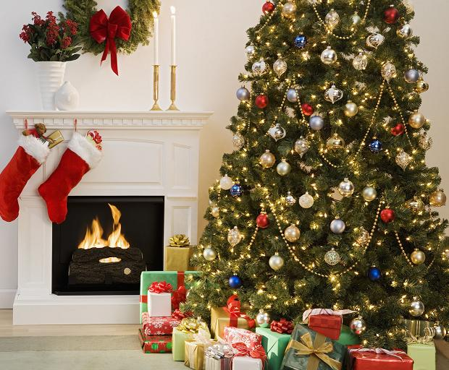
They put the Christmas tree in the dining room
near the fireplace

Slide 5
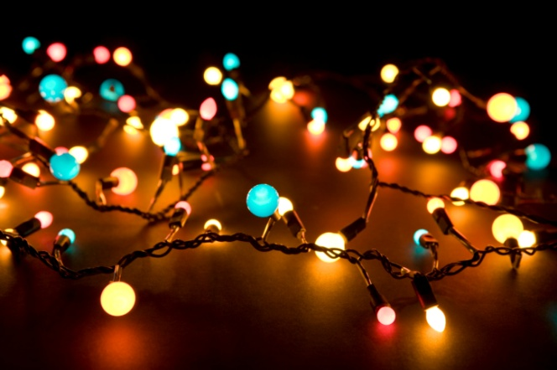
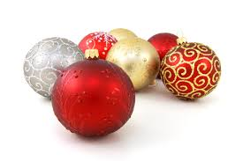
They decorate the Christmas tree with:
Lights
Baubles
Tinsels

Slide 6
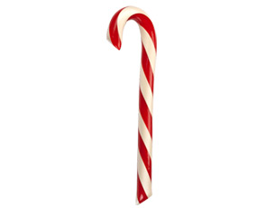
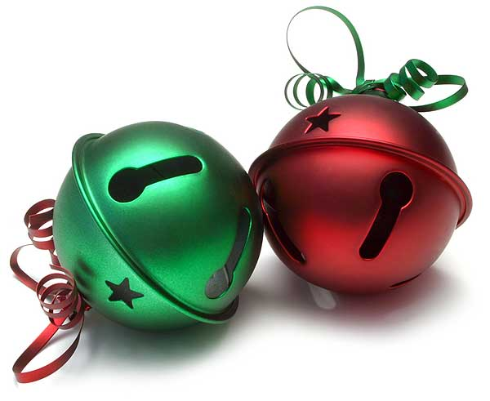
They also can use
Candy canes
Bells and stars

Slide 7
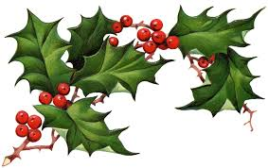
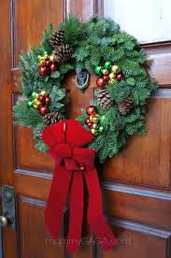
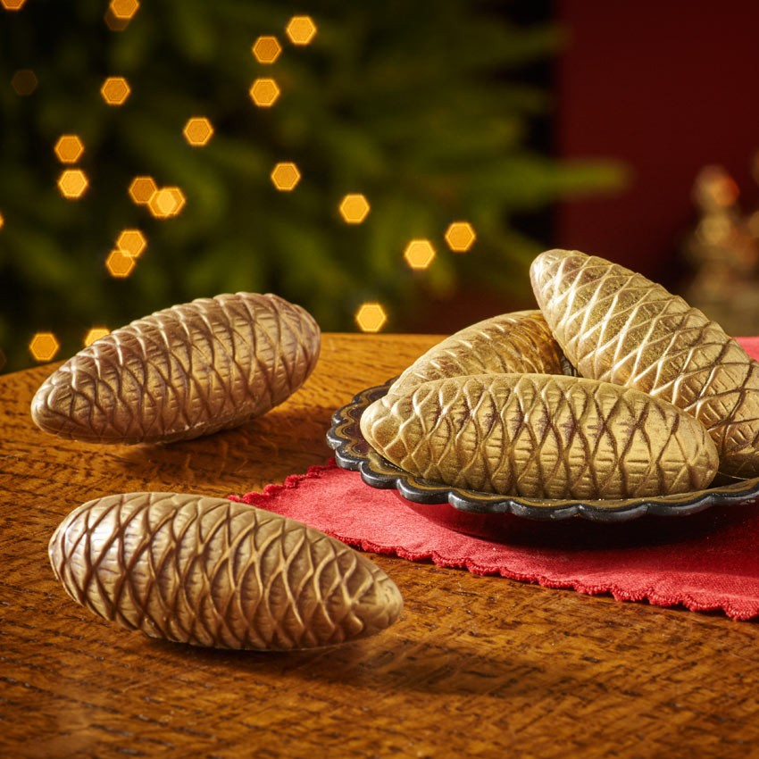
They put wreaths on the front door of their houses. These decorations are made with holly, fir cones, ribbons or other things…

Slide 8
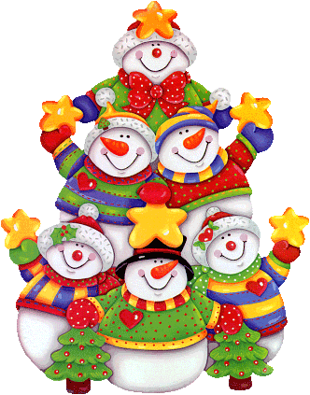
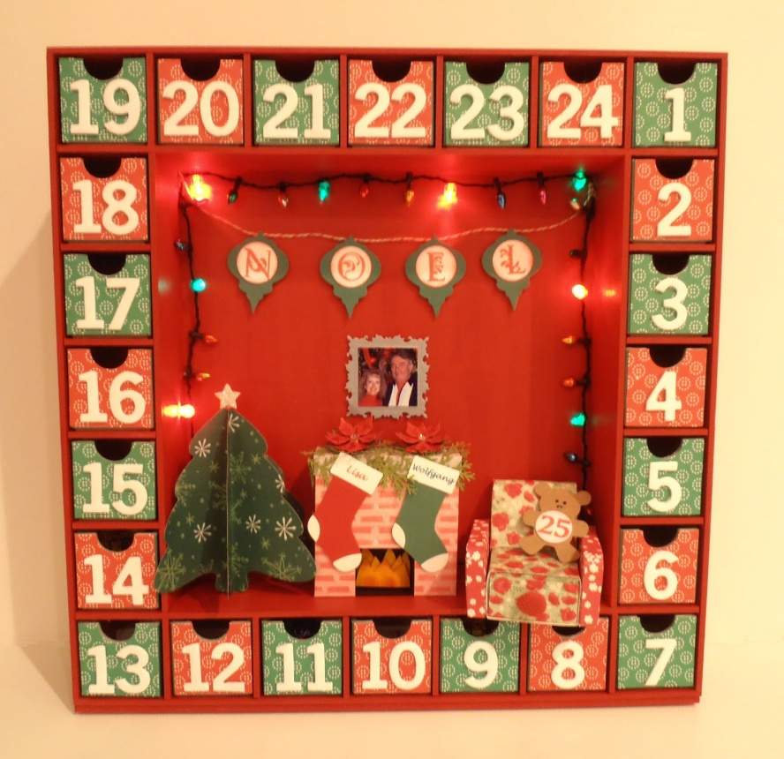
They hang the ADVENT CALENDAR on the wall. Everyday children open a window of the Calendar and eat a chocolate.

Slide 9
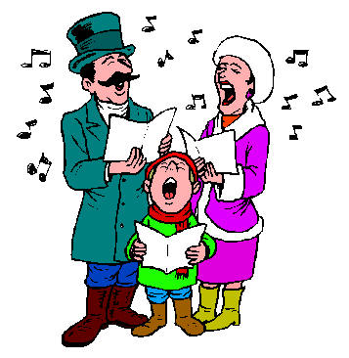
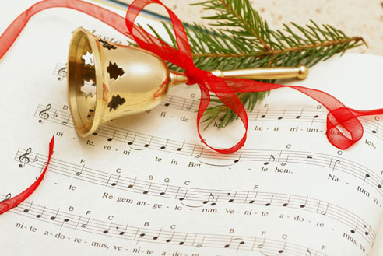
Christmas Carols are a British tradition.
They are songs about Christmas. The most popular are: JINGLE BELLS, WE WISH YOU A MERRY CHRISTMAS, SILENT NIGHT..

Slide 10
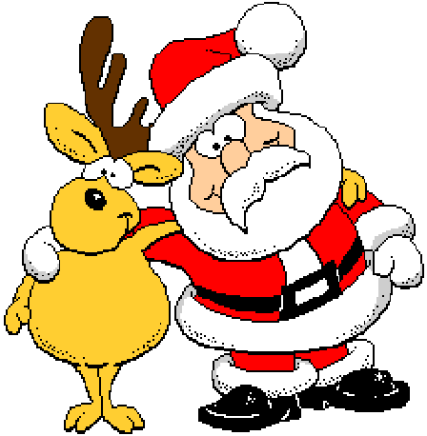
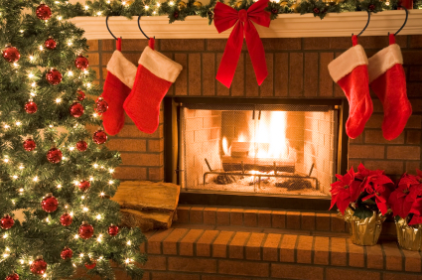
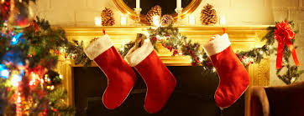
Children hang the stockings over the fireplace. Father Christmas puts the presents in the stockings.

Slide 11
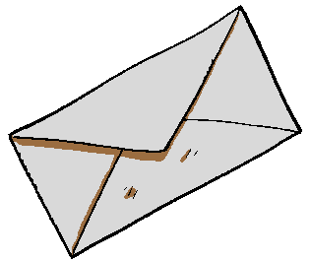
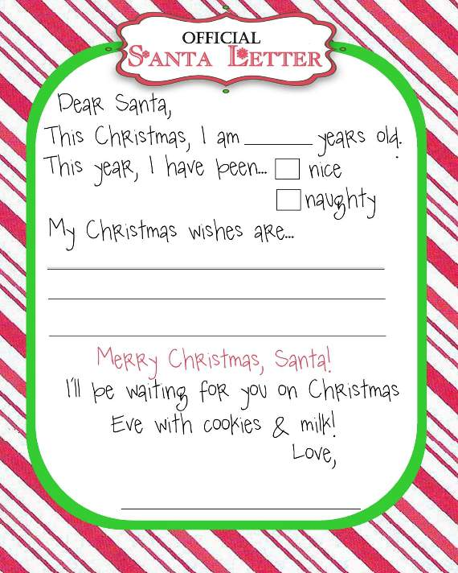
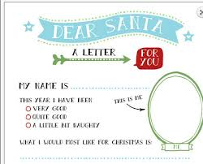
The children write the letters to Father Christmas

Slide 12
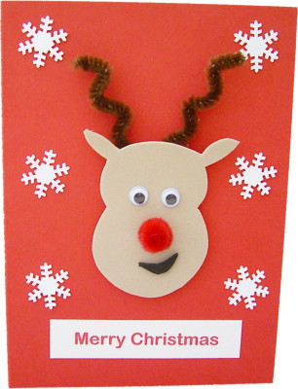
They write Christmas cards to their relatives and friends.

Slide 13
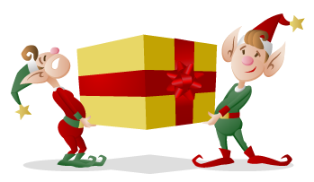
Father Christmas lives in the North Pole.
The elves prepare the presents for the children

Slide 14
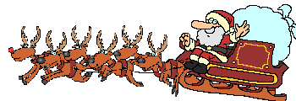
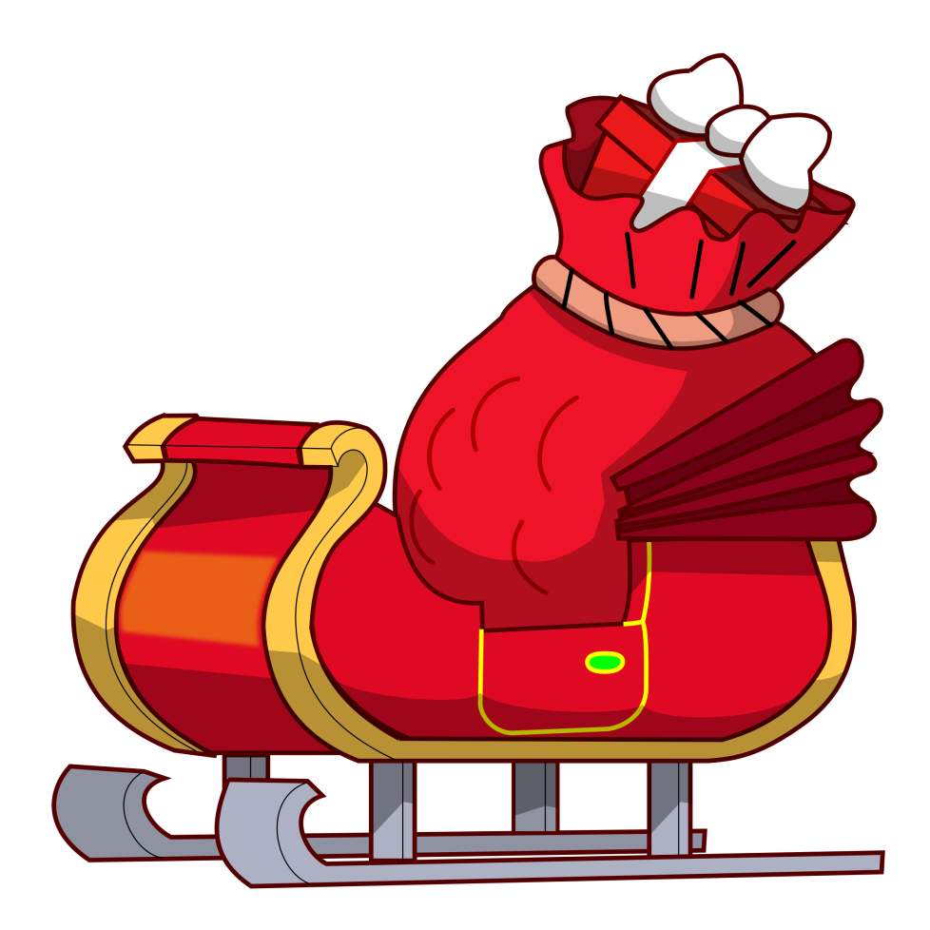
The elves put the presents on the sleigh

Slide 15
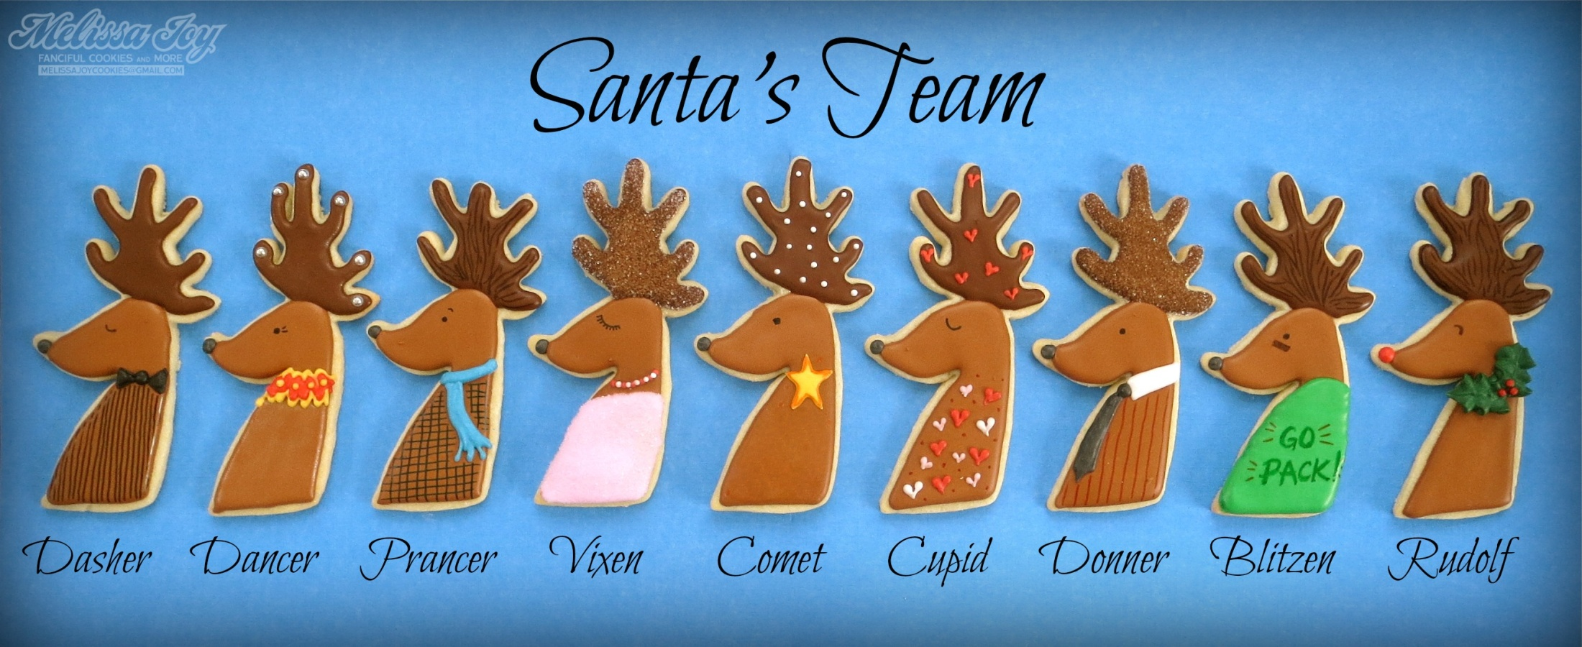
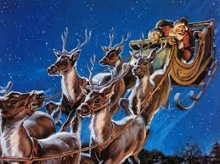
Father Christmas’ sleigh is pulled by 9 reindeers. Rudolf has got a red nose!

Slide 16
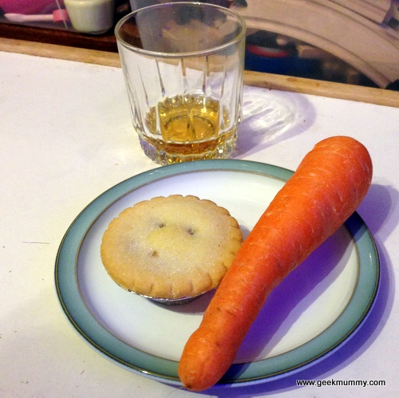
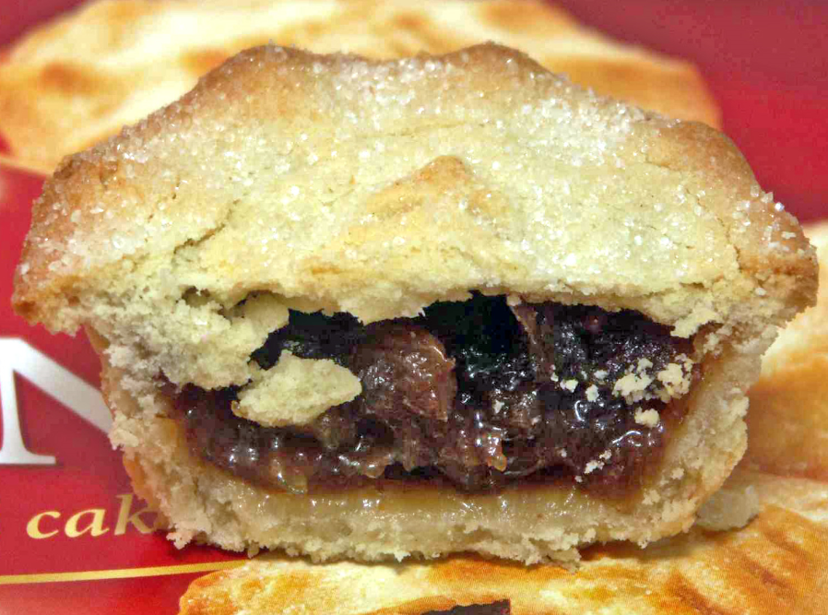
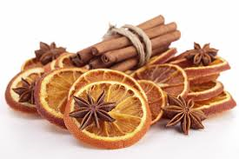
Before going to bed children leave a mince pie and sherry for Father Christmas and some carrots for his reindeer.
Mince pie is made with apples, raisin, oranges, candied fruit, spices like a cinnamon stick…

Slide 17
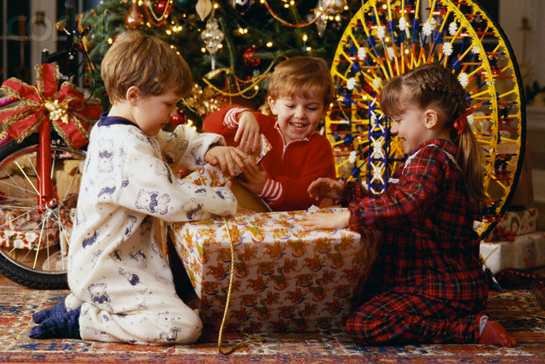
On Christmas day children open the presents

Slide 18
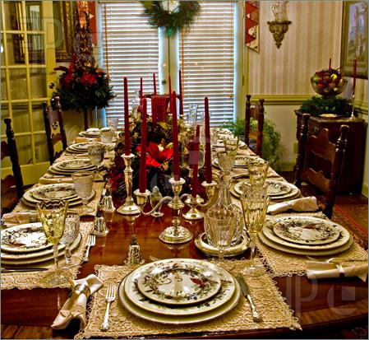
They have the Christmas dinner with their family and relatives.

Slide 19
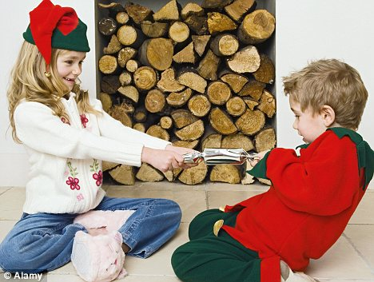
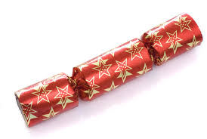
During the dinner they pull the crackers…

Slide 20
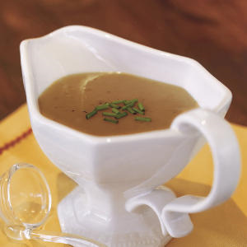
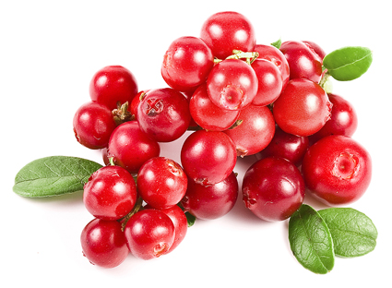
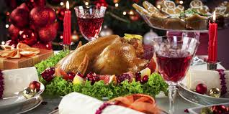
Traditional Christmas dinner is composed by:
Turkey with roast potatoes, brussels sprouts, carrots, peas with gravy sauce and cranberries.

Slide 21
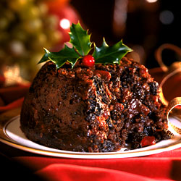
Another typical Christmas DESSERT is…Pudding
It is also called
plum pudding or
plum duff.
It is prepared with eggs, rum (liquor), candied fruit, almonds and spices

