Slide 1
S. Piero in Frassino “M.C. Zacchi Primary School”
Making friends Project
Year V
Teacher Maria Letizia Fani

Slide 3
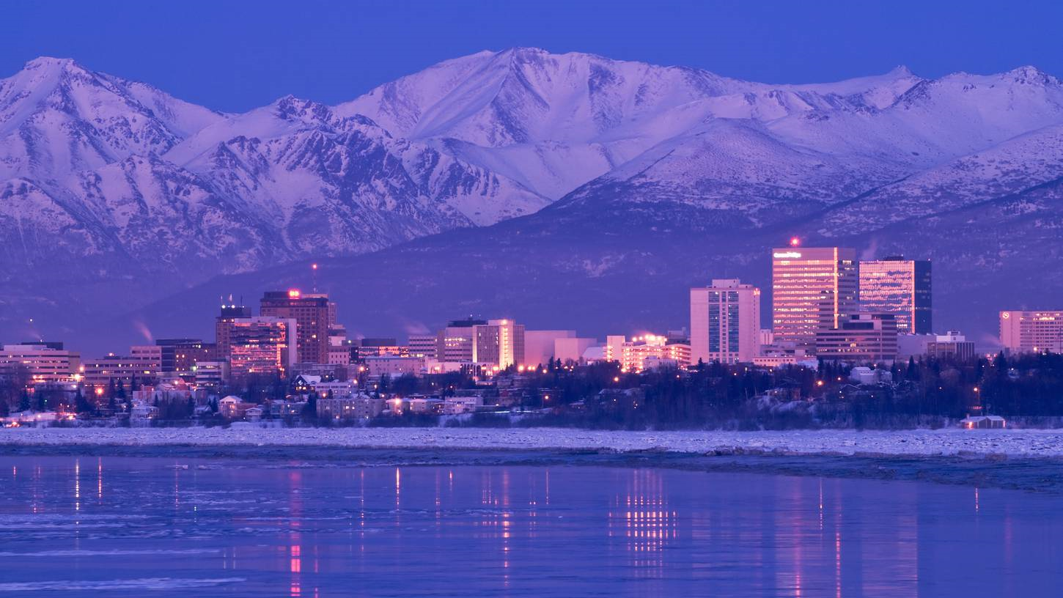
We will write to new friends very far from Italy. Where?
We found friends in Anchorage, the capital city of Alaska, USA

Slide 5
Start your letter or email message by:
The place where you are and the date:
S. Piero December the 06th 2022
The salutation:
Dear friend...
.
BODY OF THE LETTER
My name is Caterina Rossi.
I am from Italy, I live in Bibbiena,
a small village in Tuscany, near Arezzo.
I’m ten years old.
First of all introduce yourself:
Tell your full name (name+surname)
Where are you from?
Where do you live?
How old are you?

Slide 6
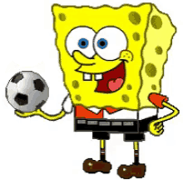
Go on talking about your interests, what you like or you don’t like.
Tell if you do any sports,
or what you usually do in your free time
In my free time I do hip hop dance on Tuesday afternoon and I go to the swimming pool on Saturday morning. On Sunday I sometimes go the cinema with my parents.
At the moment I’m following a Music course too.

Slide 7
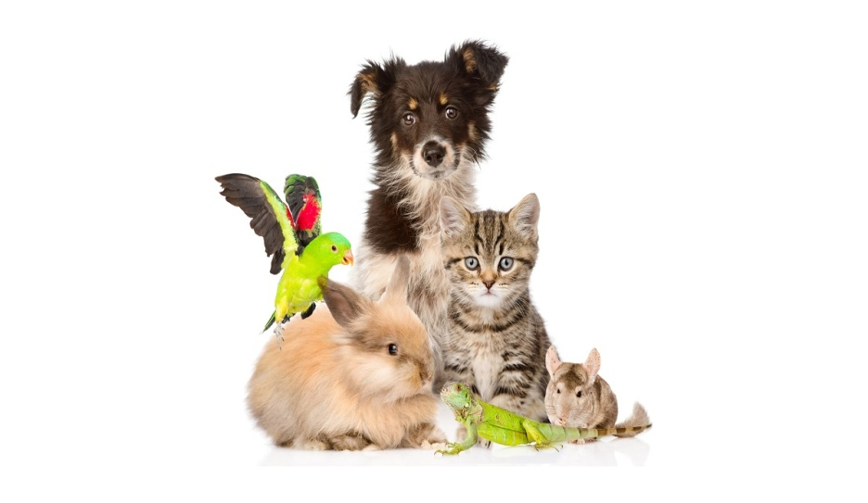
You can talk about your family.
Have you got any brothers or sisters? Or are you an only child?
Have you got any pets?
In my family there are four people.
I have got…
an elder brother,
a younger sister
I have got a cat. His name is Dino.
He is grey and brown.
It has got a long tail…

Slide 8
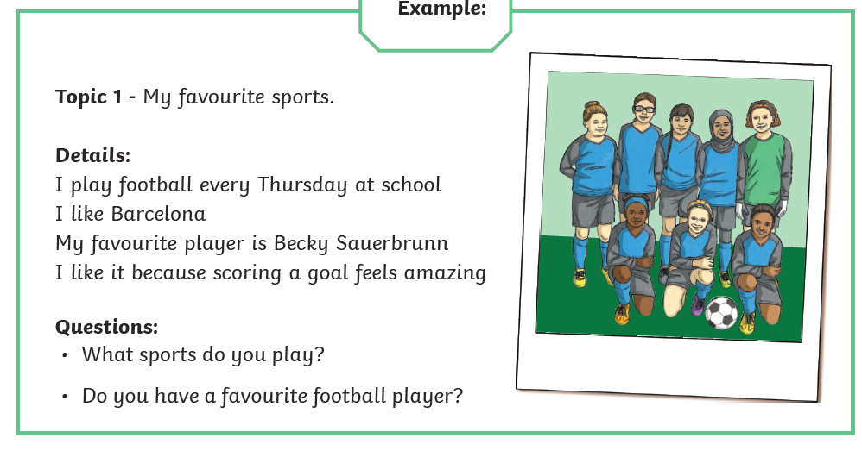
You can tell about your favourite sports, if you like football…

Slide 9
Talk about one of your friend, or your best friend
My best friend is Kevin.
He is short and fat. He is nice.
I like playing football with him.
We sometimes spend a lot of time
Talking about movies or videogames.
On Saturday evening we usually go
to the cinema together.
Talk about your school,
favourite school subject,
what don’t you like?
I am in year five at the Primary School in S. Piero in Frassino, a very small village near Arezzo, not far from Florence.
I go to school from 8 am to 5 pm, from Monday to Friday, it’s a full time school. I always have lunch at school with my friends at 1 o’ clock pm.
My favourite school subject is Art and I’m very good at Maths.
I also like Science but I’m not very good at P.E.

Slide 10
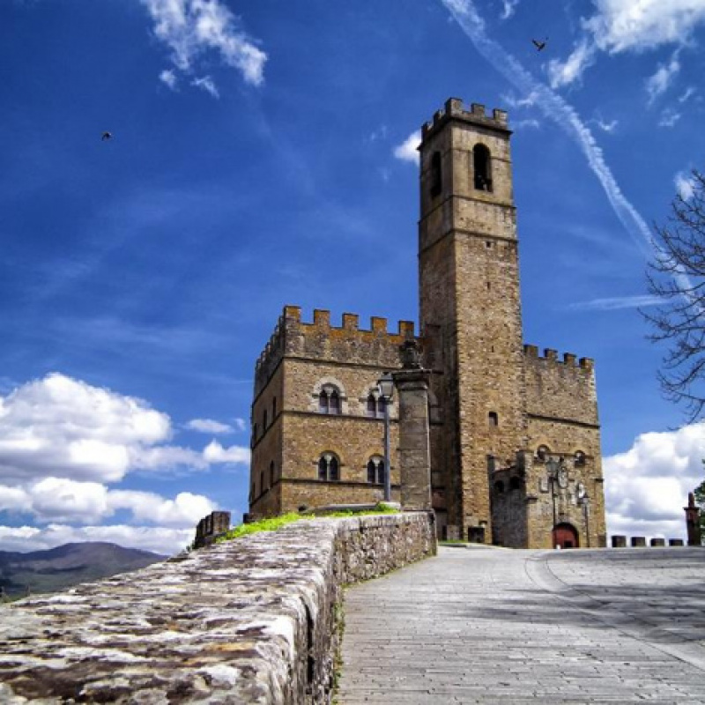
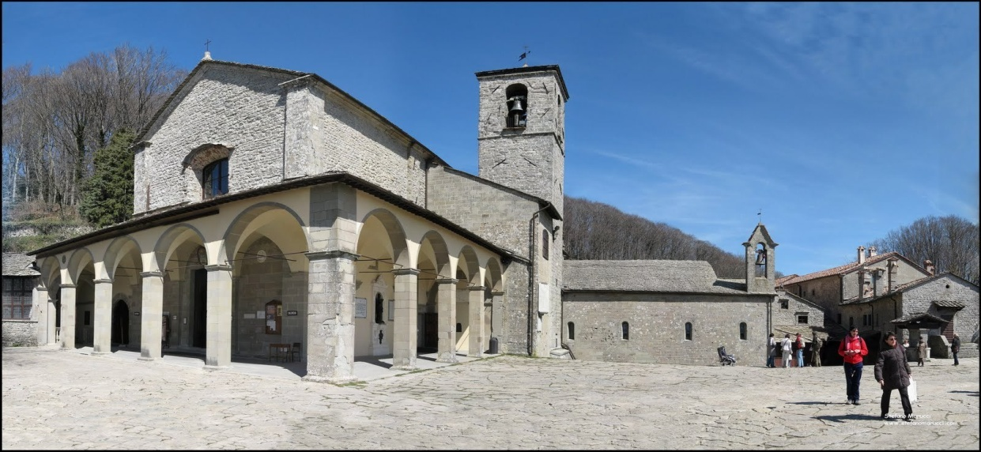
You can write other letters to talk about your country, Italy. You can add touristic information about Casentino valley.
You can insert photos or drawings. For example, you can talk about the medieval castle in Poppi, made by the Guidi family in the XII century.
Or you can tell about Saint Francis and Mount La Verna, or the monastery in Camaldoli and our beautiful forests in Casentino National Park.
Guidi family,
noble house

Slide 11
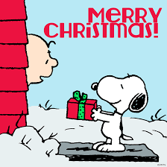
A stamp in the top right corner.
Dear Tom,
We are having lots of fun on holiday. Yesterday, we went to the beach. I made a huge sandcastle and ate lots of ice cream.
Today we went to a theme park. We went on lots of scary rides but it was lots of fun!
Tomorrow we are going to go on a boat trip. I hope we see dolphins!
From Anna x
Lines for writing the address.
Tom Hill
You could also send a post card
Or season greetings
for Christmas,
or Easter
123 High Street
Clifftop Town
HT13 4TW
Space to write about your holiday – what you have done and what you will be doing.
The name and address for who you are sending the postcard to.

Slide 12
Example of a Postcard
Dear Daisy
How are you? We are at the seaside!
It has been like a dream and very nice weather too. What a treat! We have had ice cream every day and my Mum said maybe I can go on a donkey tomorrow and she will teach me to swim, what a week it’s been! We’ve spent lots of money as it isn’t cheap and our feet are tired but it’s been worth it.
Lots of love and see you soon.
May xx
Daisy McClean
3 Sheaf Street
Milton Keynes
MK3 3ET
Tell about one
of your holidays

Slide 13
Remember to be precise in your hadwriting,
use the script font and revise your grammar.
Penpalling can be fun!

Slide 14
I’m looking forward to hearing you soon,
Love,
Caterina
Finish off your letter using an appropriate ending, for example:
‘Love from’ or ‘See you soon’,
Write me soon,
followed by your signature.
Before your name or final signature, add any extra information you would like to tell them.
PS = Post Scriptum....
“I’m sending you a nice sticker, or one of my photo!”

