Slide 1
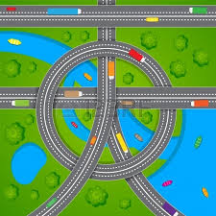
S. Piero in Frassino Primary School
ROAD SAFETY EDUCATION
Teacher
Maria Letizia Fani

Slide 2
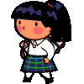
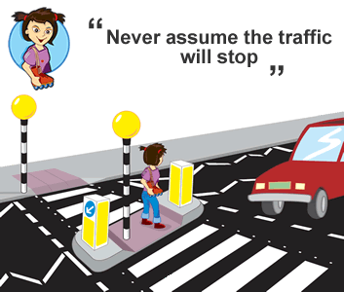
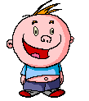
When we walk along the street in a city or in a village, we are pedestrians; especially when we are on the zebra crossing…
Be careful!
Watch your steps!
Look to the right
Look to the left!

Slide 3
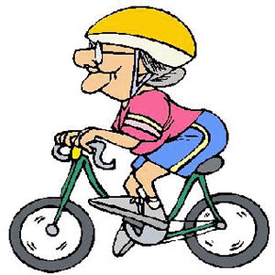
If you ride the bike, put on the helmet
If you drive a car
Be very careful!!

Slide 4
Respect the road signs and all indications!
First of all consider the shapes:
A triangle means danger
A circle is a prohibition
A square is an indication

Slide 5
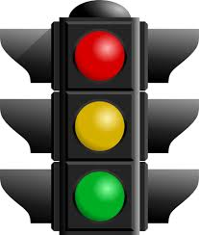
Now learn all the most important signs!!
Can you understand the traffic light?
STOP!
WAIT, SLOW DOWN
GO

Slide 6
SIGNS OF DANGER
YOU MUST SLOW DOWN,
OR STOP
SLOW DOWN BECAUSE THERE IS NEAR YOU, OR THERE COULD BE:
YOU HAVEN’T THE RIGHT OF WAY
PEDESTRIANS CROSSING
CYCLING LANE
ANIMALS CROSSING
RAIL CROSSING
POSSIBILE ICE ON THE ROAD
A TRAFFIC LIGHT
UNEVEN ROAD

Slide 7
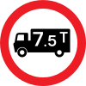
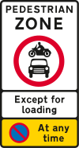
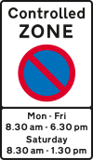
SIGNS OF PROHIBITION
NO ACCESS
THERE IS A LIMIT OF SPEED
IT’S IMPOSSIBLE TO ENTER BY CAR
NO LEFT TURN
ONE WAY
NO PARKING
YOU CAN’T STOP

Slide 8
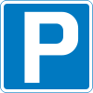
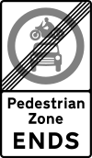
INDICATIONS
THE MOTORWAY ENDS
YOU ARE NEAR THE HIGHWAY BEGINNING
ROAD WORKS
CHANGE DIRECTION
CAR PARKING
ROAD WITHOUT EXIT
NOW YOU CAN ENTER
BY CAR

Slide 9
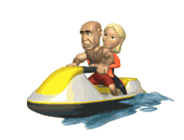
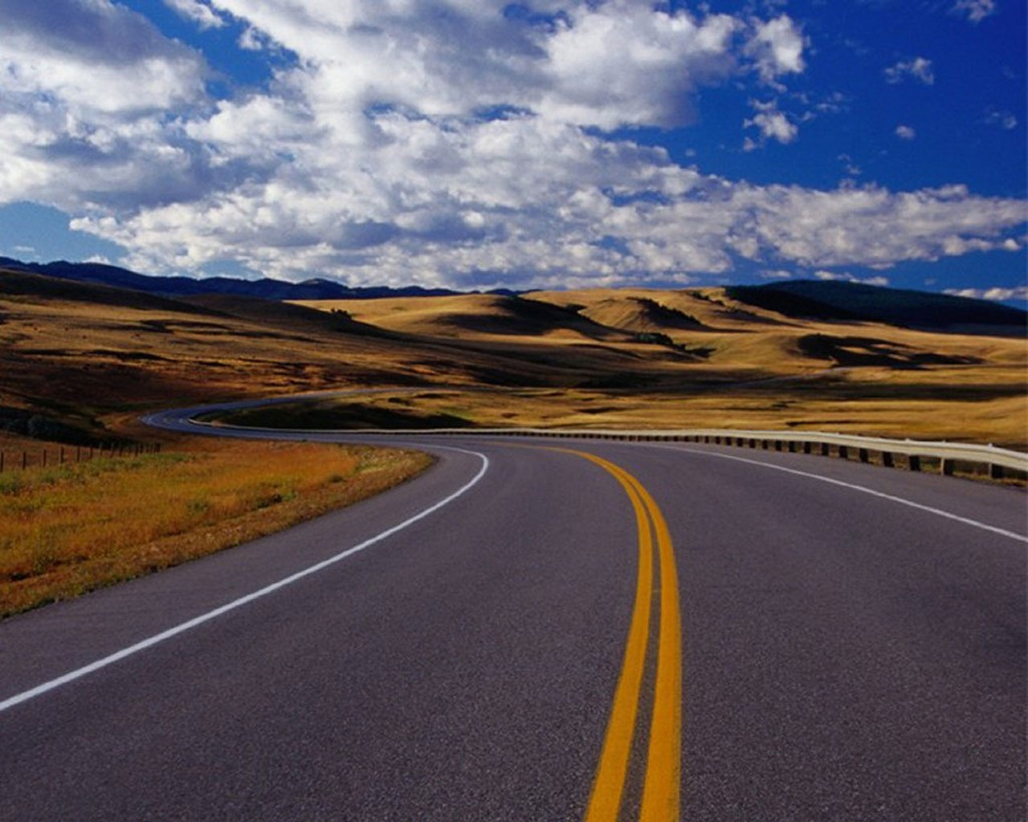
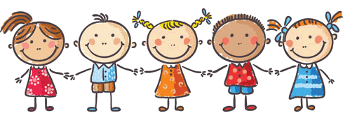
REMEMBER! It’s not important to go fast, it’s important to arrive
You travel better if you aren’t alone!
Yes, it’s true!

Slide 10
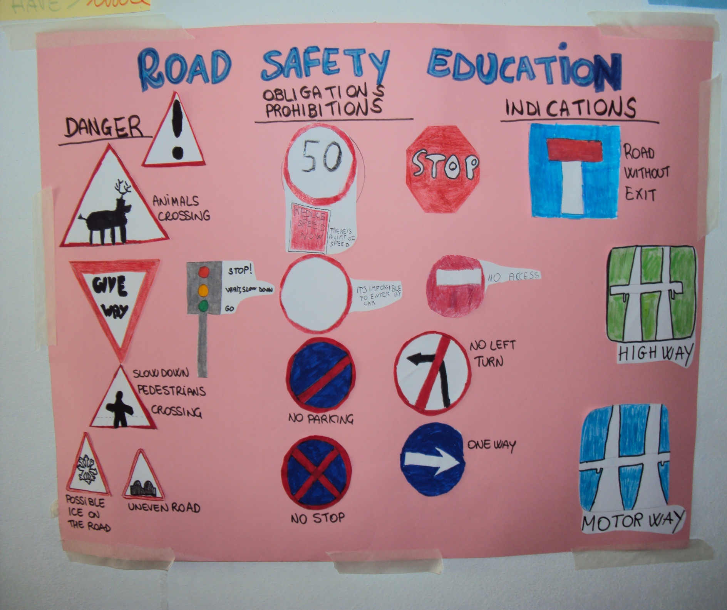
Road safety education
A class poster

