Slide 1
A world of colours
Can you name all the colours
in English?
Teacher M.Letizia Fani
S. Piero in Frassino Primary School
Year II

Slide 2
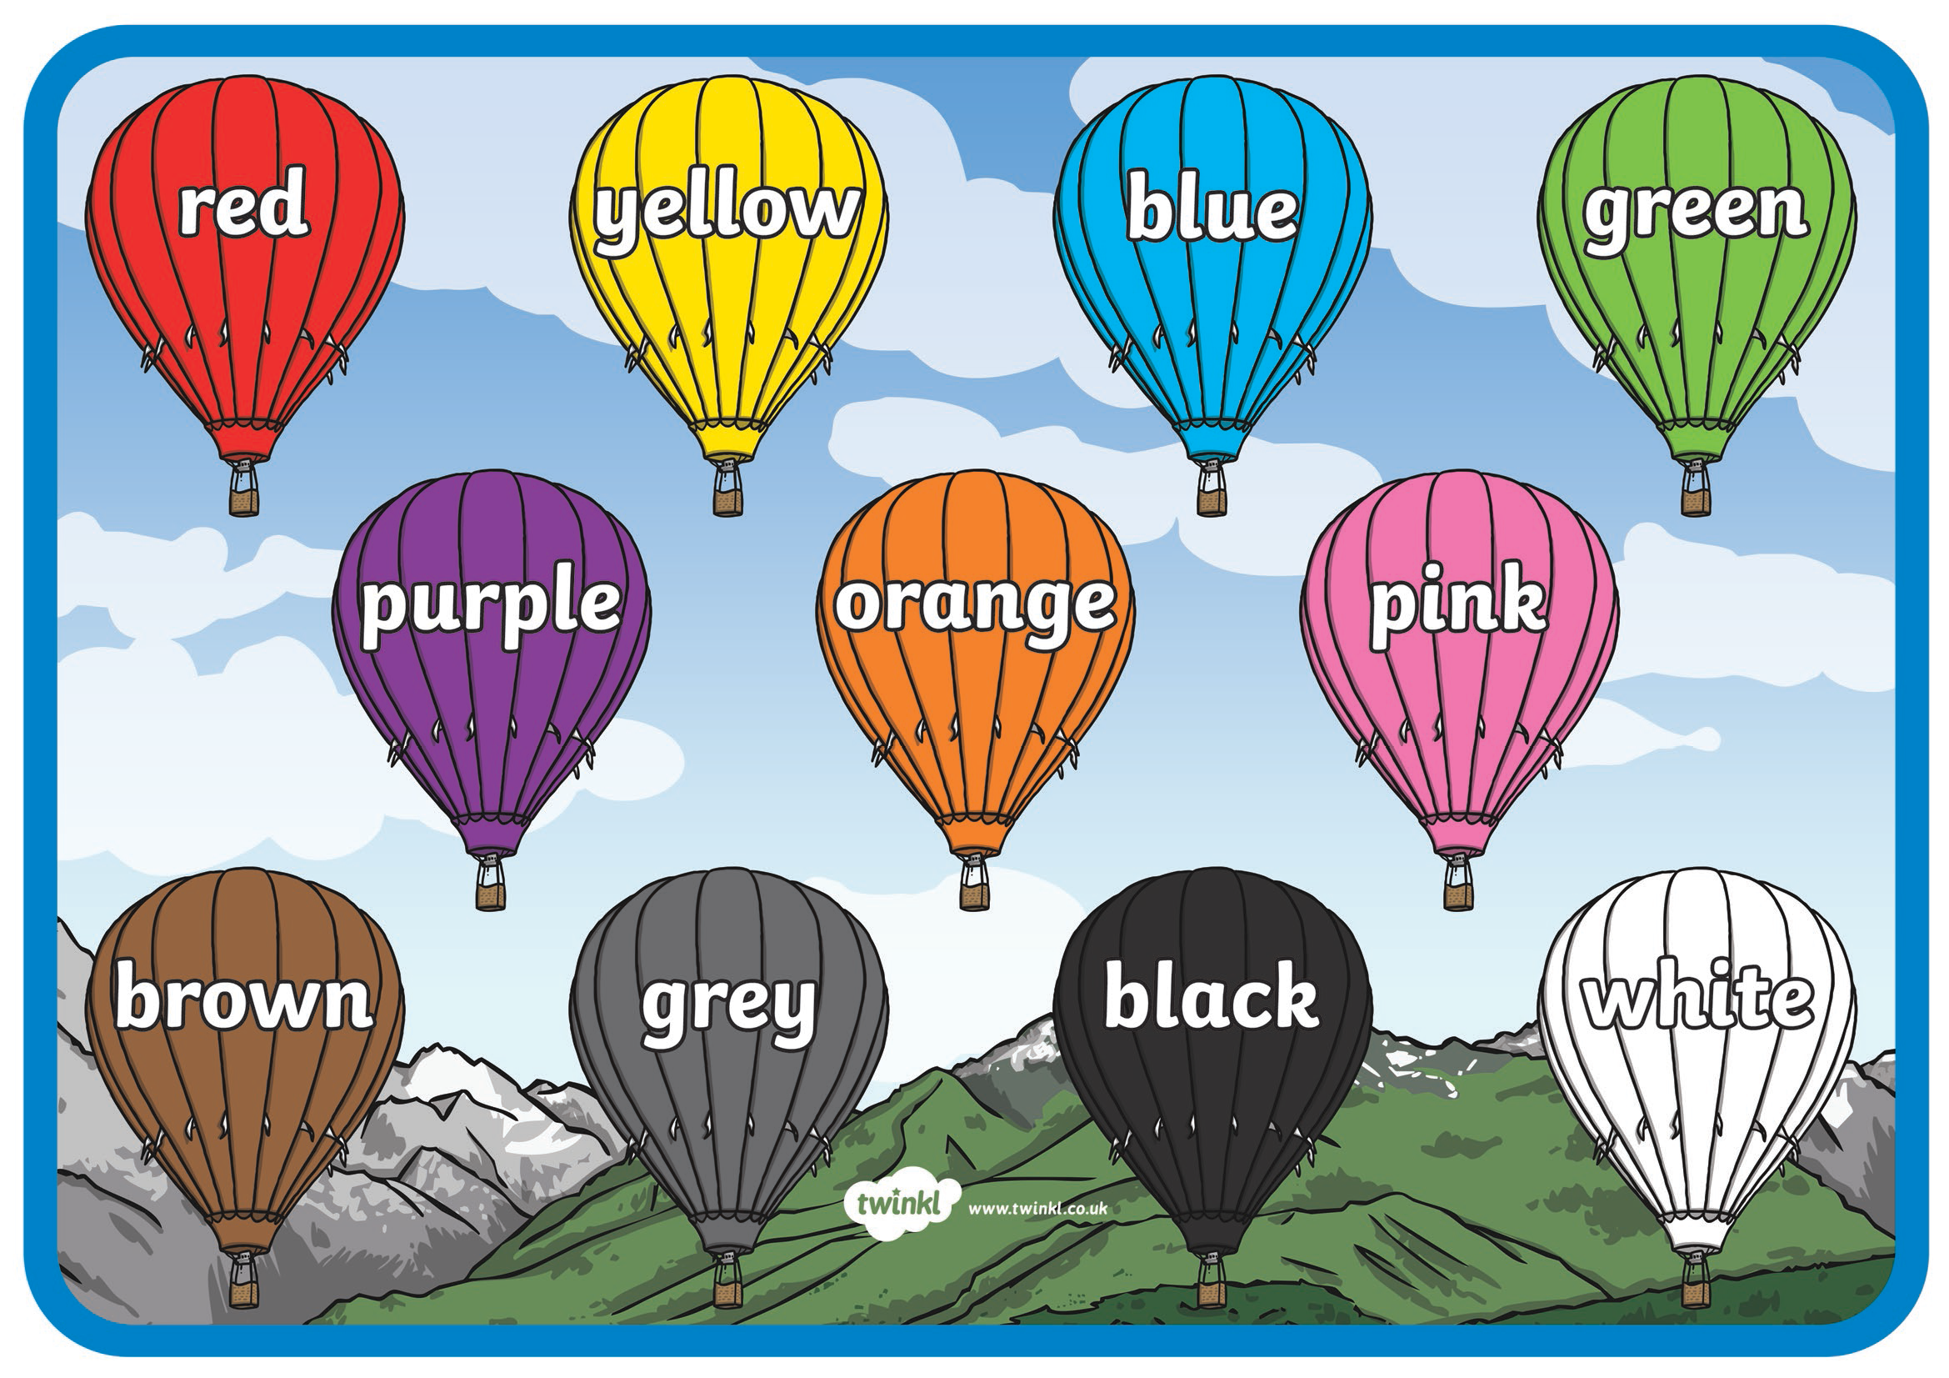
Listen and repeat the colours’ names

Slide 3
https://learnenglishteens.britishcouncil.org/vocabulary/a1-a2-vocabulary/colours
https://youtu.be/qhOTU8_1Af4
Remember:
Light = chiaro
Dark= scuro
Light blue
Blue

Slide 4
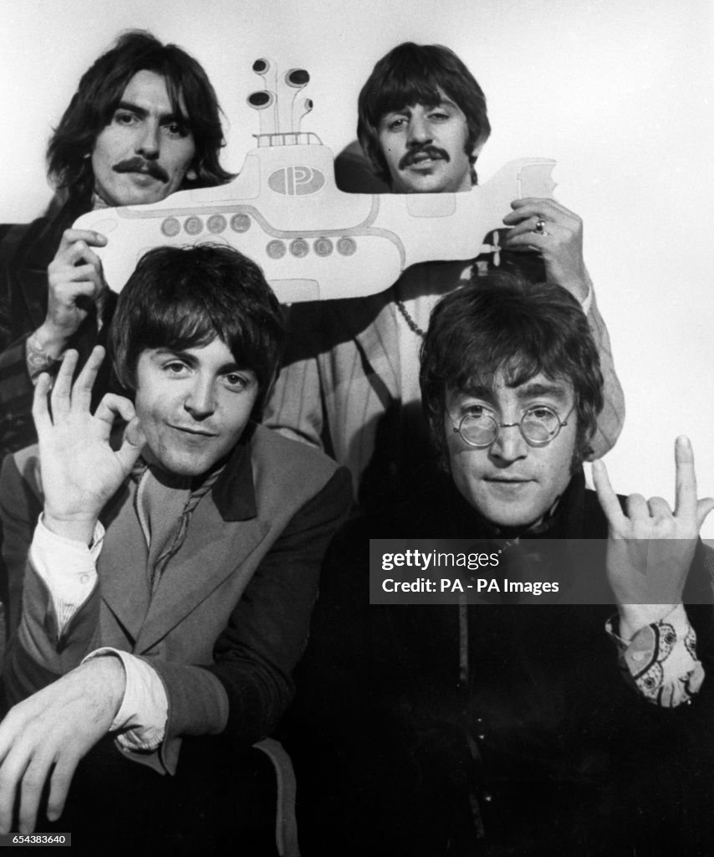
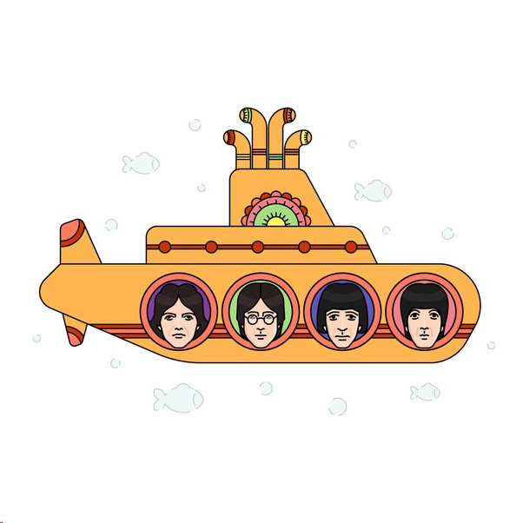
In the town where I was born Lived a man who sailed to sea And he told us of his life In the land of submarines
So we sailed on to the sun 'Til we found a sea of green And we lived beneath the waves In our yellow submarine
We all live in a yellow submarine Yellow submarine, yellow submarine We all live in a yellow submarine Yellow submarine, yellow submarine
And our friends are all aboard Many more of them live next door And the band begins to play
We all live in a yellow submarine Yellow submarine, yellow submarine We all live in a yellow submarine Yellow submarine, yellow submarine (…)
Yellow Submarine by The Beatles
Do you like our songs?

Slide 5
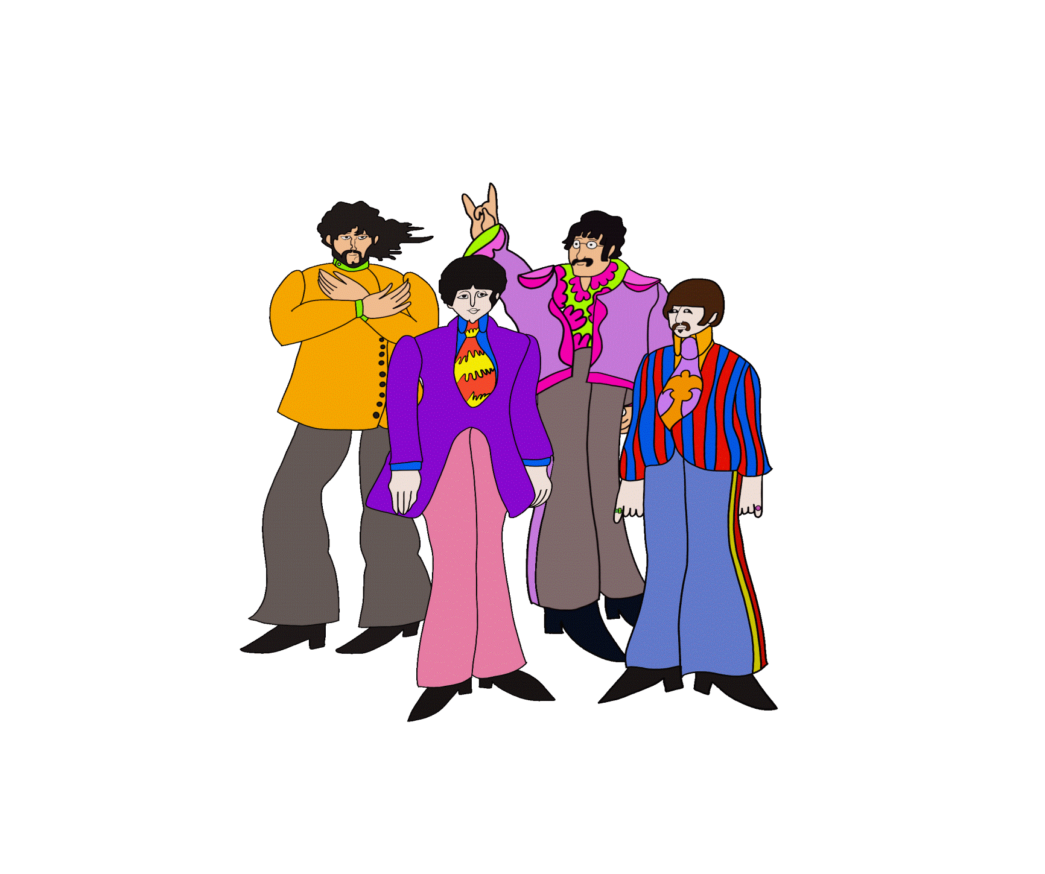
Be careful!
Primary colours can be mixed
to form secondary ones. Can you solve these?
+
= ?
+
= ?
+
= ?
+
= ?
+
= ?

Slide 6
To do a sketch = fare uno schizzo
To draw = disegnare
To paint = dipingere
Brush
Pencil
Crayons
Felt tips
What’s the difference between
PORTRAIT
and
SELF PORTRAIT?

Slide 7
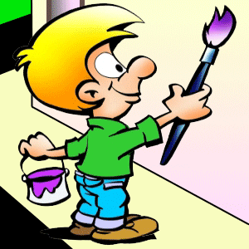
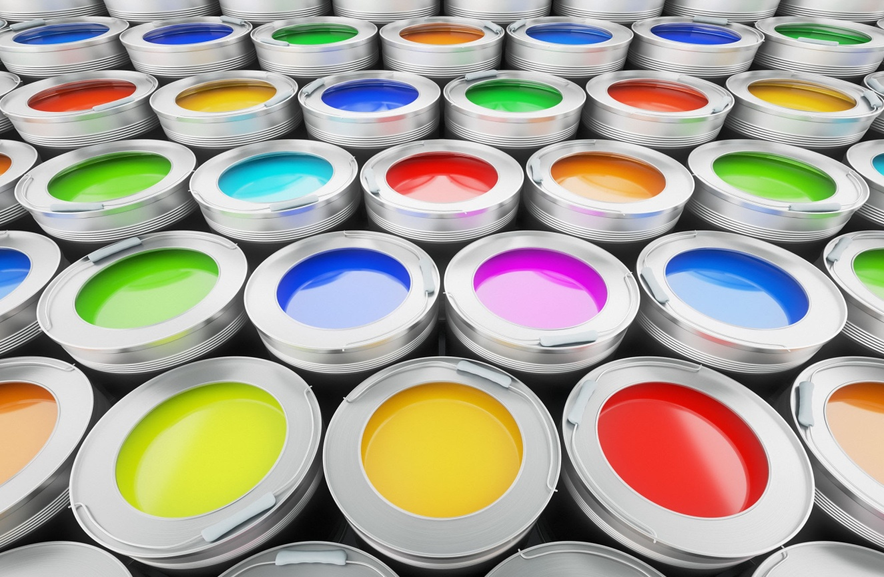
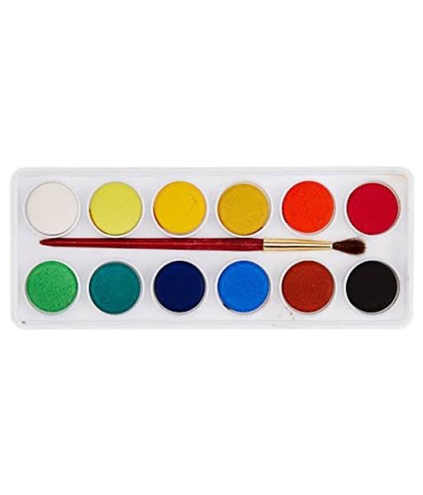
This is a painter's canvas:
he has got many paints
An artist can also use water colours

Slide 8
Well done!
You are true artists!

