Slide 1
The Very Hungry Caterpillar.
By Eric Carle
Teacher: M.Letizia Fani

Slide 2
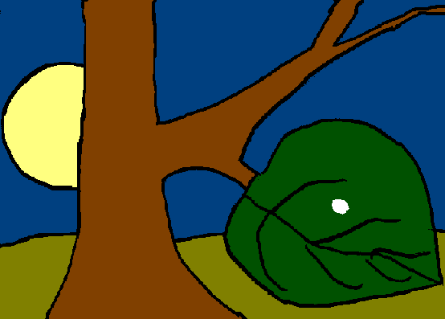
In the light of the moon a little egg lay on a leaf.

Slide 3
One Sunday morning the warm sun came up and pop! Out of the egg came a tiny and very hungry caterpillar.

Slide 4
He started to look for some food.
I’m hungry!

Slide 5
On Monday he ate through one apple. But he was still hungry.
I’m still hungry!

Slide 6
On Tuesday he ate through two pears, but he was still hungry.
I’m still hungry!

Slide 7
On Wednesday he ate through three plums, but he was still hungry.
I’m still hungry!

Slide 8
On Thursday he ate through four strawberries, but he was still hungry.
I’m still hungry!

Slide 9
On Friday he ate through five oranges, but he was still hungry.
I’m still hungry!

Slide 10
On Saturday he ate through…..
I’m ill!
That night he had stomach-ache!

Slide 11
The next day was Sunday again. The caterpillar ate through one nice green leaf, and after that he felt much better.

Slide 12
Now he wasn’t hungry anymore- and he wasn’t a little caterpillar any more.
He was a big, fat caterpillar.

Slide 13
He built a small house, called a cocoon, around himself. He stayed inside for more than two weeks.
Then he nibbled a hole in the cocoon, pushed his way out ………

Slide 14
He was a beautiful butterfly!

Slide 15
HOW MANY FRUITS IN TOTAL?
CAN YOU SOLVE THE PROBLEM?
+
+
+
+
HOW CAN YOU CALCULATE?
WRITE ON THE BLACKBOARD THE OPERATION…

Slide 16
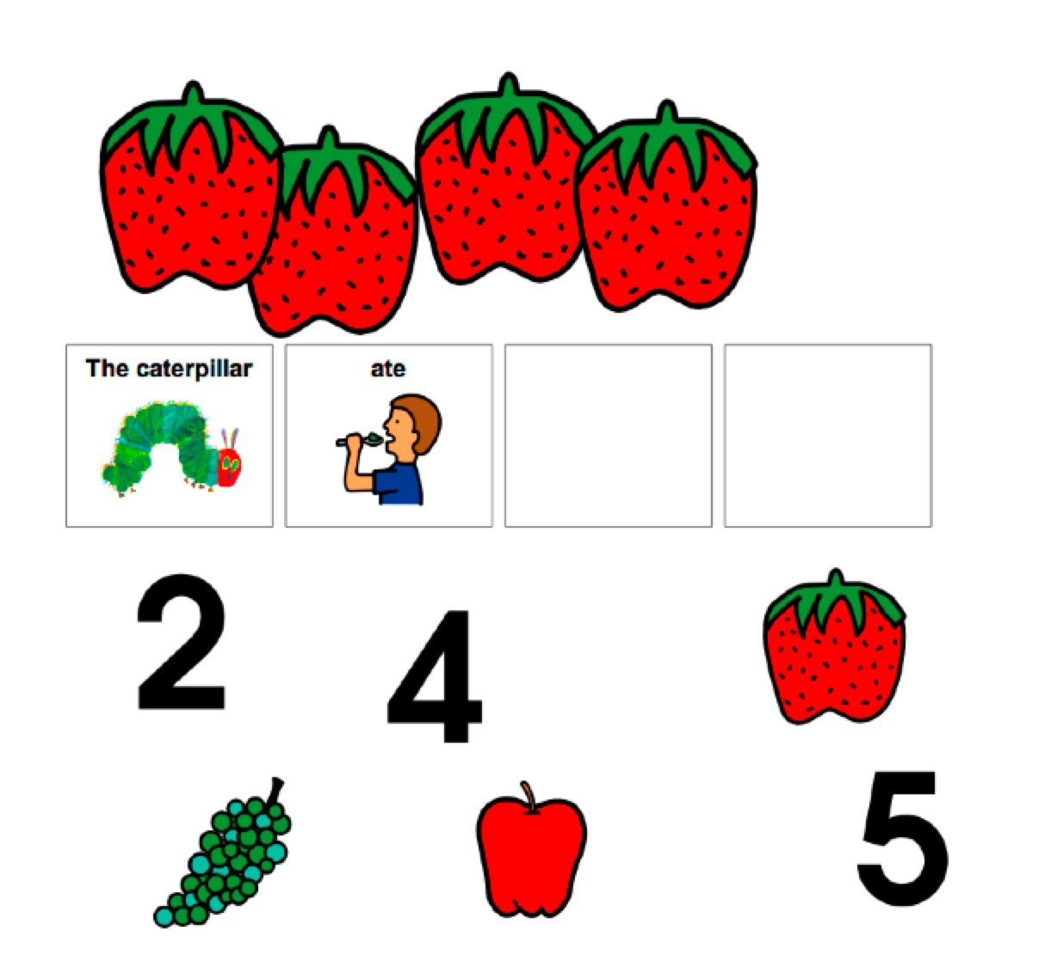
POINT TO THE RIGHT NUMBER

