Slide 1


Istituto Comprensivo Statale
“XIII Aprile 1944”
Via della Repubblica – Soci (AR)
Primary school “E. Perodi” - Soci
Classes: V A and V B
S.Y. 2018-2019

Slide 2

GEOGRAPHY - ENGLISH
“WALKING
IN THE
WORLD”

Slide 3
C.L.I.L. “WALKING IN THE WORLD” PRIMARY SCHOOL OF SOCI - CLASSES VA- VB SCHOOL YEAR 2018- 2019
CONTENT | COGNITION | CULTURE | COMMUNICATION
THE CONTENT OF THE DISCIPLINE IS: semplified sometimes anticipated in italian there is frequent repetition there is frequent renforcement sometimes explanation in italian of a word or a sentence Discussion and presentation of the new vocabulary through pictures. In the first step presentation of our planet through the globe: «Children, this is our planet, the Earth, repeat… Earth…. “… You can see the coloured parts…they are the continents….How many continents can you see? Yes they are 5 or 7 according to expert…” Discussion in italian about the number of continents. Continents and Oceans Children point on the globe and ask each other the name of a continent or of an ocean accordingly to the order given by the leader. Find pictures and information about the monuments. Write a short description. Find on the globe famous cities and monuments through games, i.e. “Put the monuments in the correct position on the map”. | Language aims Structure: To have Do you like…? Past tens of “TO BE” How was the …………built? Why was the …….. built? How big is it? How long did it take to build it? Geography Vocabulary Understand the meaning of new words from the context. Speaking: use new words and structures Final CLIL test. | Use Internet for watching some videos. Use Internet for finding information about the Hearth and the main monuments of the world. Visit the “Colosseum” during a trip in Rome. | Use a language that is accessible to the class, consider special needs. Improve their language skills. Learn some new words (geographic vocabulary). Videos to learn properly. Memorize / Remember geographic items. Frontal lessons. Pair work. Group work.

Slide 4
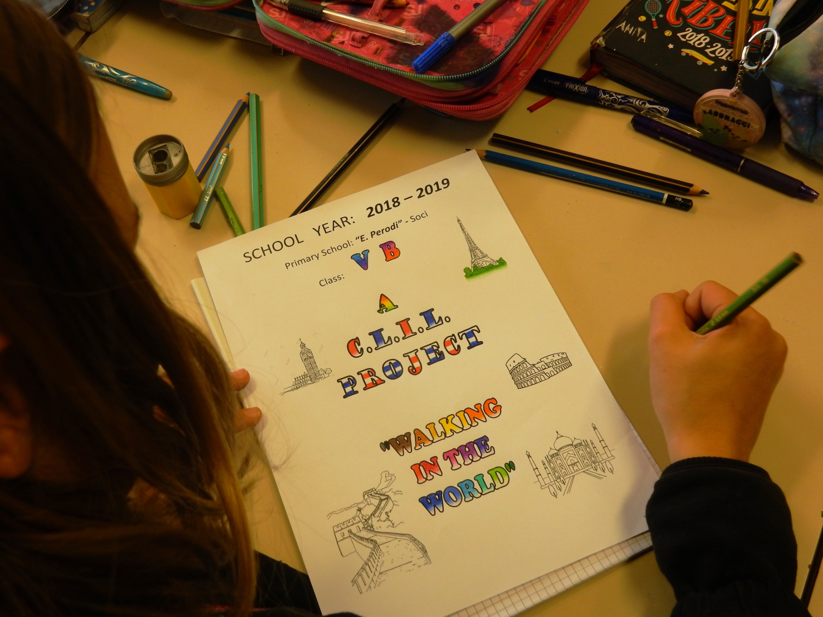

Slide 5
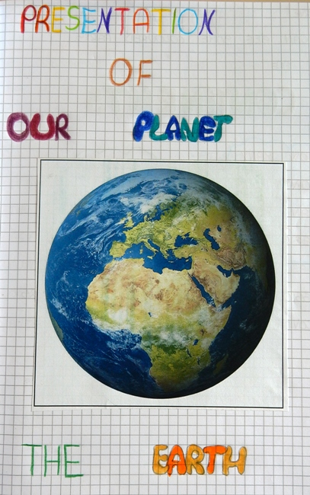
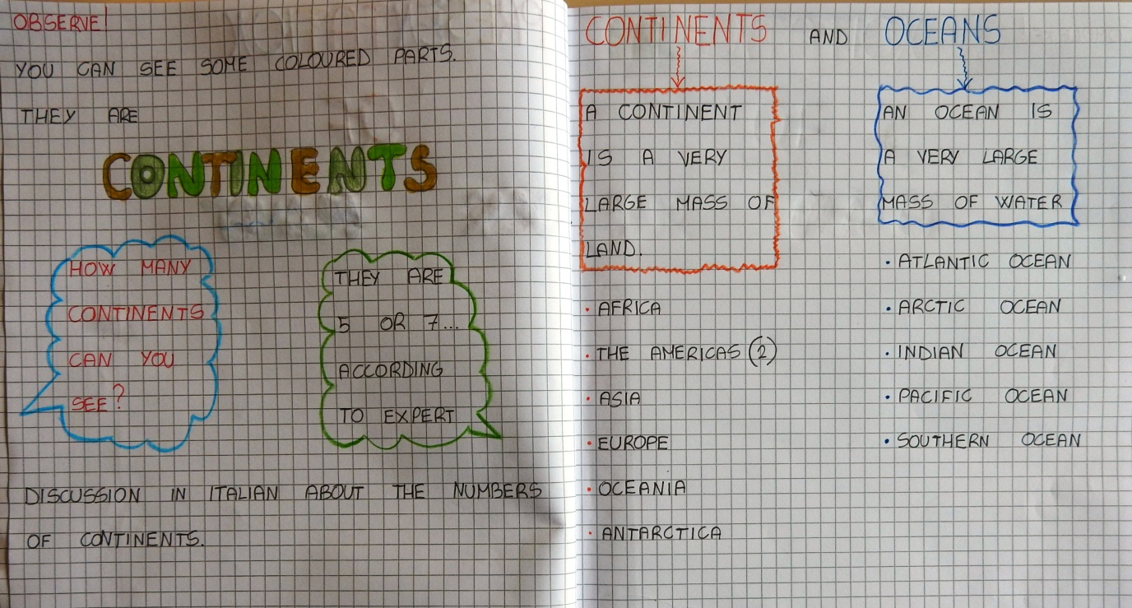
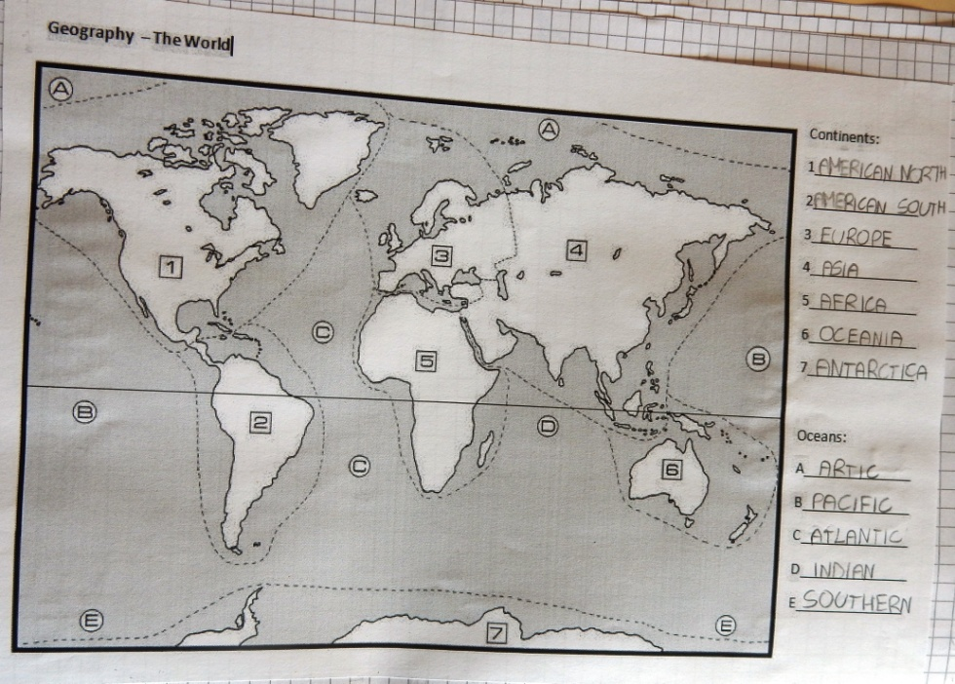

Slide 6
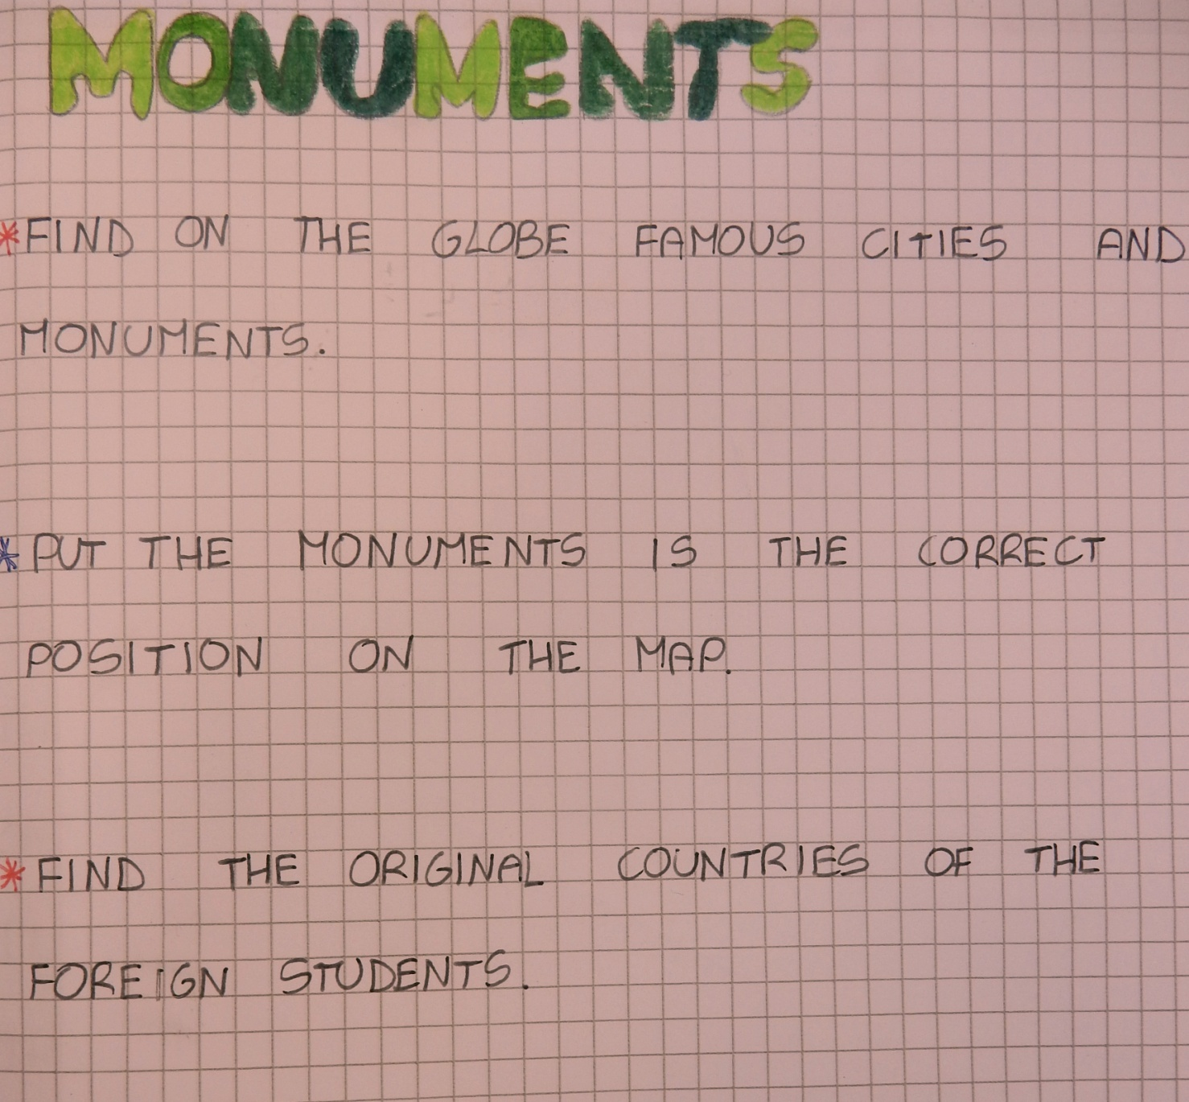

Slide 7
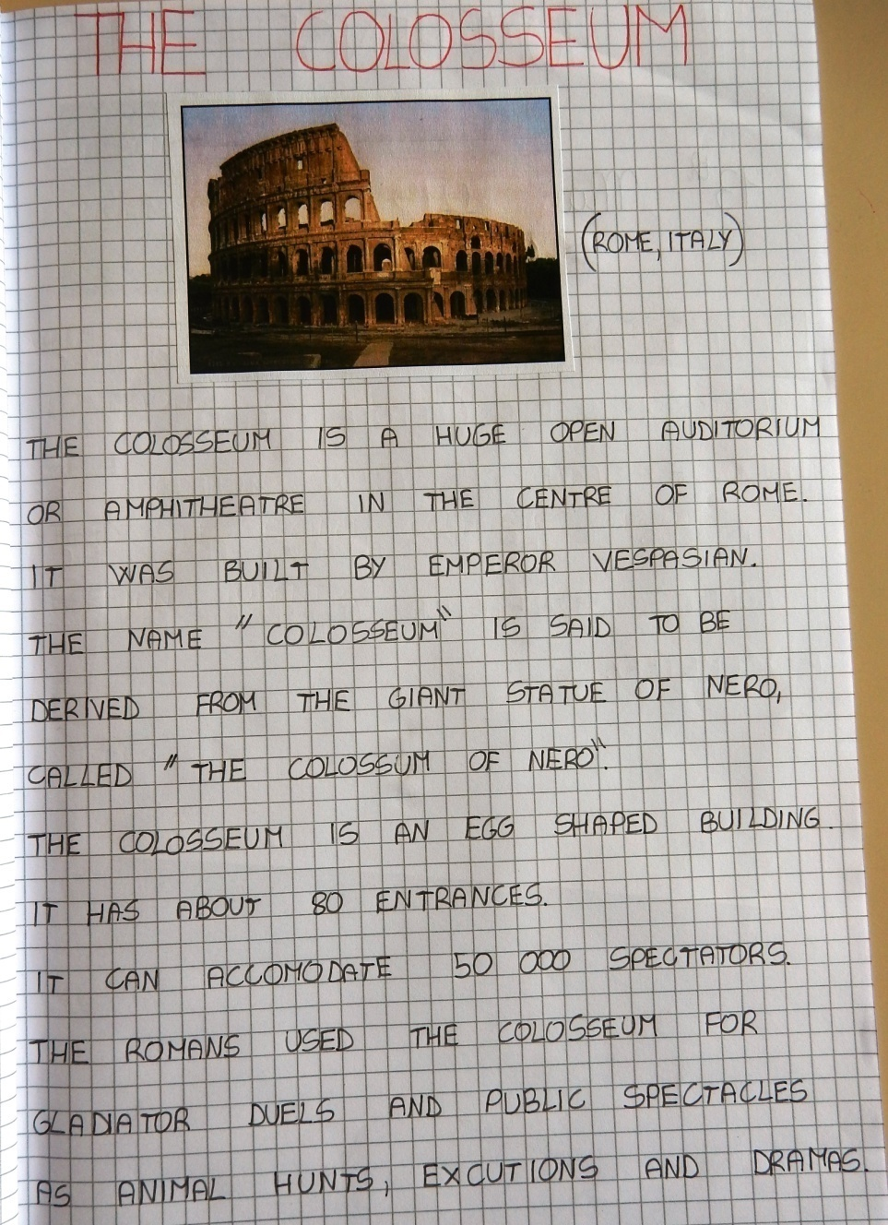
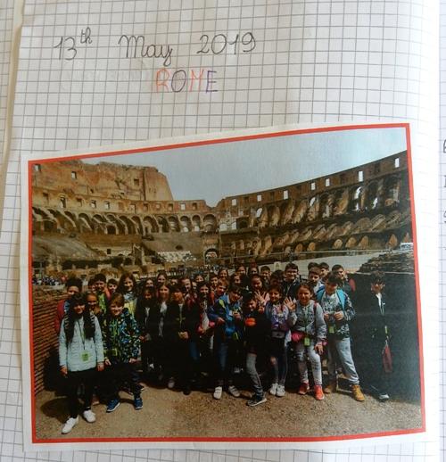
Find pictures
and information
about the monuments.
Visit the Colosseum.

Slide 8
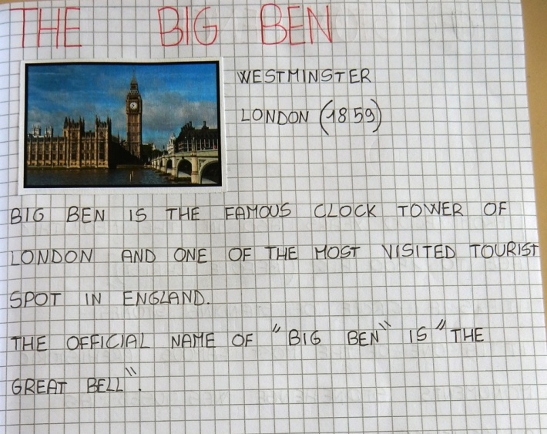
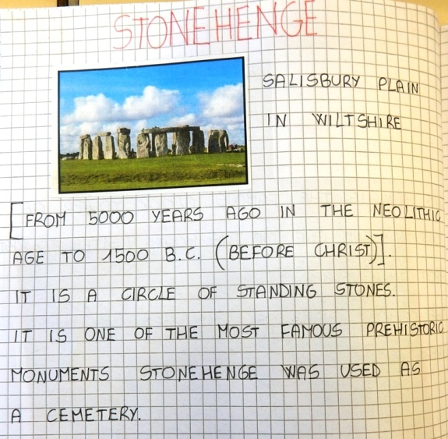
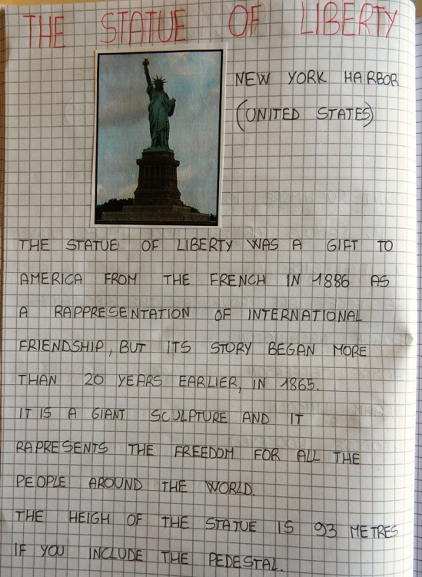
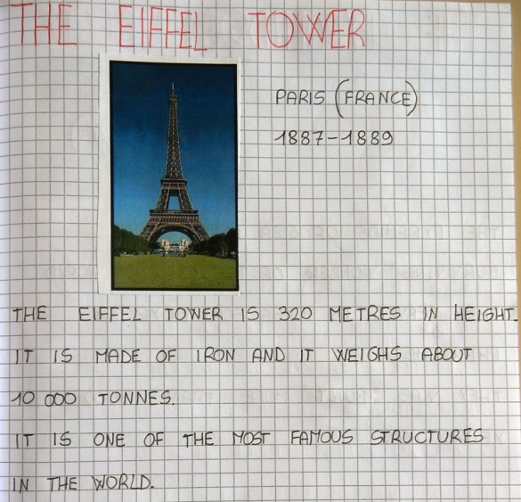
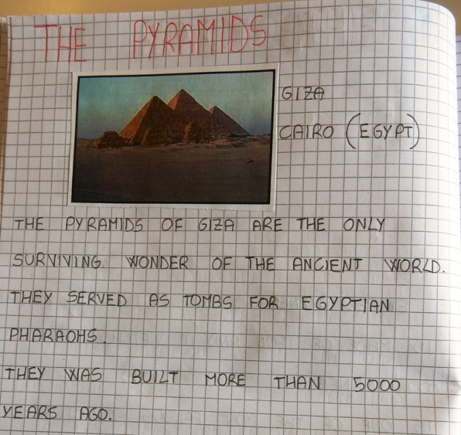
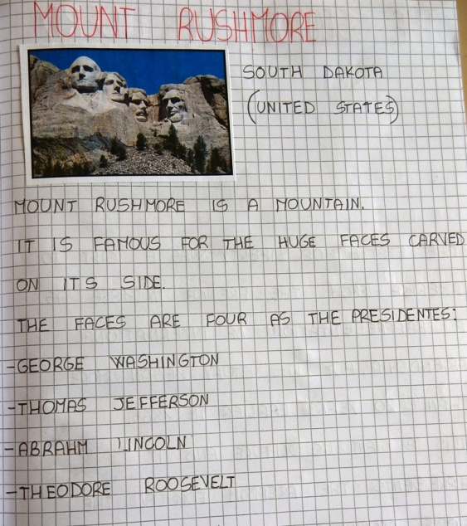
Find pictures
and information
about the monuments!

Slide 9
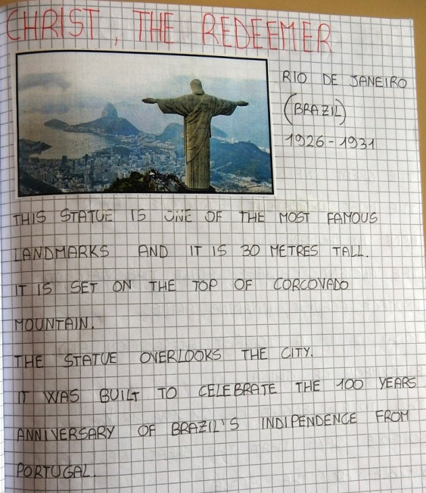
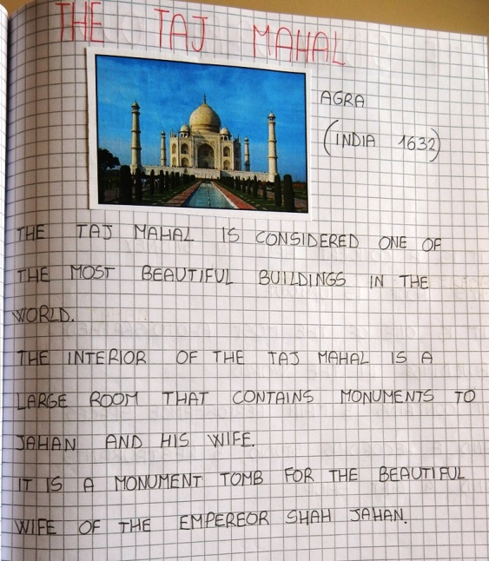
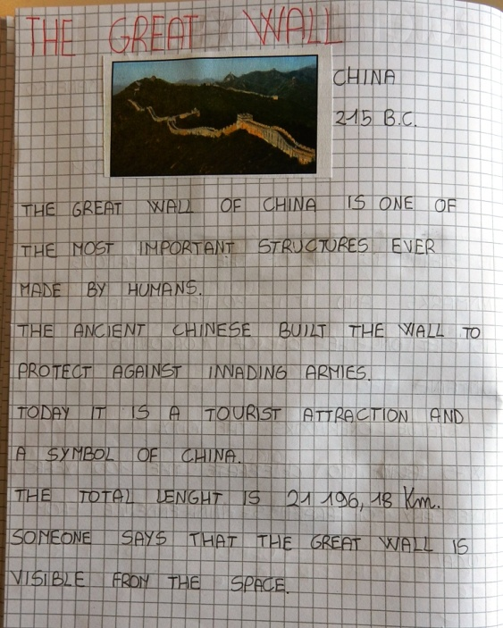
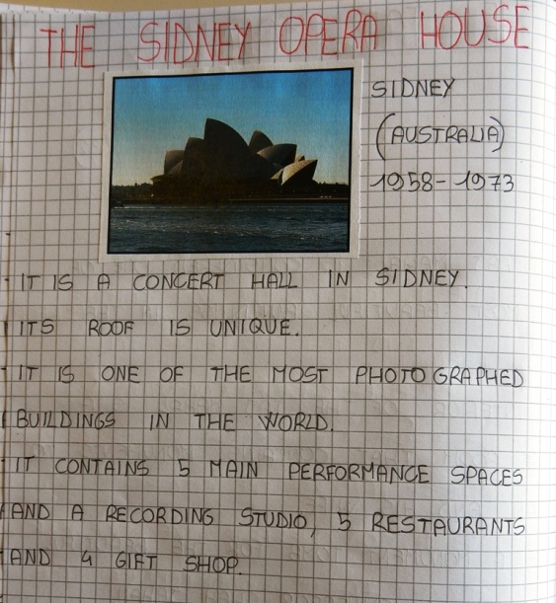
Find pictures
and information
about the monuments!

Slide 10
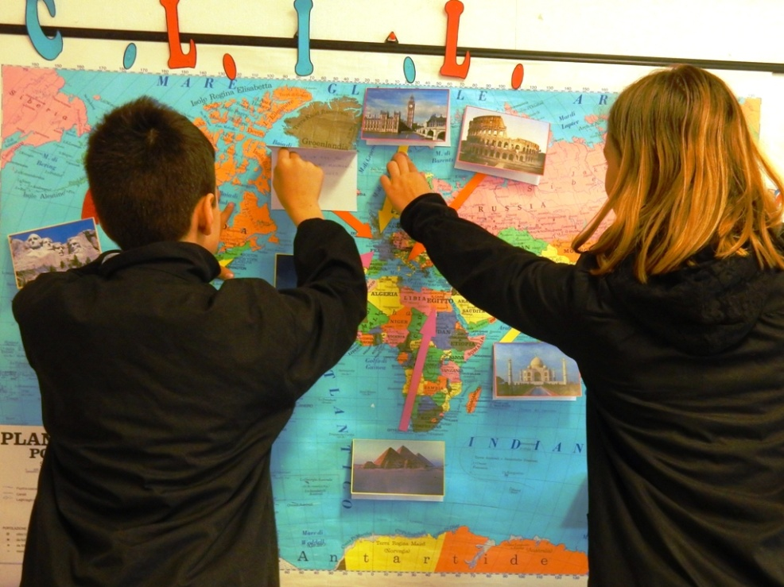
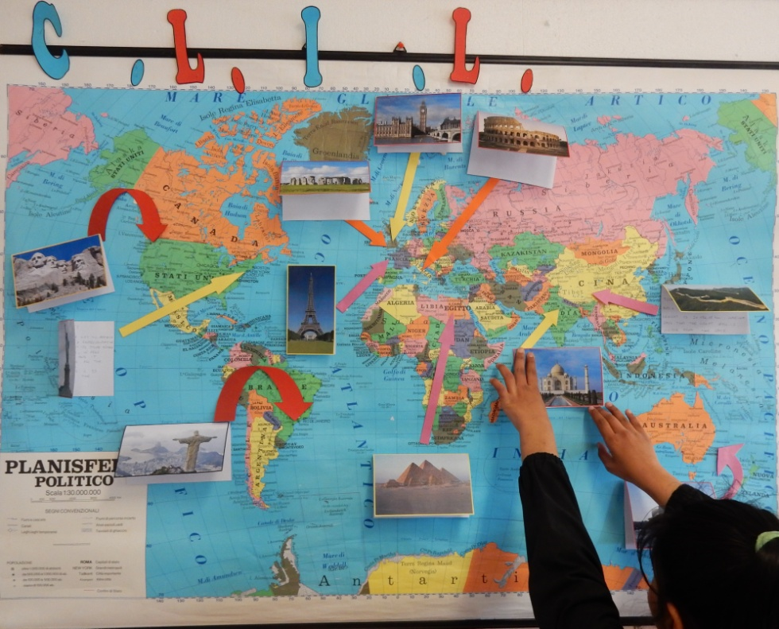
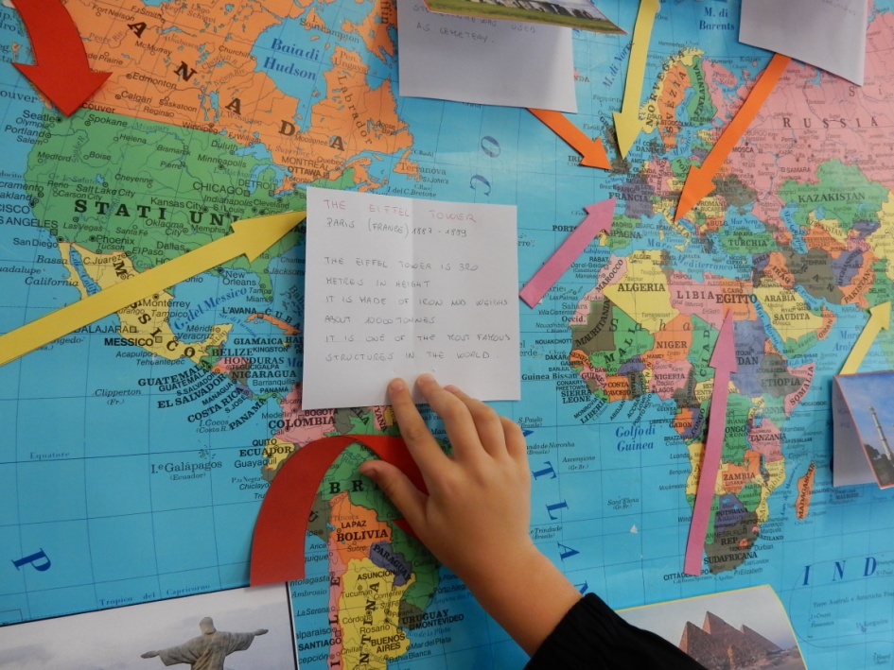
Put the monuments
in the correct position
on the map!

Slide 11
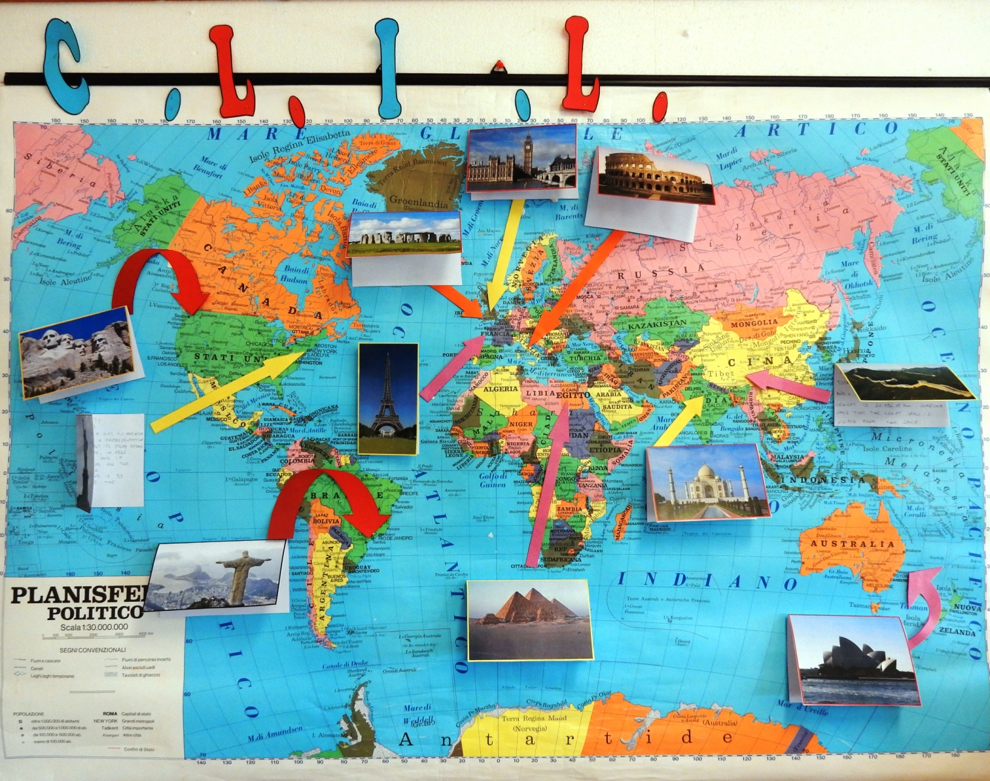
OUR POSTER

Slide 12
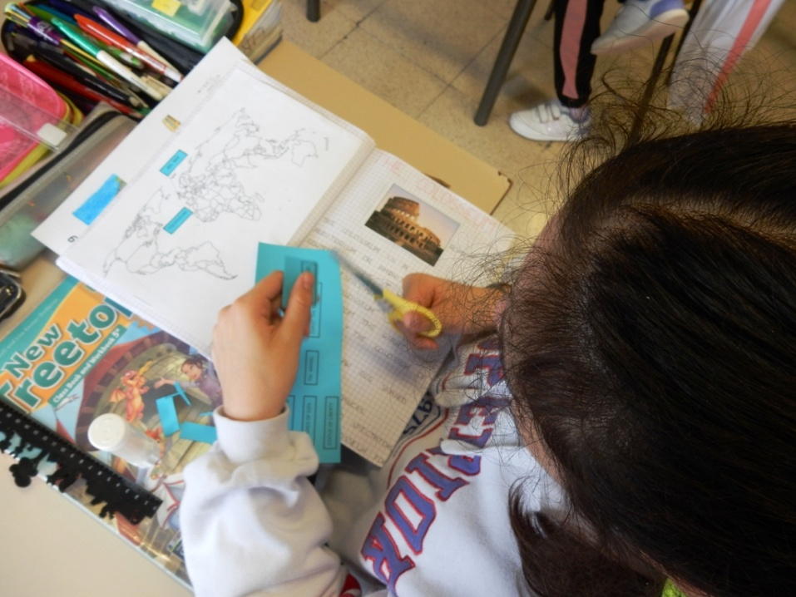
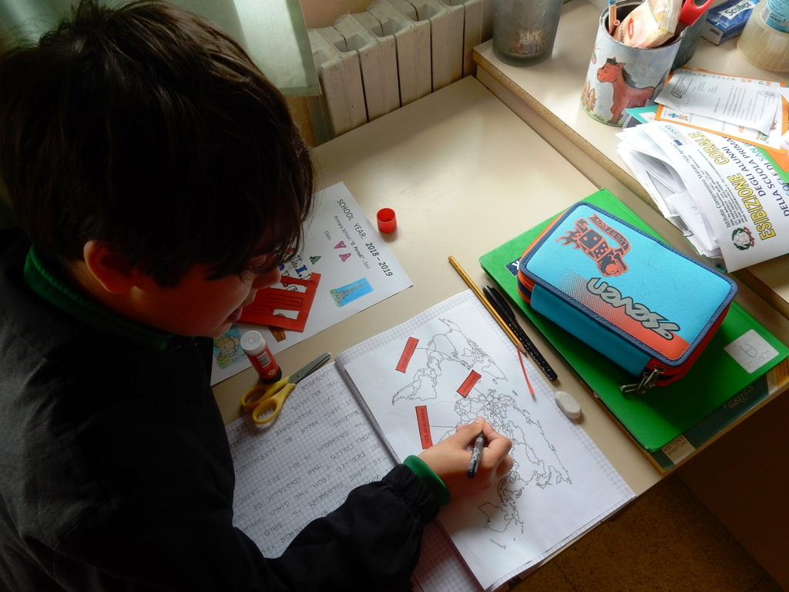
Put the monuments in the
correct position on the map
in your workbook!

Slide 13
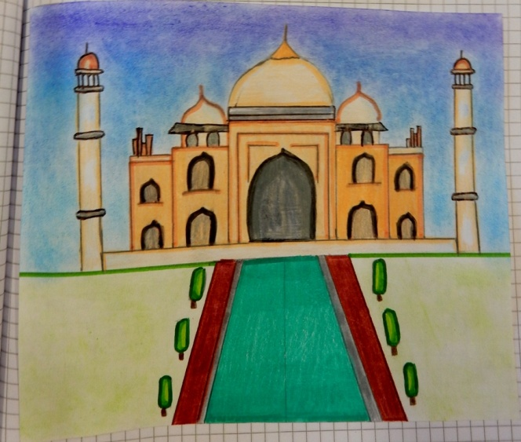
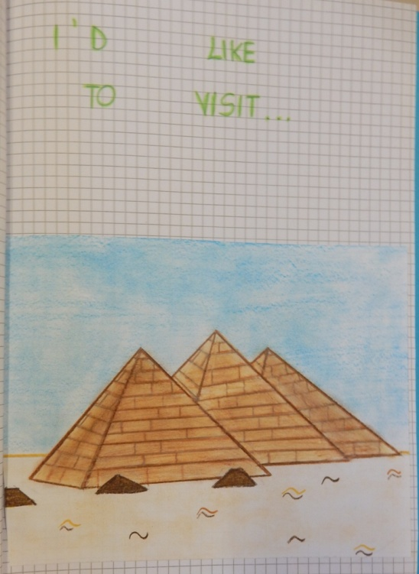
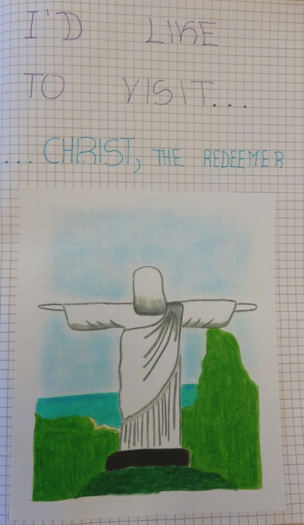
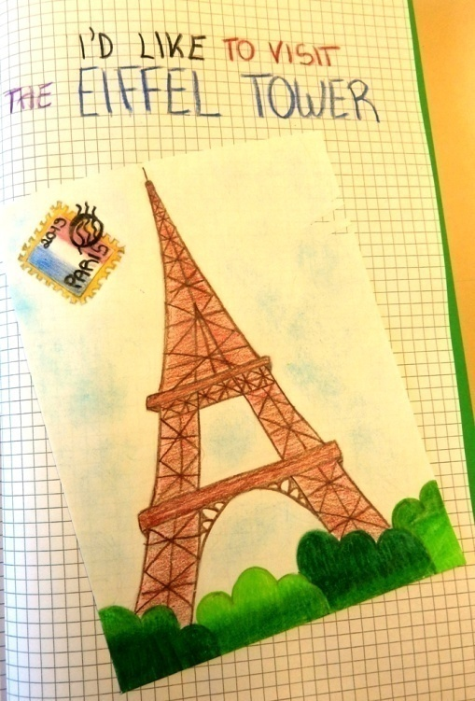
I’D LIKE TO VISIT…

Slide 14
JELID A.
LORENZO A.
GABRIEL B.
MAXIMILIAN B.
GIULIA C.
FRANCESCO C.
GIACOMO C.
FRANCESCA D. C.
JACOPO F.
SUCHITA K.
MATTEO M.
CATERINA N.
GABRIELE O.
ANNA P.
LORENZO P.
ALESSIA PAOLA P.
RICCARDO R.
ANITA S.
SIMONE S.
DANIELE V.
MATILDE V.
MELISA Z.
CHRISTIAN A.
REMZIE A.
ANNA B.
LAURA B.
MATILDE C.
NICOLA C.
FRANCESCA C.
LUNA C.
LORENZO C.
DYLAN D.
SOFIA F.
FILIPPO F.
LAPO G.
FRANCESCO I.
GIULIA L.
MICHELE N.
AMRA N.
GIUSEPPE P.
FRANCESCO P.
ANITA S.
SERENA V.
KHADIJA W.
V A
V B
Teacher: Laura Bartolini

