Slide 1

Primary school “E. Perodi” - Soci
Classes: IV A and IV B
S.Y. 2022-2023
Istituto Comprensivo Statale
“XIII Aprile 1944”
Via della Repubblica – Soci (AR)
TEACHERS: Laura Bartolini – Lucia Valenti

Slide 2
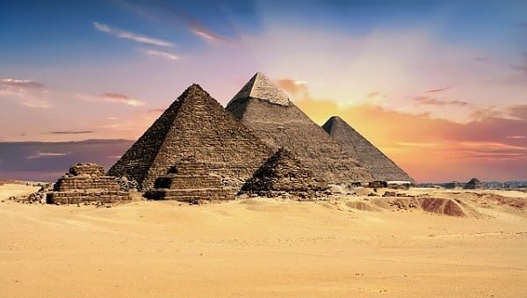
HISTORY - ENGLISH
ANCIENT EGYPT

Slide 3
C.L.I.L. ANCIENT EGYPT “DISCOVERING ANCIENT EGYPT” PRIMARY SCHOOL OF SOCI - CLASSES IVA- IVB SCHOOL YEAR 2022- 2023
CONTENT | COGNITION | CULTURE | COMMUNICATION
To identify features of a historical period. To identify features of a region To identify customs To identify hieroglyphics Introduction of some names Discussion and presentation of the new vocabulary through flashcards games. Language aims: Structure: Is the Nile a very big river? Yes, it is. Does it flow into the Mediterranean Sea? Yes, it does. Can Egyptians write? Yes, they can. Have they got pyramids? Yes, they have. Can can’t / have got, has got, haven’t got, hasn’t got /on the right, on the left/ in,on/ What is it?/ When is the Great Pyramid from?/ When are the first mummies from? Who’s that? What his/her name? Where is...? Vocabulary: Egypt, Egyptians, country, land, river, place, date, B. C. Before Christ, AD Anno Domini, climate, delta, Mediterranean Sea, Red Sea,sunny and hot / rocky and sandy desert/Nile/sarcophagus/ mummy/hieroglyphics/ map/ mask/ pyramid /tomb/Tutankhamon | A crossword puzzle Teacher designs a crossword puzzle using termsand information about Egypt. Students areasked, in groups, to fill it in. Memory game Ask the children to play a memory game to consolidate new lexis. The teacher prepares cards with new lexis and pictures. Draw and color the different part Pharaon’s clothing and symbols. Draw and color flashcards. Play “Word games”. Match words with pictures. Speaking: use new words and structures. Make some Egyptians masks and describe them to the class. Create an Egyptian papyrus. Final CLIL test. | Use Internet for watching a video: “Ancient Egypt”. Use Internet for finding information about ancient Egypt. | Use a language that is accessible to the class, consider special needs. Improve their language skills. Learn some new words. (History vocabulary) Videos to learn properly Memorize / Remember historic items Frontal lessons Pair work Group work

Slide 4
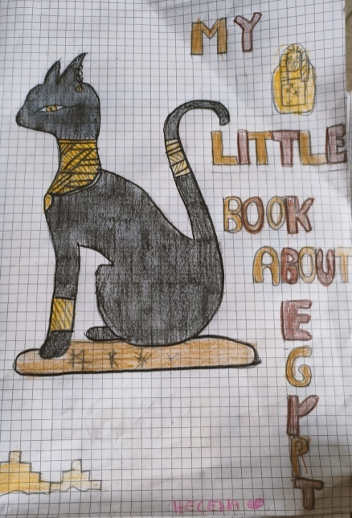
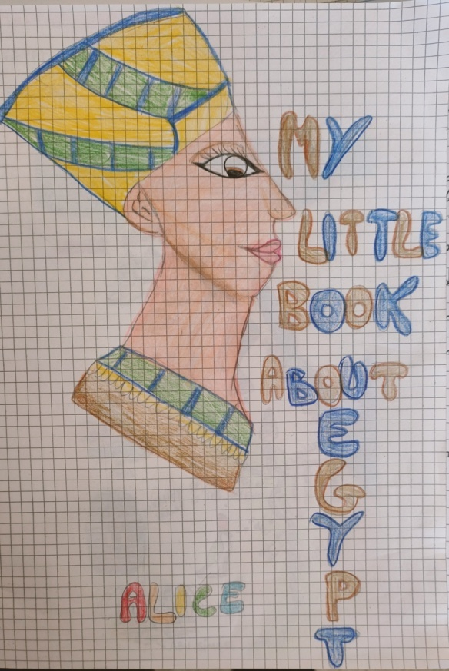
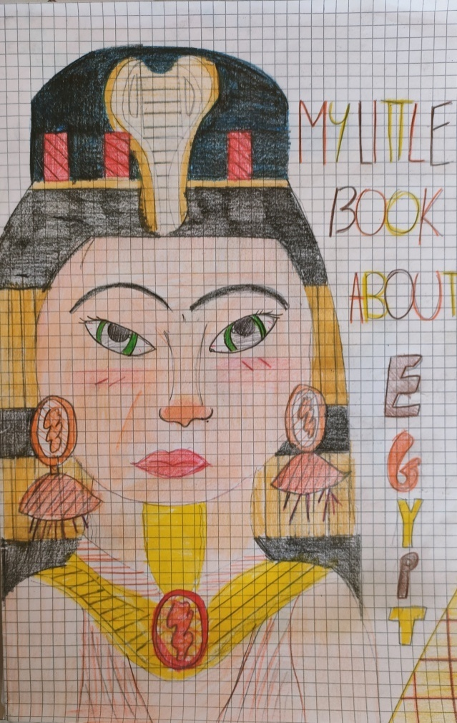
MY LITTLE BOOK
ABOUT
EGYPT

Slide 5
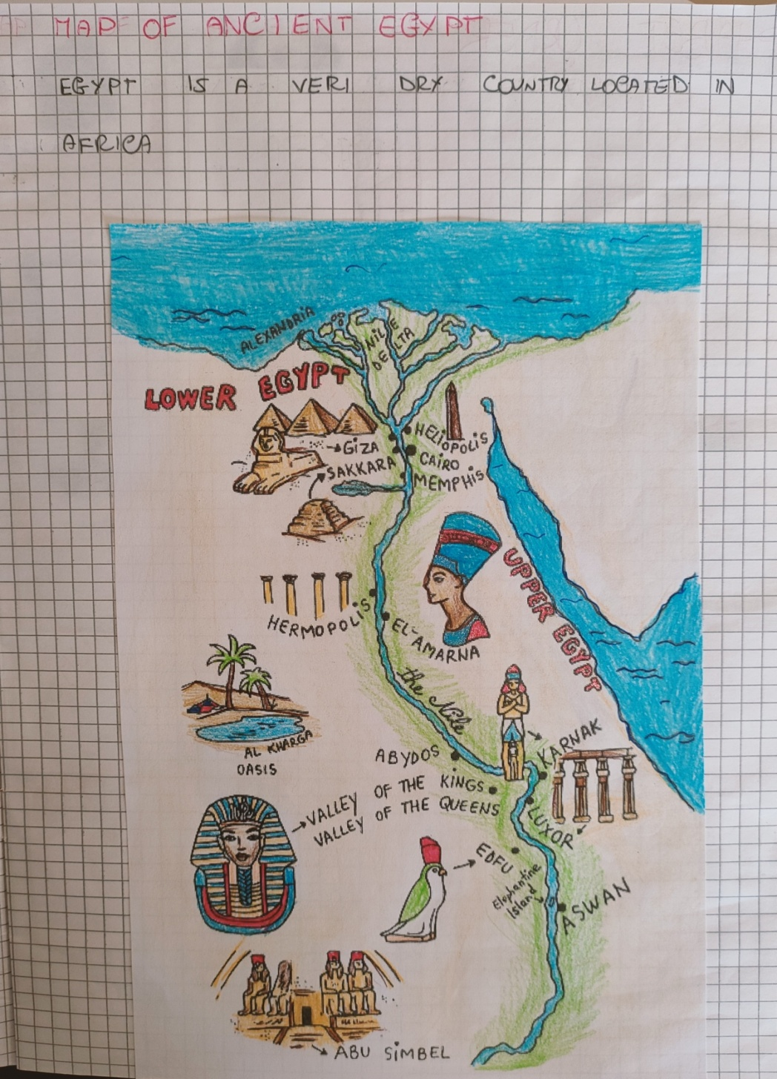
WHERE?

Slide 6
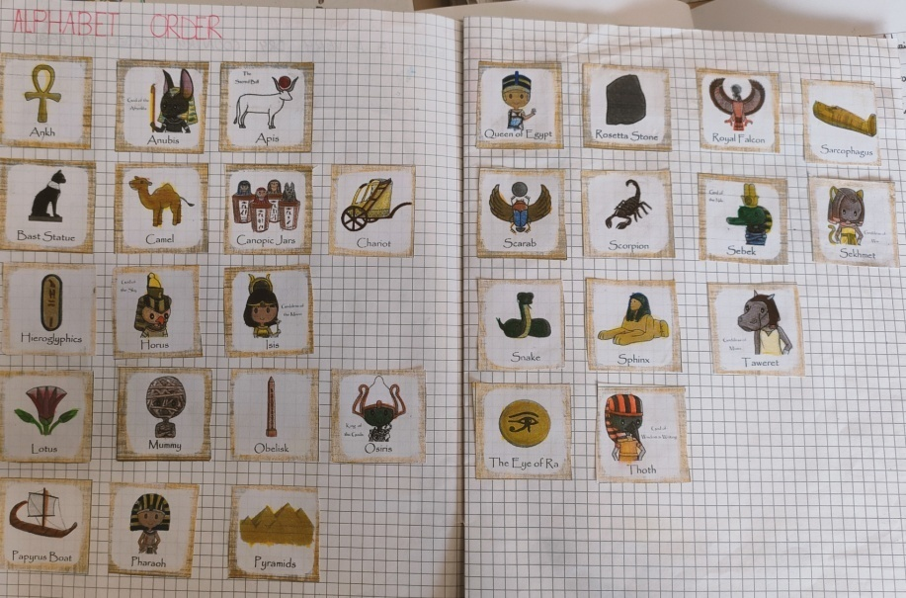
ALPHABET ORDER

Slide 7
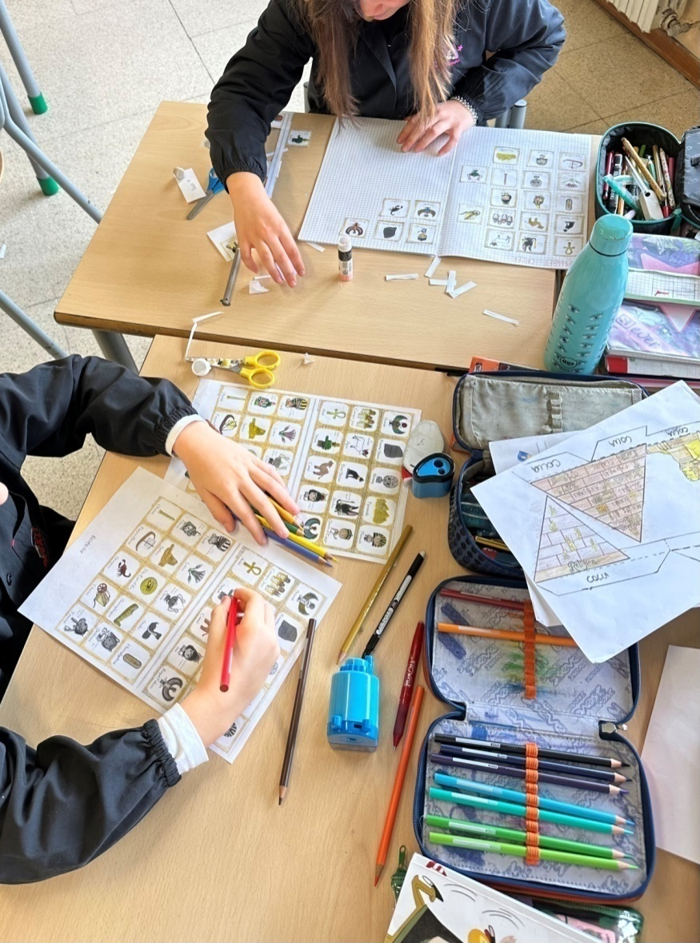
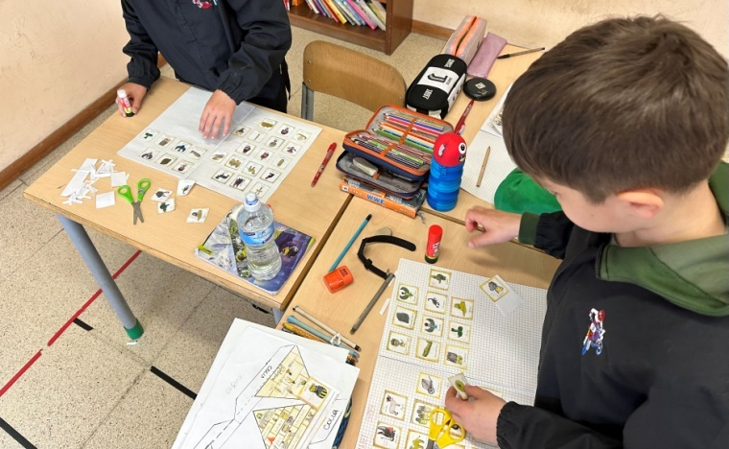
CHILDREN
AT WORK!

Slide 8
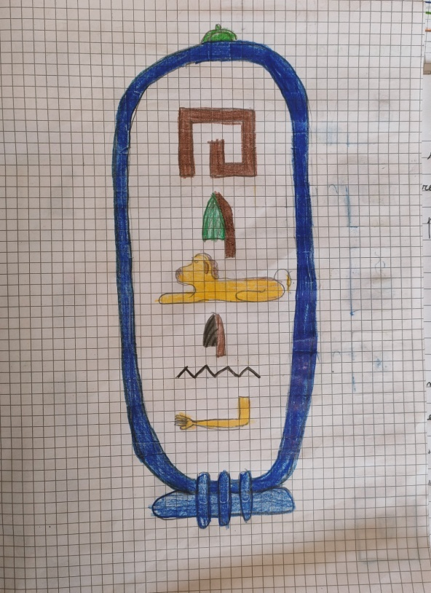
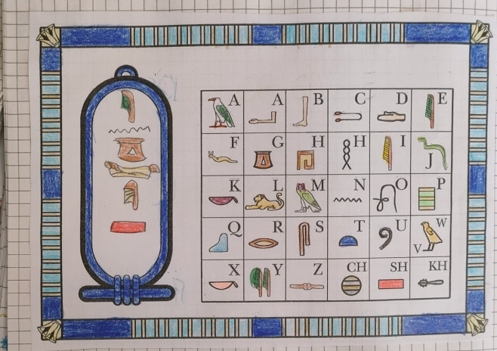
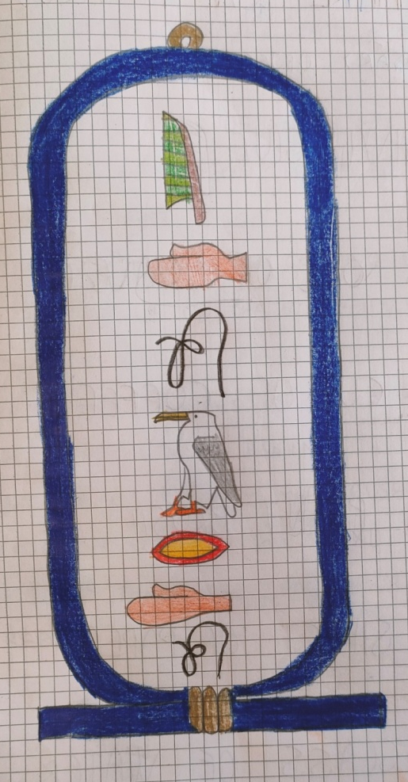
HIEROGLYPHICS

Slide 9
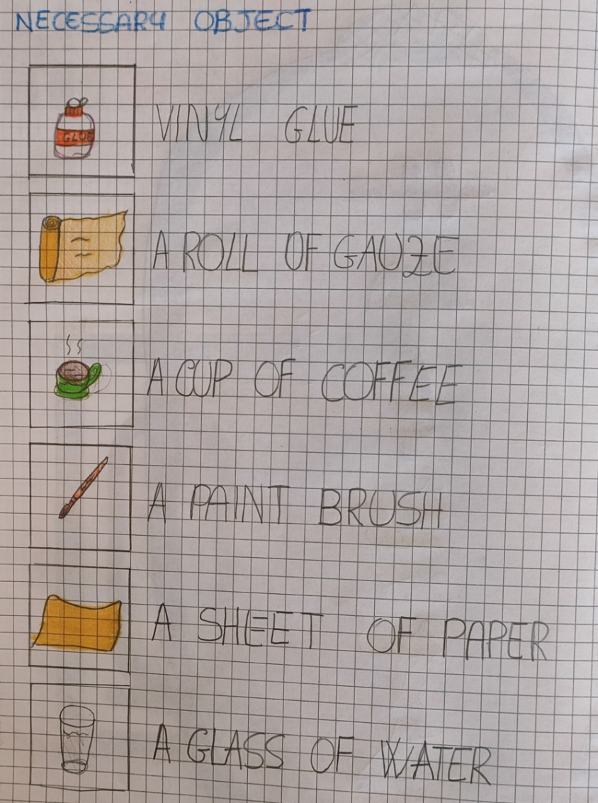
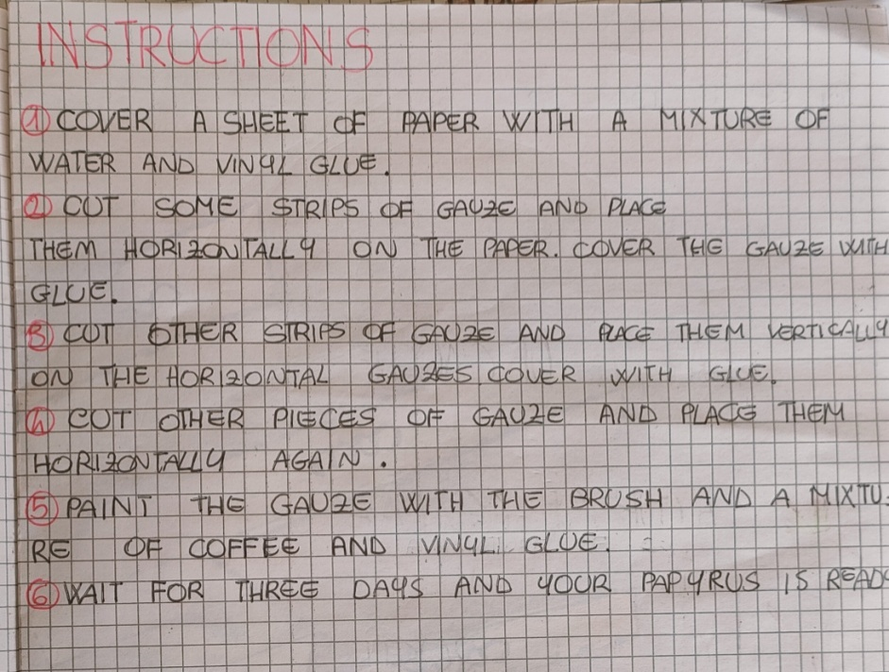
LET’S MAKE A
PAPYRUS!

Slide 10
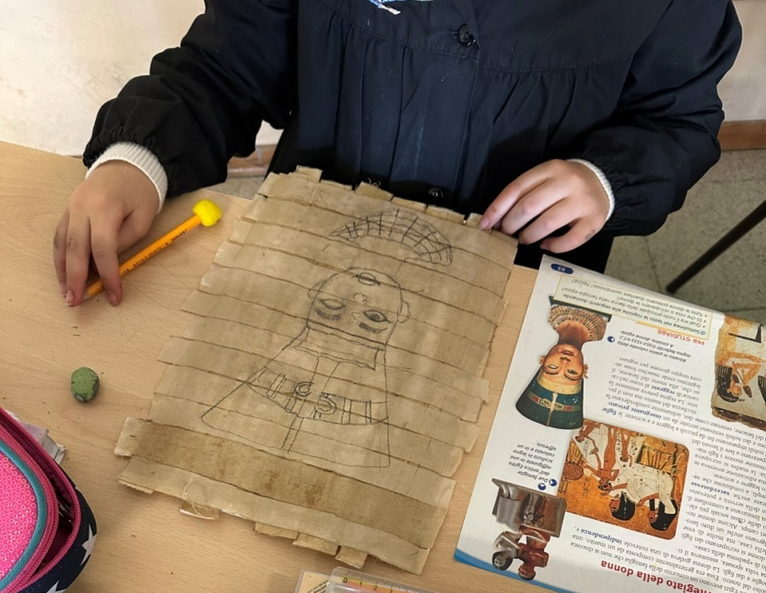
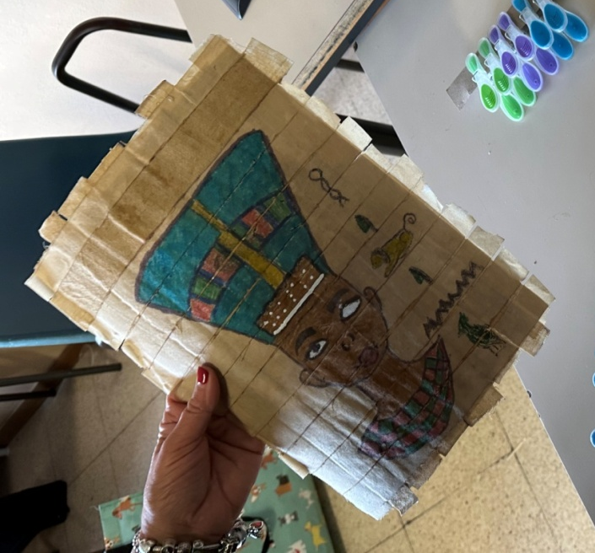
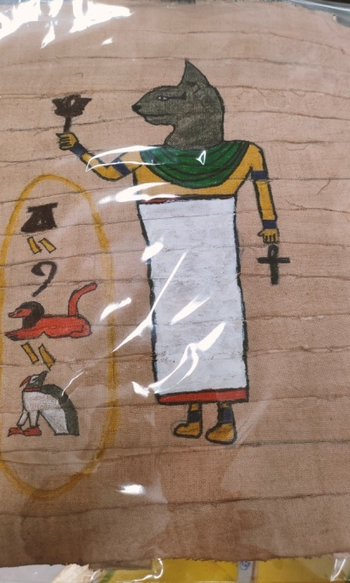
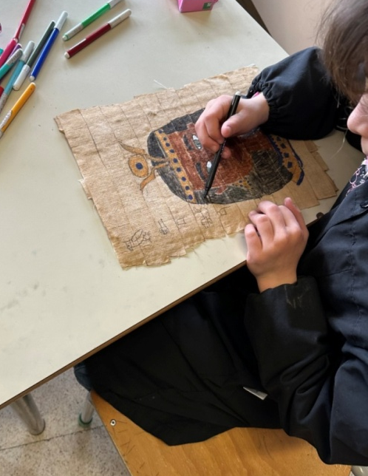
CHILDREN AT WORK!

Slide 11
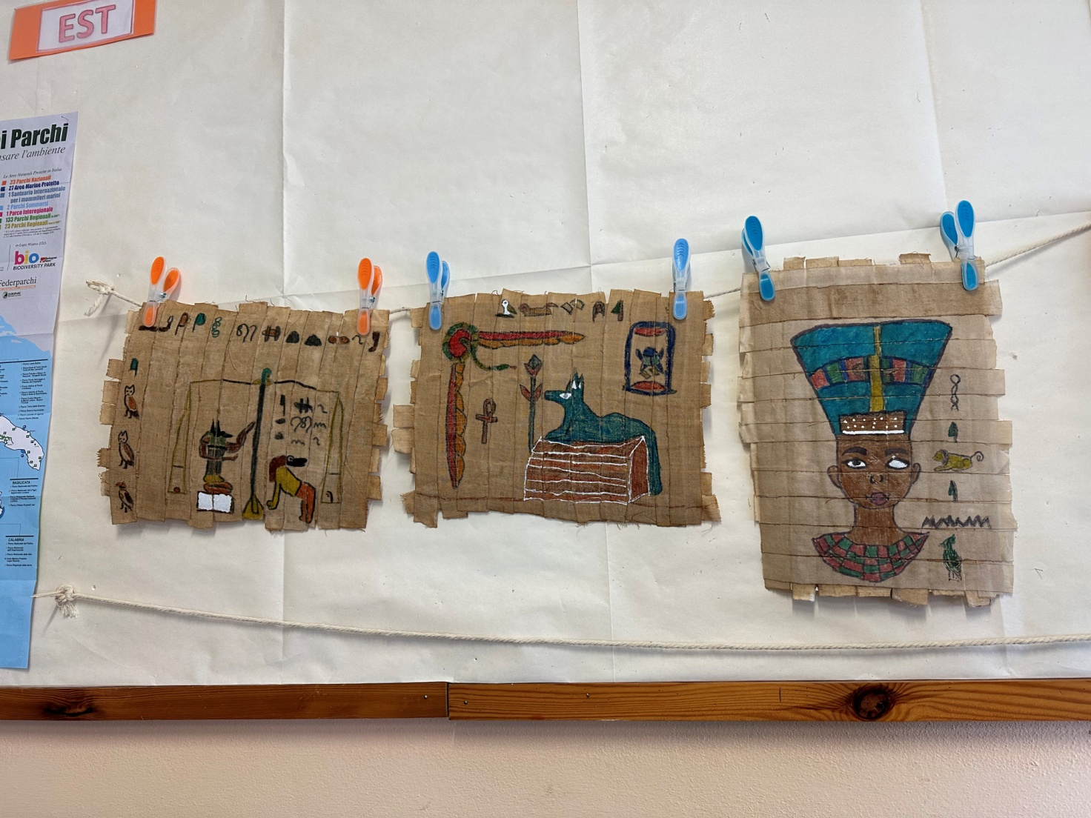
EXHIBITION

Slide 12
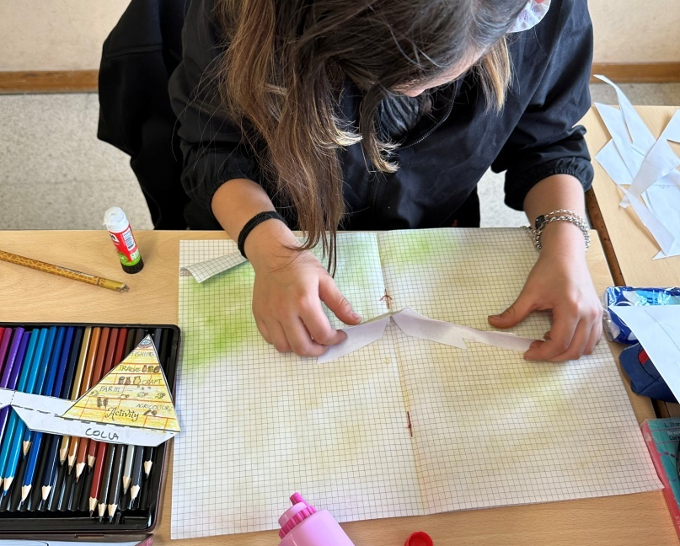
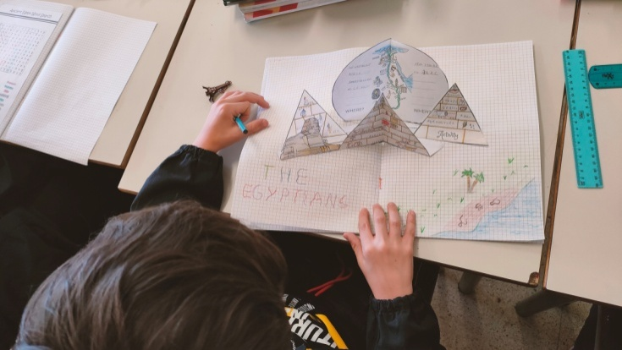
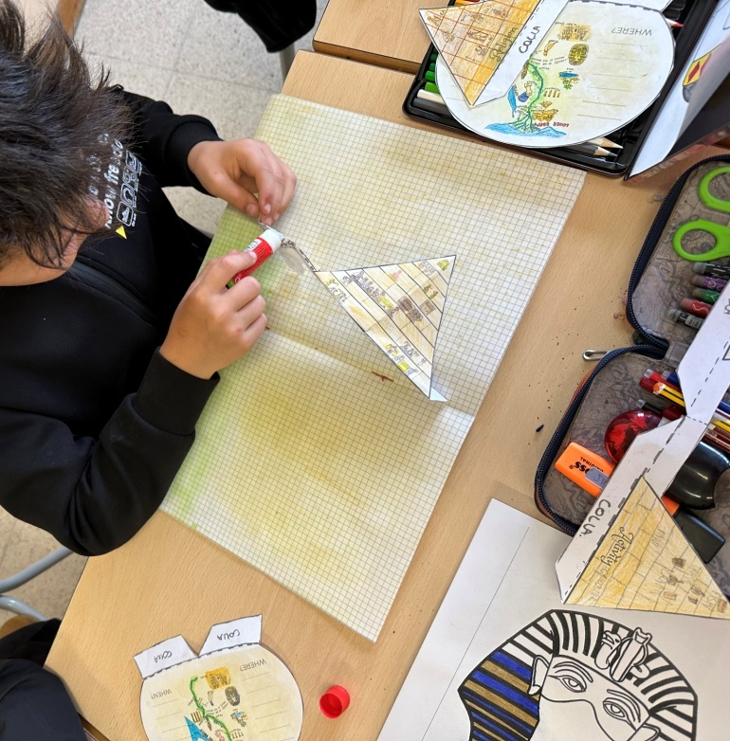
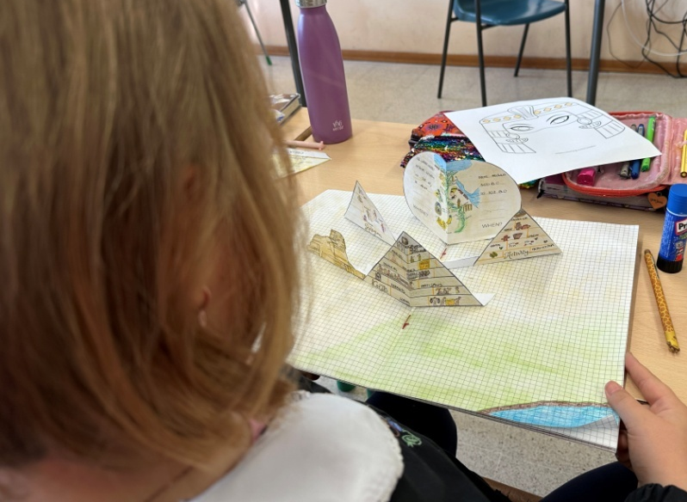
Learn by playing!

Slide 13
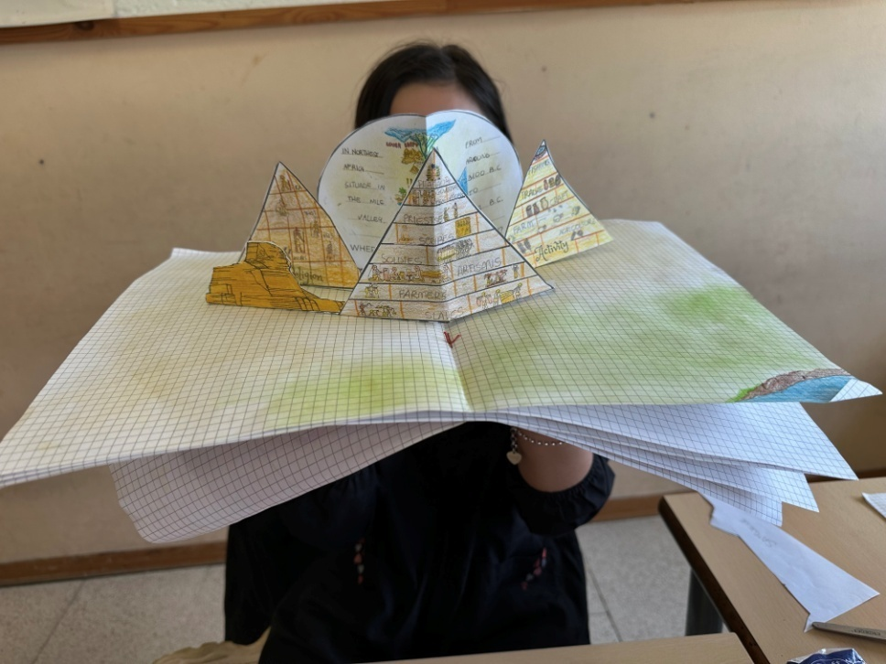
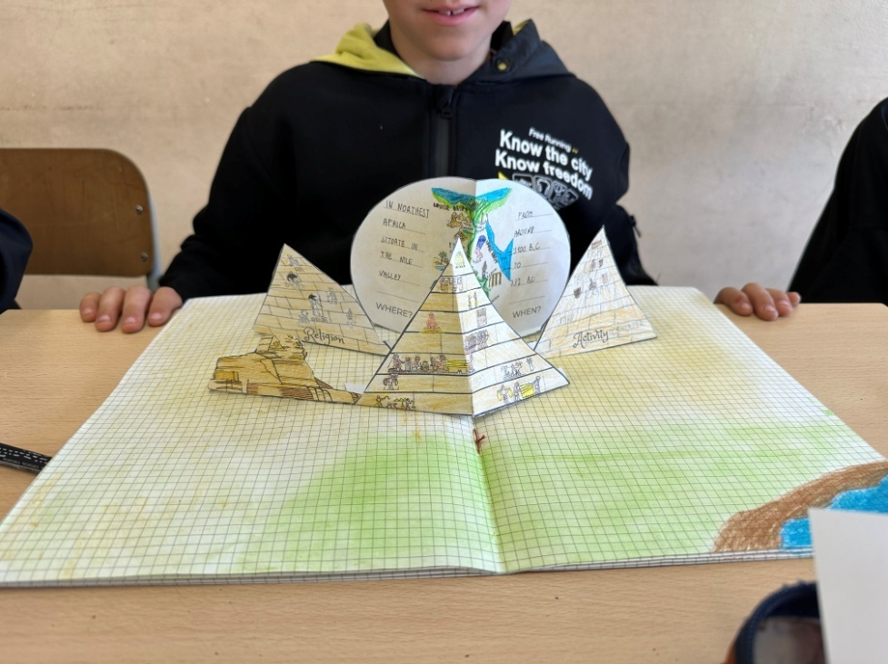

Slide 14
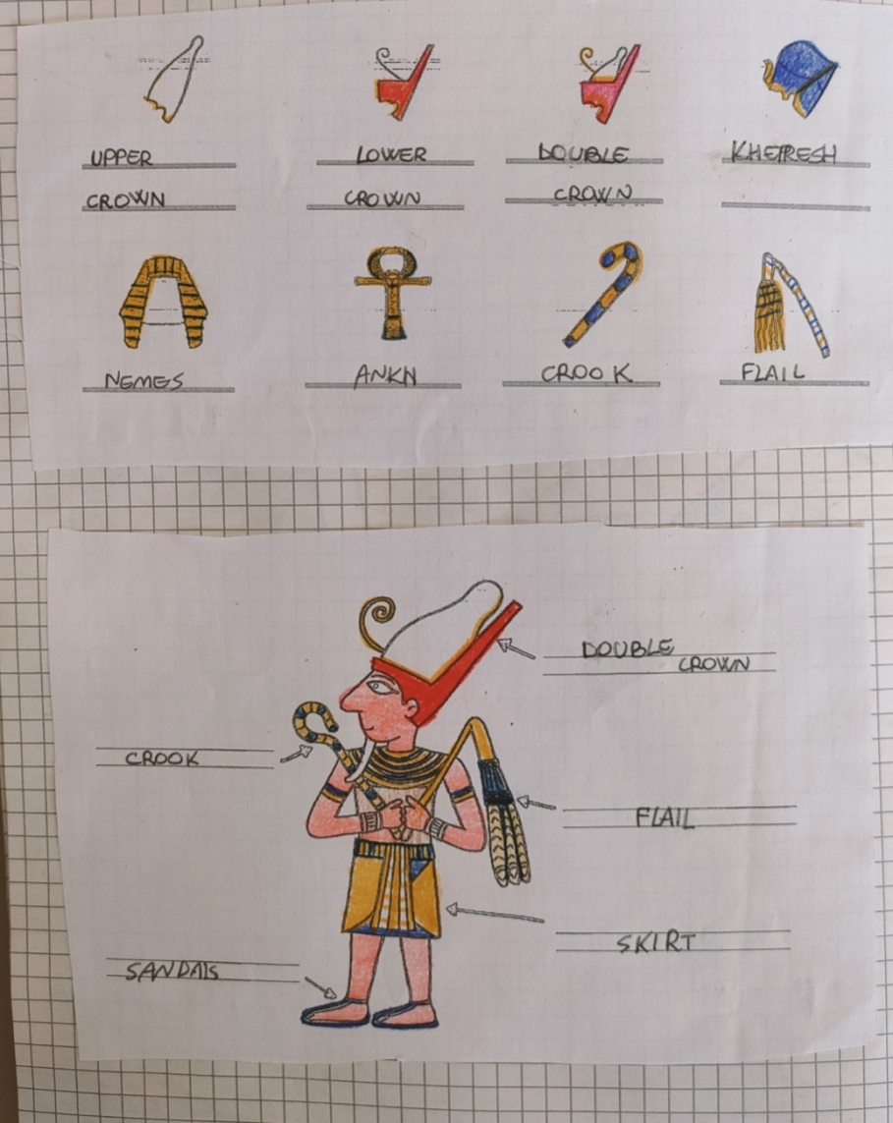
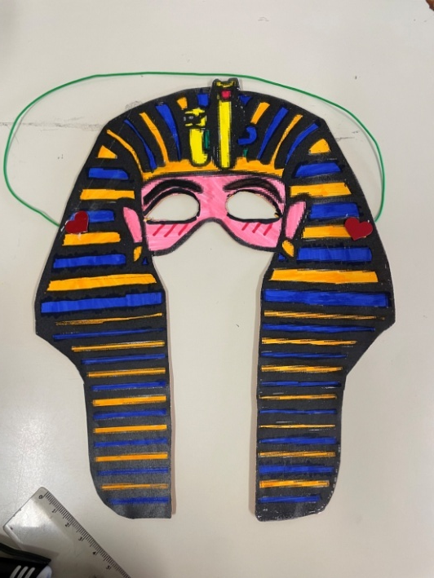
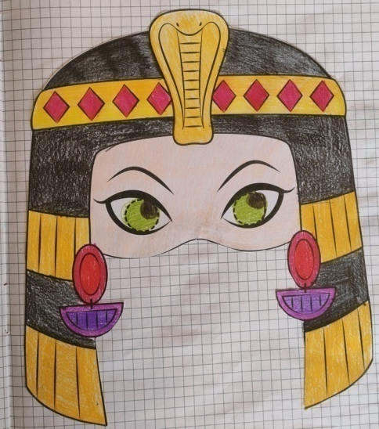
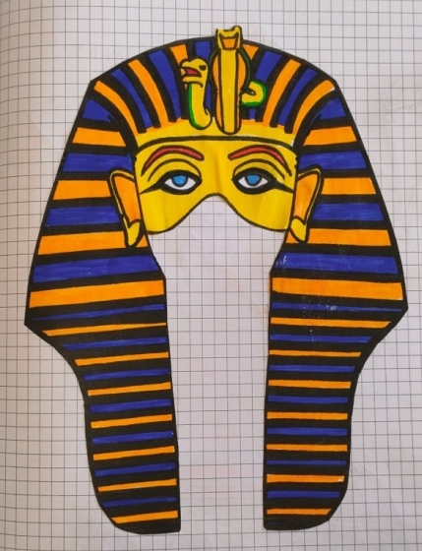
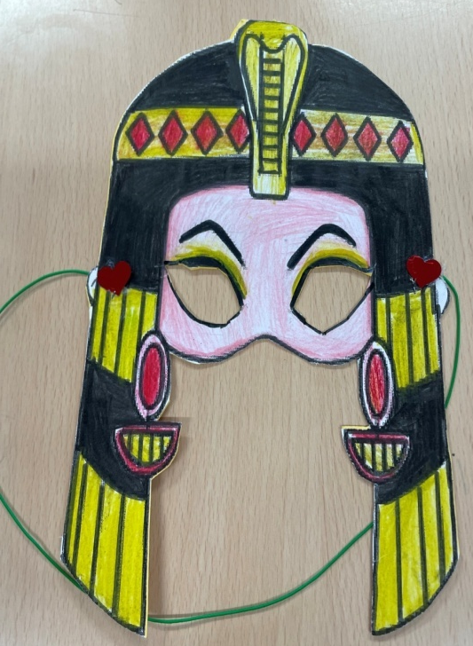
PHARAOH CLOTHING
EGYPTIAN MASK

Slide 15
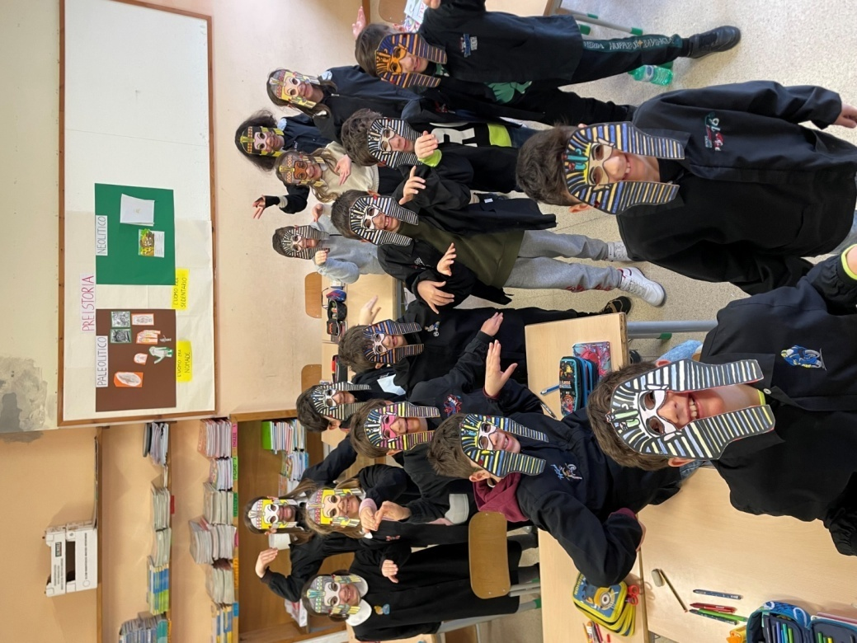
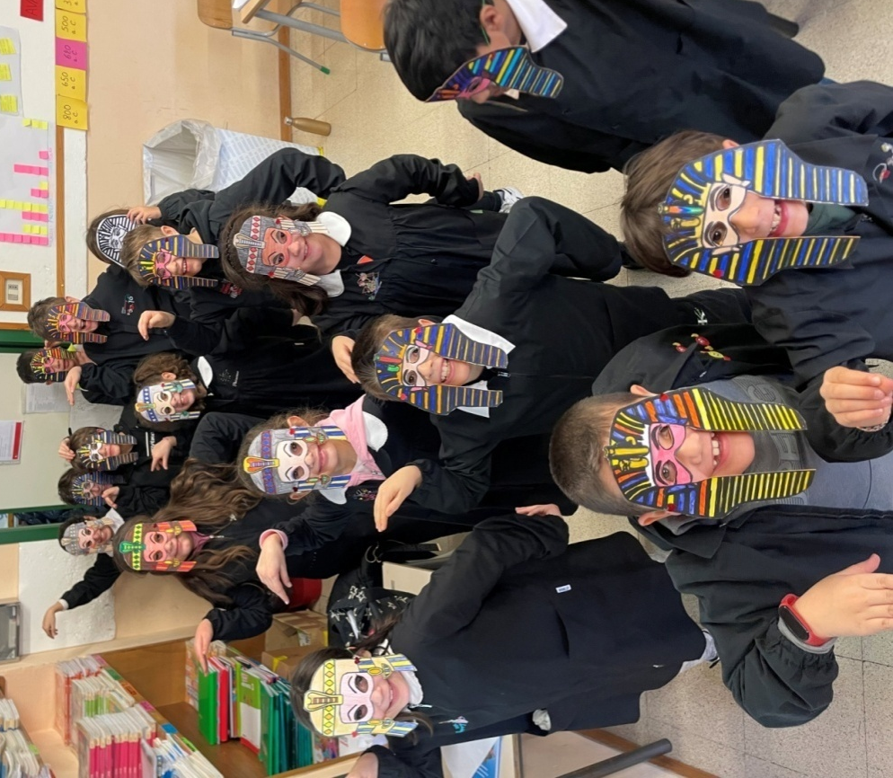
OUR MASKS

Slide 16
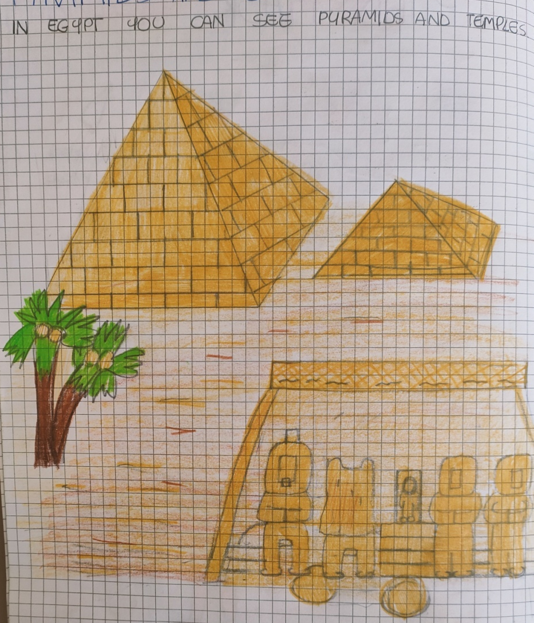
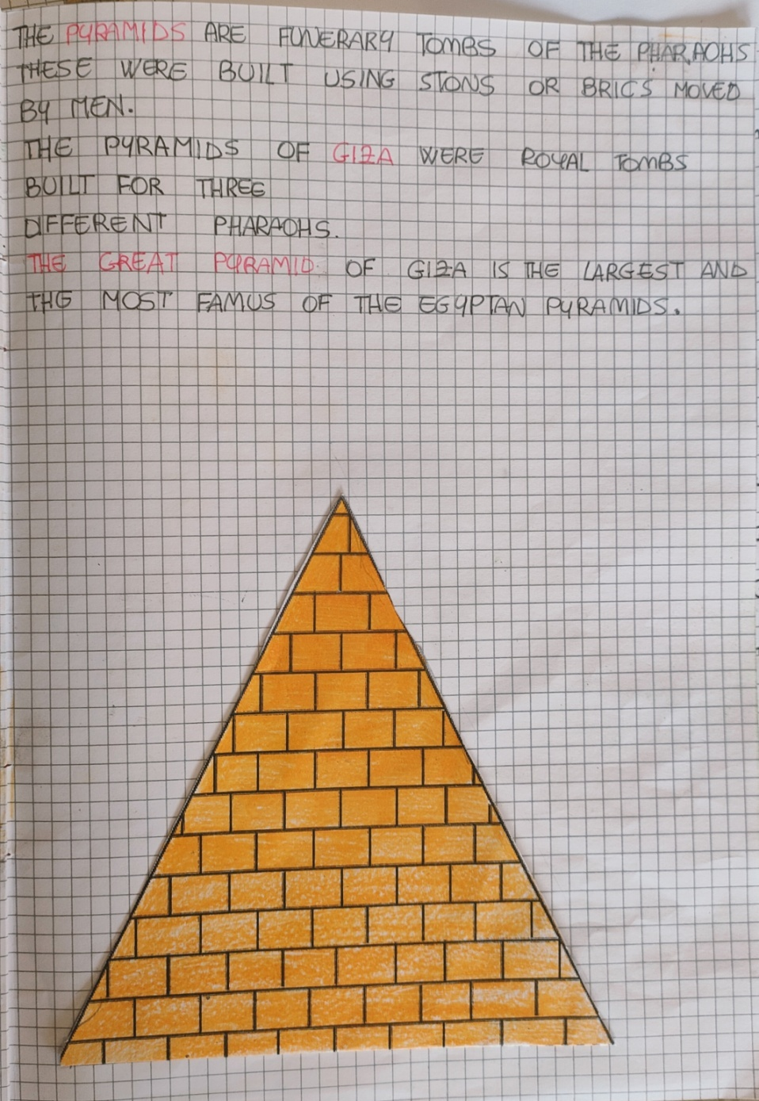
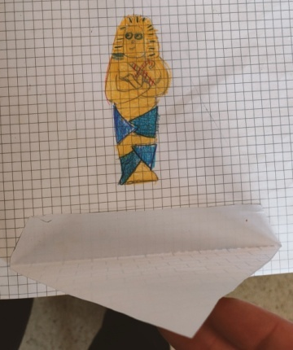
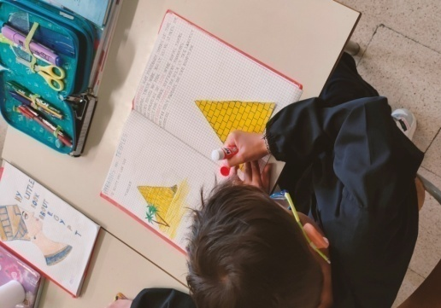
PYRAMIDS AND TEMPLES

Slide 17
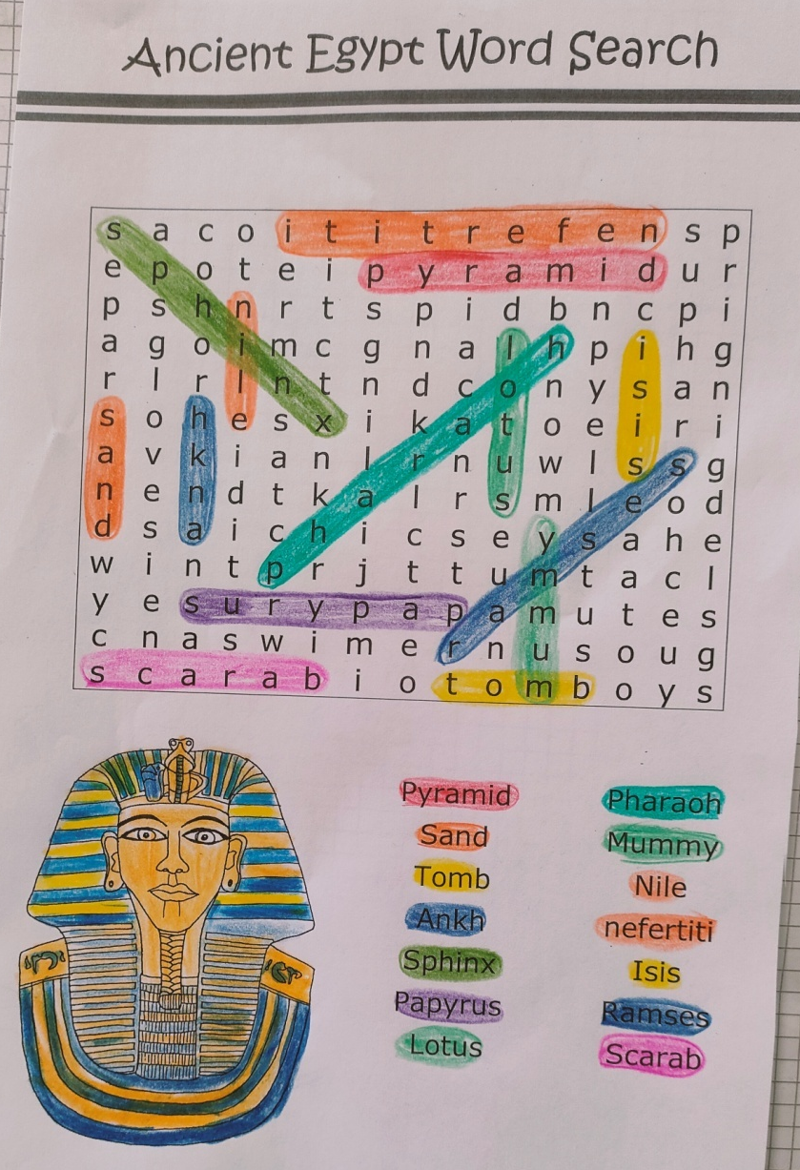
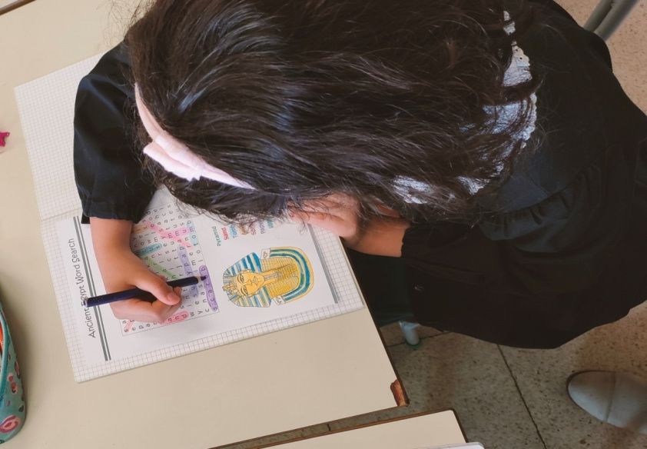
WORD GAME

Slide 18
IV A
IV B
ROBERT E. B.
COSIMO D.R.
ARGJEND D.
KEVIN D.
CATERINA F.
AMELA F,
DUCCIO F.
LAPO G.
NICHOLAS M.
STELLA M.
REBECCA N.
AJNURA N.
SAMUELE P.
DENIS D. P.
ANNA S.
MATTIA T.
INAS Z.
HELENA B.
FRANCESCO C.
ADELE C.
EMMA D.P.
EDOARDO D.
ELFAT E.
FRANCESCO F.
ALESSIO G.
ALICE G.
ABDUL M.
ANDREA M.
LORENZO P.
DAVID F. P.
LAMYAE R.
CLAUDIO R.
DIEGO S.
GIULIA V.
Teacher: Lucia Valenti
Teacher: Laura Bartolini

