Slide 1
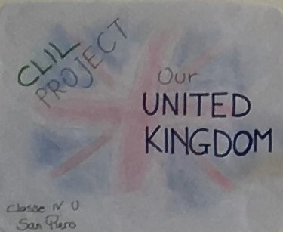
Istituto Comprensivo di Soci San Piero in Frassino Primary School Class IV U School Year 2018/2019
CLIL Project
Content and Language Integrated Learning

Slide 2
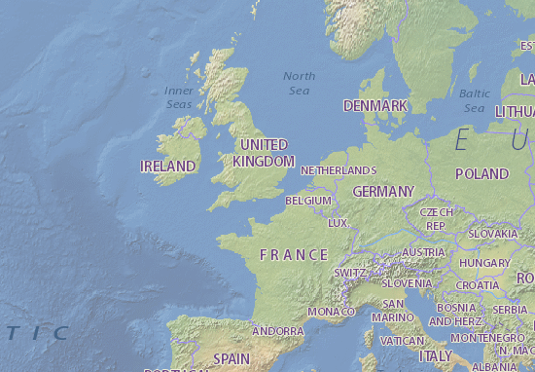
Geography English
The United Kingdom

Slide 3
CONTENT | COGNITION | CULTURE | COMMUNICATION
Knowing the UK customs and traditions. Stating that the UK is a sovereign state which consists of four individual countries: England, Scotland, Wales and Northern Ireland. Each of these four states will be studied following a common grid which consists in: Description and drawing the flag The peculiar symbol The Patron Saint (and his history) The most famous place The capital city The most typical food A legend We will start with an overall vision of the Country and then we will take and study each Region one by one. At the end of each country, pupils will produce a pop up consisting on a map with the above mentioned information. Language aims Description (of a flag, symbol, food…) Use of the simple present Use of adjectives Vocabulary Food Colour Places | Recall subject specific vocabulary and simple grammatical structures Remember information about the geography of the British Isles Read a map Locate countries on a map Narrate the stories of each countries Describe typical food and symbols Read and understand information in a text Use and organize information Present contents Cooperate Define roles in a group There will be used lots of strategies in order to fix new information: Role playing and simulation (e.g. pretending to be a giant to talk about the legend of the Giant’s Causeway). Knowing new words thanks to the wordlists and drills (repeated sentences). Using maps and finding them on the web, pupils will navigate with google maps in order to search and find places we speak about. Studying legends and improving the language by reading texts. | By using maps (simple maps and web maps) pupils will be able to orient themselves and find places. They can ideally start travelling from their own country to different parts of the UK. Knowing different customs and traditions will make them more aware of the differences they can face with during travels and future life. | They will work in cooperative learning groups, they make individual progress in tandem with others and they will speak about the concepts in circle time. According to CLIL concepts, we will study this topic (linked to Geography) by using mainly iconic language connected with new words which will improve the lexicon of the students.

Slide 4
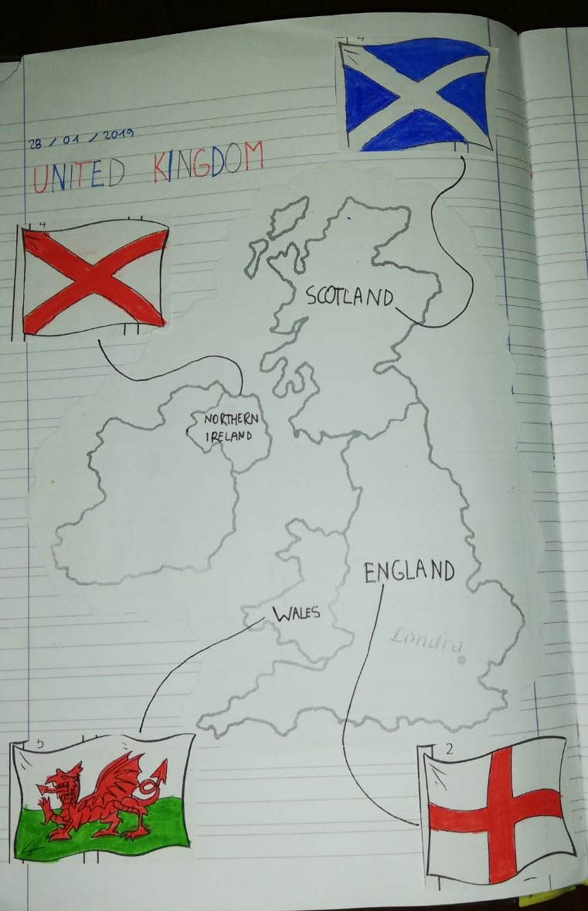
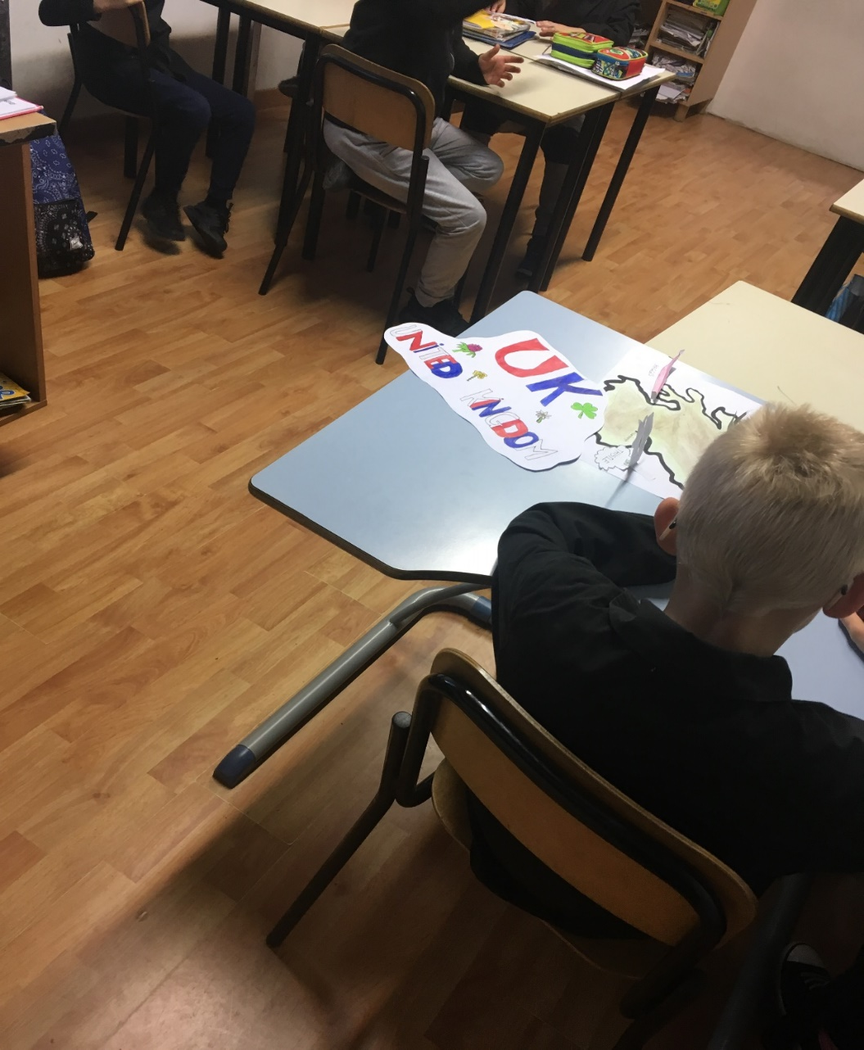
UK and FLAGS: those four flags, together, become…

Slide 5
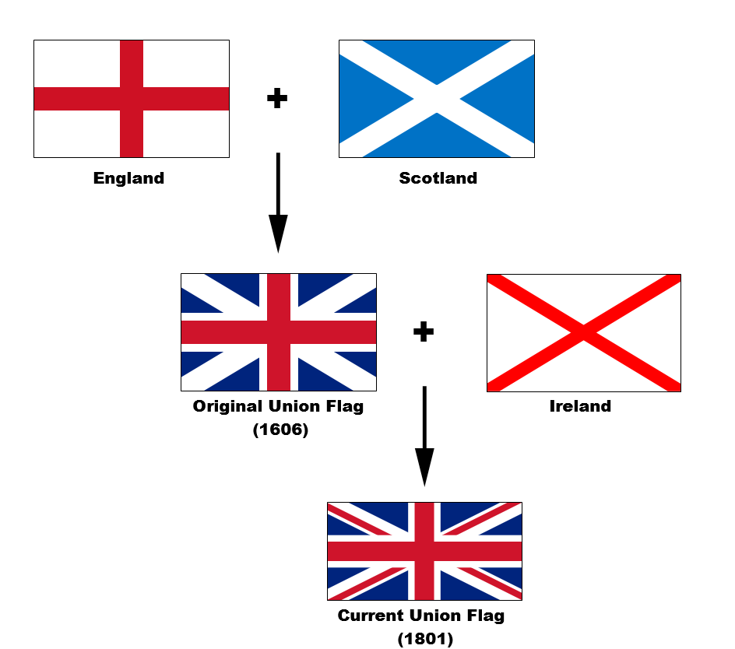

Slide 6
SCOTLAND
Symbol Thistle
Patron Saint Saint Andrew
Famous Place Lochness
Capital city Edimburgh
Typical food Smoked Salmon, Haggis
Object Bagpipe

Slide 7
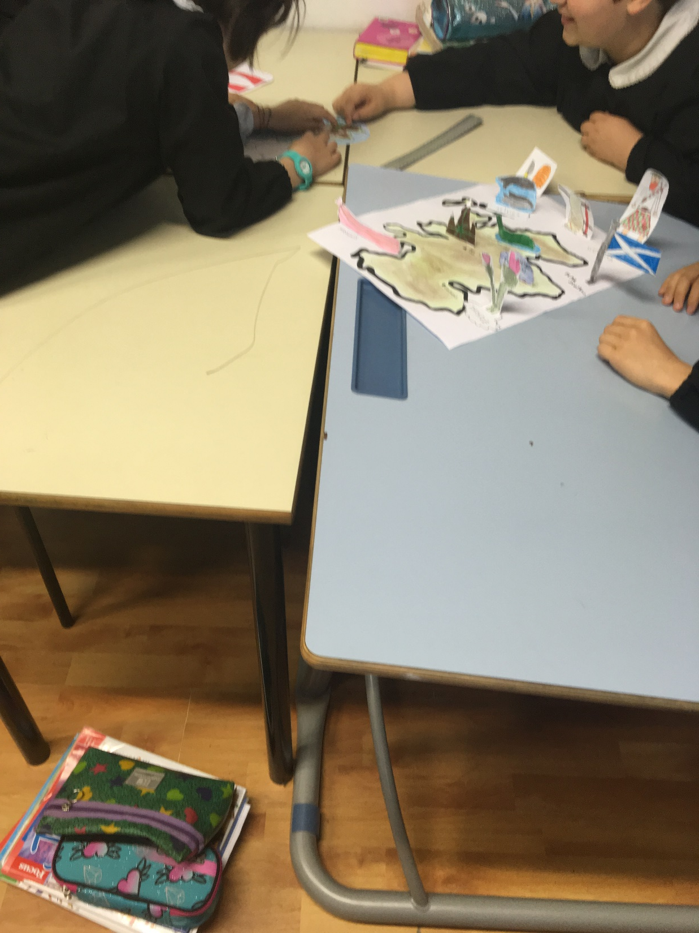

Slide 8
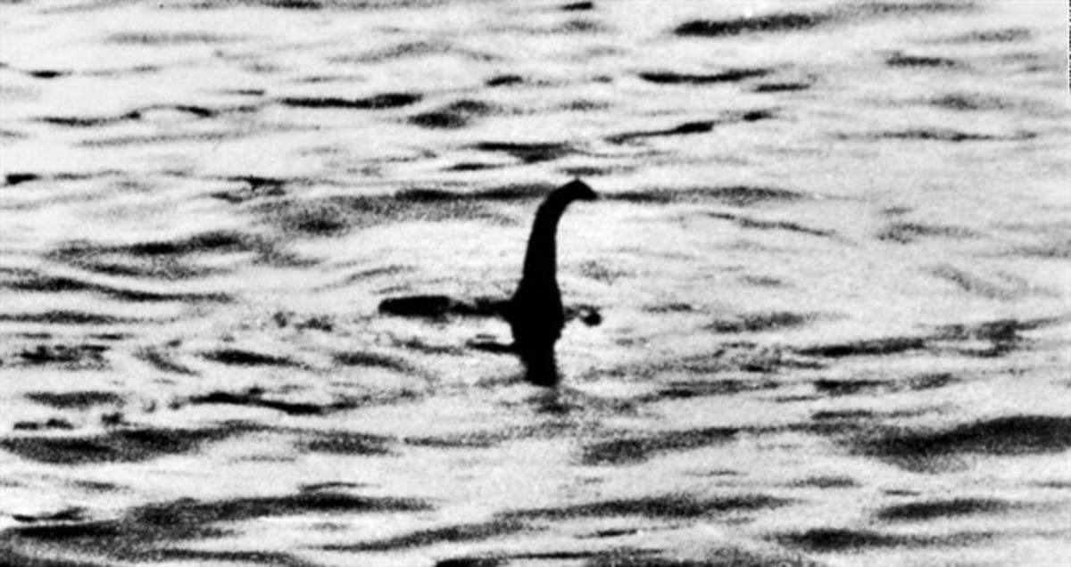
The legend of Nessie, the hidden monster of the loch

Slide 9
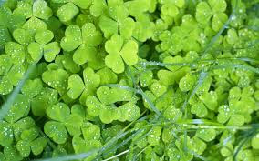
NORTHERN IRELAND
Flag Red cross on a white field
Symbol Shamrock
Patron Saint Saint Patrick
Famous Place The Giant’s Causeway
Capital city Belfast
Typical food Irish Stew, Guinness
Object Harp

Slide 10
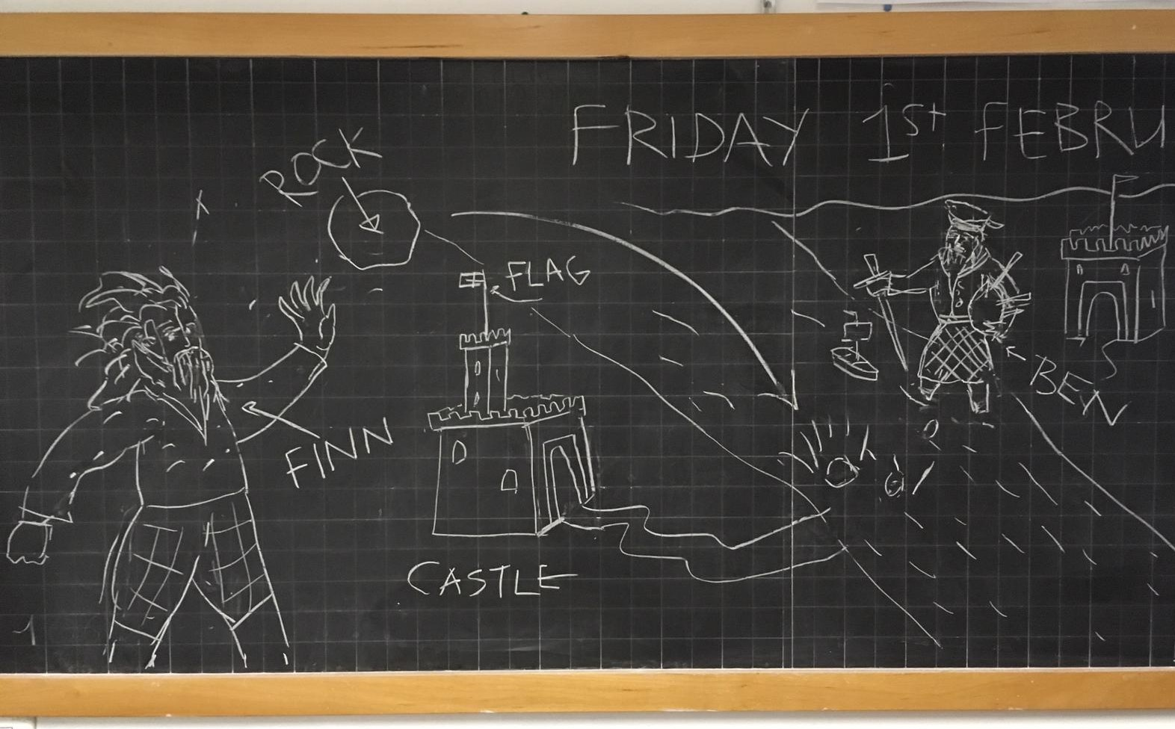
The legend of the two giants

Slide 11
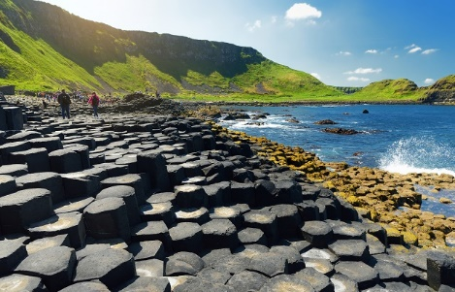
The Giant’s Causeway

Slide 12
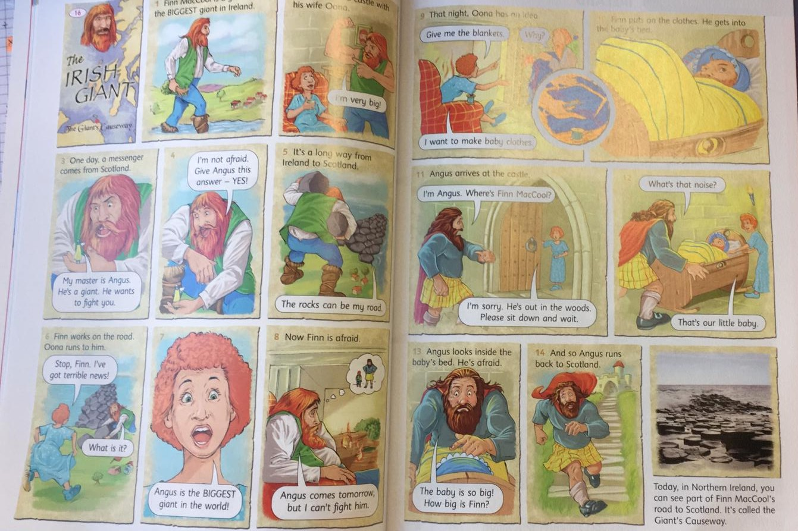

Slide 13
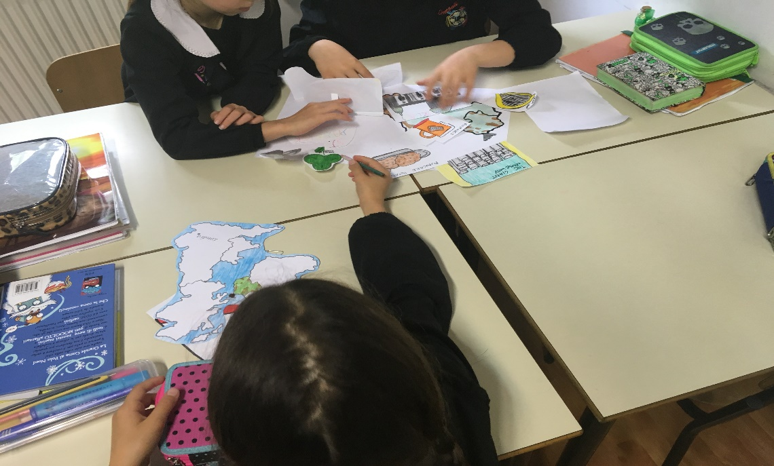
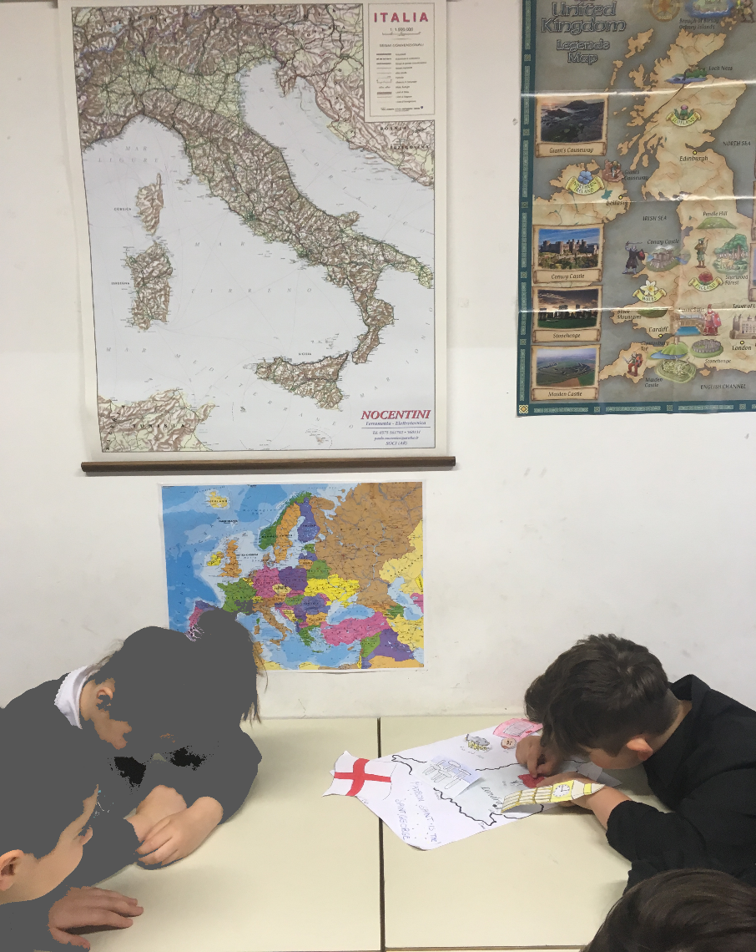
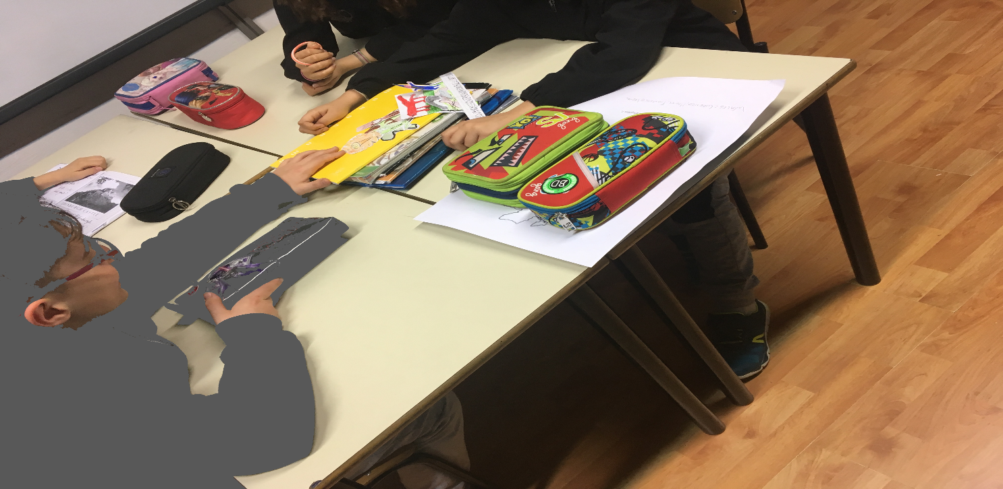
Cooperative Learning

Slide 14
WALES
Symbol Daffodil, Leek
Patron Saint Saint David
Famous Place The town with the longest name
Capital city Cardiff
Typical food Lamb, Leek
Legend Linked to King Arthur – Merlin is believed to be born in Carmarthen

Slide 15
The History of the Welsh love spoon
According to Welsh foklore, these ornately carved spoons are traditionally made from a single piece of wood by young men as a love token for their sweethearts to show their affection and intentions for their loved one.

Slide 16
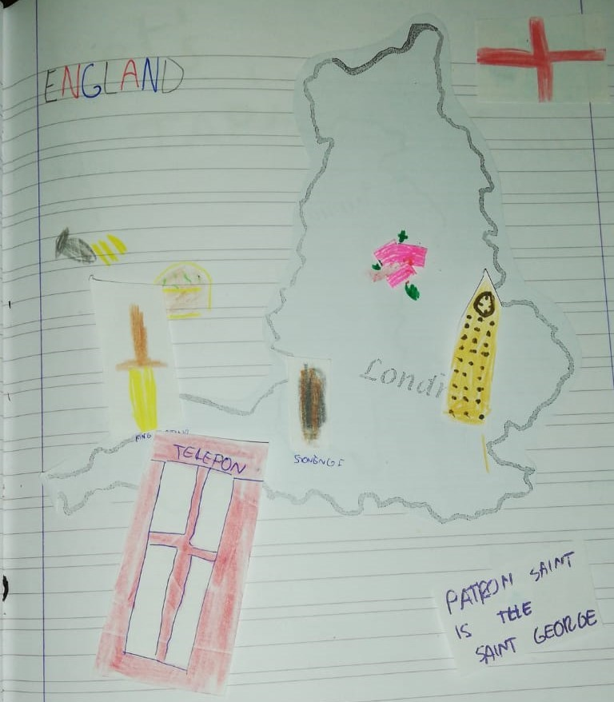
ENGLAND
Symbol Rose
Patron Saint Saint George
Capital city London
Famous place Stonhenge
Typical food Fish and Chips, Pie
Legend King Arthur and his Knights of the Round Table

Slide 17
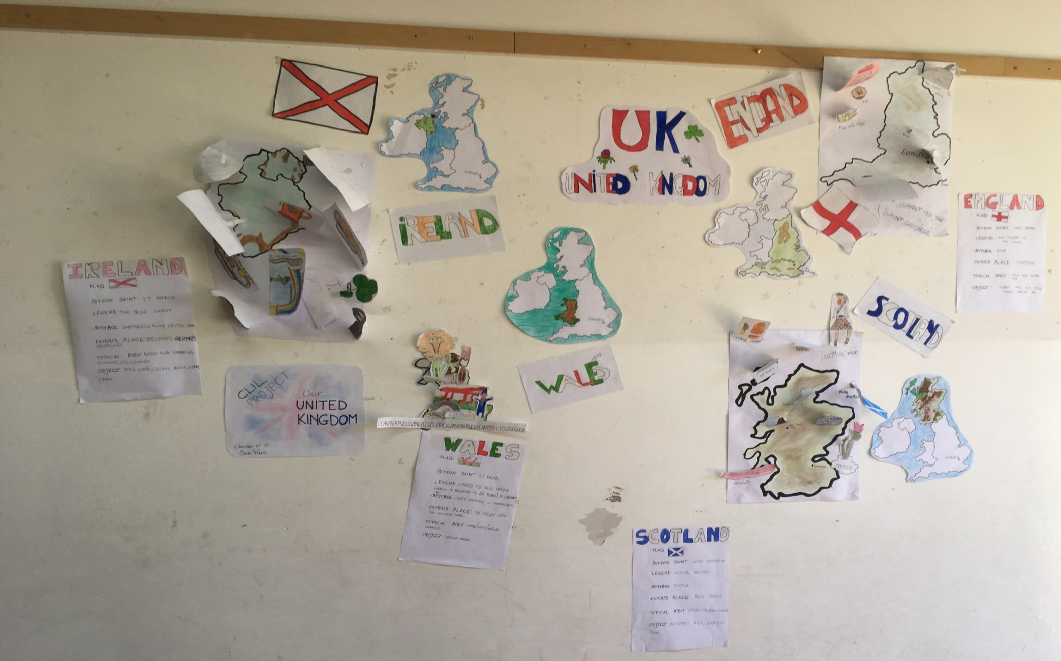
Posters

Slide 18
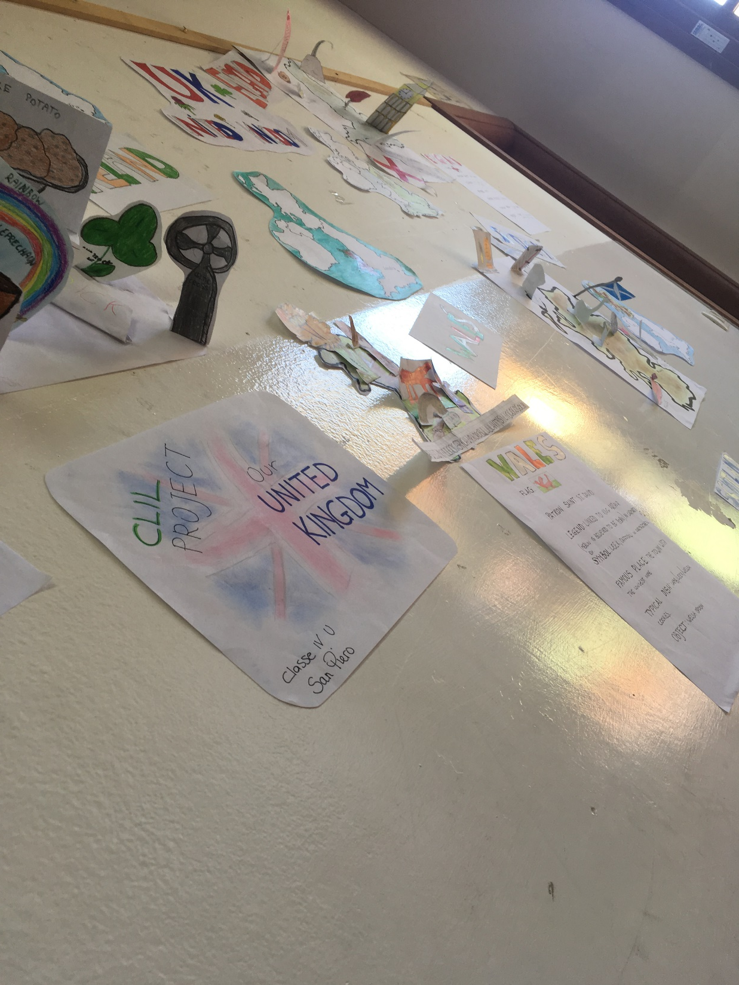

Slide 19
Classe IV Unica San Piero School Year 2018/2019
Alterini Matteo
Bartolini Thomas
Biagioni Filippo
Cavalieri Lorenzo Enrico
Cenni Gabriele
Chini Andrej
Cipriani Valentino
Falchi Luisiana
Franchini Sofia
Gabiccni Francesco
Giabbani Emma
Giannini Federico
Guerra Lisa
Mancioppi Irene
Neacsu Alexia
Vadalà Maniel
Teacher Laura Leprai

